Slide 1
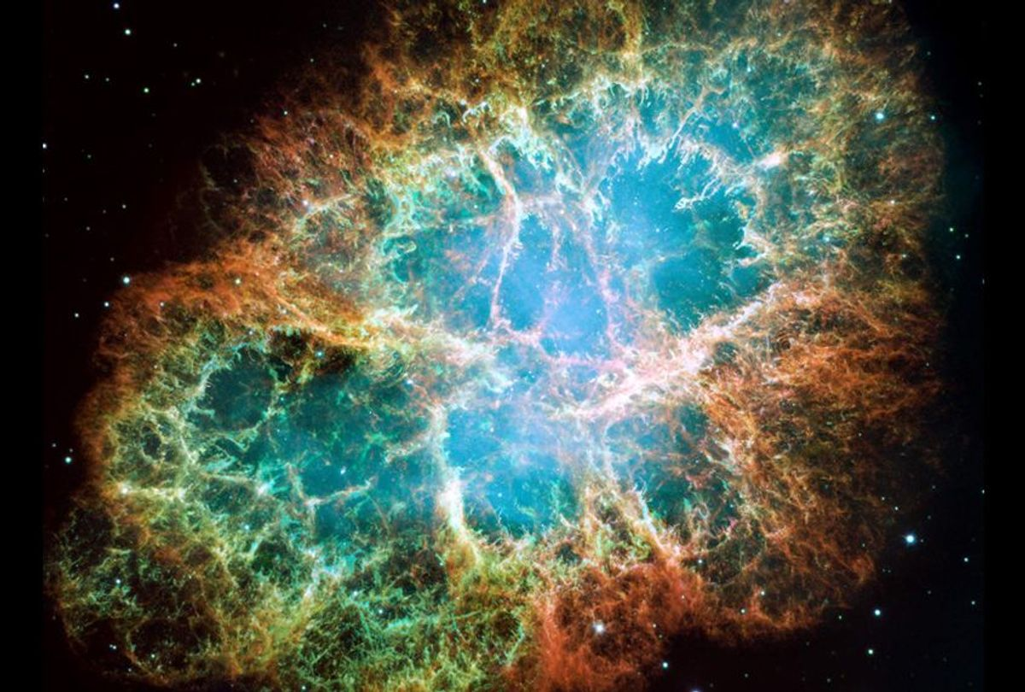
Non-Linear Noise Subtraction for Low Frequency
Final Presentation for LIGO SURF 2021 August 19, 2021
Student: Yuka Lin
Mentor: Dr. Gabriele Vajente

Slide 2
Outline
Motivation
NonSENS Algorithm
Results
Questions

Slide 3
Motivation

Slide 4
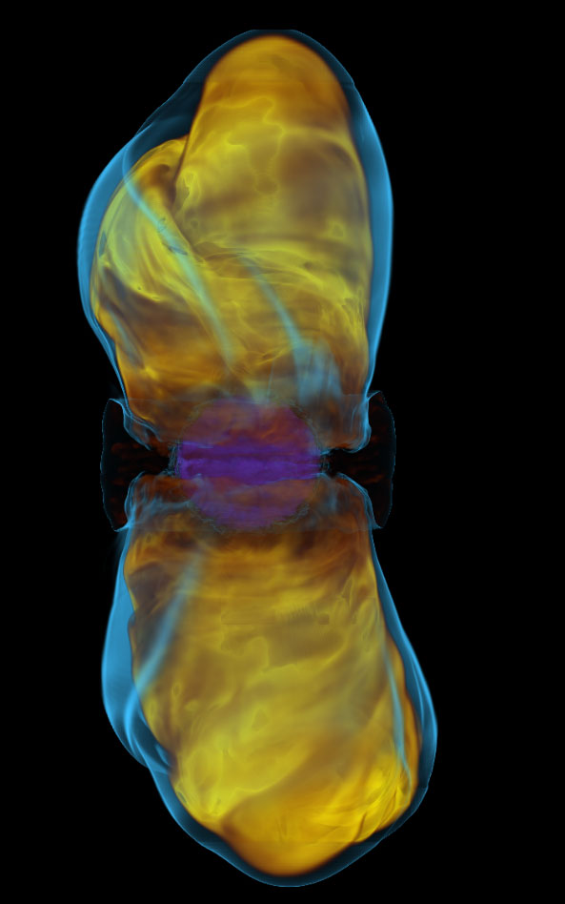
Core-Collapse Supernovae
when a massive star reaches the end of its lifespan and experiences rapid collapse
in an event such as a galactic supernova, a fraction of the GW memory might be able to be detected above the noise floor
GW “memory” is permanent deformation of spacetime in the LOW FREQUENCY range of the signal
GW memory emission of CCSN’s can peak below ~10 Hz
has the center frequency around 2Hz but it has tails that survive up to 40Hz and that can be above the current LIGO noise for a galactic SN

Slide 5
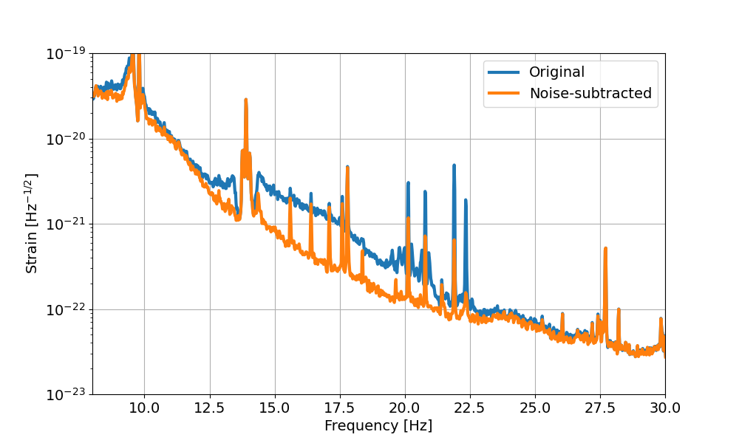
NonSENS Algorithm
Non-Stationary Estimation of Noise Subtraction
Original application of the algorithm used for subtraction in frequency ranges over 10 Hz
Now we want to modify the algorithm to perform similar noise reductions under 10 Hz
Project Goal: reduce the noise in the range where the GW memory is relevant for a CCSN
https://alog.ligo-wa.caltech.edu/aLOG/index.php?callRep=57423

Slide 6
NonSENS Algorithm

Slide 7
NonSENS Algorithm
Was created to reduce the noise that are coupled non-linearly and non-stationary in a strain signal
Noise “couples” or leak into main signal; limits sensitivity of detectors
Noise coupling – physical process of adding some noise sources to the GW output
Linear
Non-linear
$h_{GW}$ = Gravitational Waves signal
$$h\left(t\right)=h_{GW}+H[s(t)]+\sum_{i=1}^{N}{α_{i}[x_{i}(t)s(t)]}+ε_{F}$$
$α_{i}$ = non-linear noise coupling
$H$ = linear noise coupling
$s(t)$ = “fast” noise witness
$x_{i}(t)$ = “slow” modulation noise witness

Slide 8
What is the non-Linear subtraction?
In the linear and stationary subtraction, the noise that is witnessed by some auxiliary channel will couple to the strain
In the non-stationary case, the coupling is modulated (In other words, the effects of the noise in the strain contains non-stationary characteristics)
$$ε_{L}=\int_{0}^{∞}{h\left(τ\right)s\left(t−τ\right)dτ=}H[s\left(t\right)]$$
$$ε_{NL}=\sum_{i=1}^{N}{\int_{0}^{∞}{α_{i}\left(τ\right)n_{i}\left(t−τ\right)dτ=}}\sum_{i=1}^{N}{α_{i}[x_{i}(t)s(t)]}$$
Where:
$$n_{i}(t)=x_{i}\left(t\right)s(t)$$

Slide 9
Auxiliary Channels
Auxiliary channel – time series data recorded by the detector; monitors detector behavior and environment
$s\left(t\right), f$ast noise witnesses contains content in the higher frequency band (1-10 Hz)
$x_{i}\left(t\right)$, slow modulation witness contains content in the lower frequency band (below 1 Hz)

Slide 10
Subtraction
The modulated signals are coupled with the non-stationary transfer function $α_{i}$
Then:
Purpose of algorithm is to find the best parameters that will reduce the maximum amount of noise from the target strain as possible; the algorithm then will perform a prediction of the most optimal subtraction possible
$$h_{sub}\left(t\right)=h\left(t\right)−sum of modulated signals$$

Slide 11
Results

Slide 12
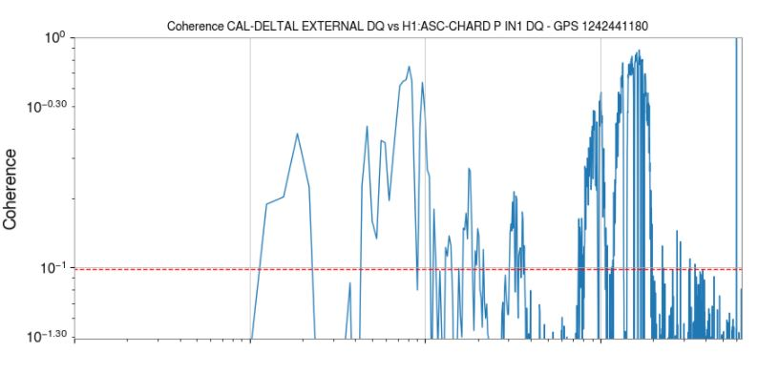
Results:
Step 1) Linear Coherence:
Linear coherence describes the correlation between the two signals in the frequency domain.
Coherence
Frequency [Hz]
https://ldas-jobs.ligo.caltech.edu/~gabriele.vajente/bruco_lf_2021_06_22/

Slide 13
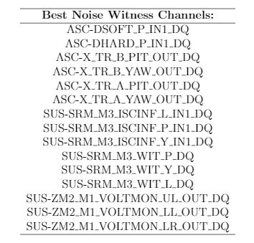
Results:
Step 2) Picking fast noise witness channels that perform the best linear subtraction
Some naming convention for channels:
Subsystems:
ASC - Alignment Sensing and Control
SUS – Suspension
Mirror Identifiers:
SRM – Signal Recycling Mirrors
ZM2 – 2nd Squeezer Mirror
M1, M3 – Suspension levels
Signal Identifiers:
DSOFT – differential control arms (soft)
DHARD – different control arms (hard)
X_TR – transmission to X arm

Slide 14
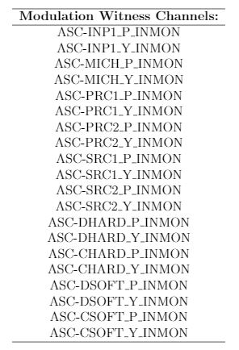
Results:
Step 3) Try non-stationary subtraction by adding “slow” modulation channels.

Slide 15
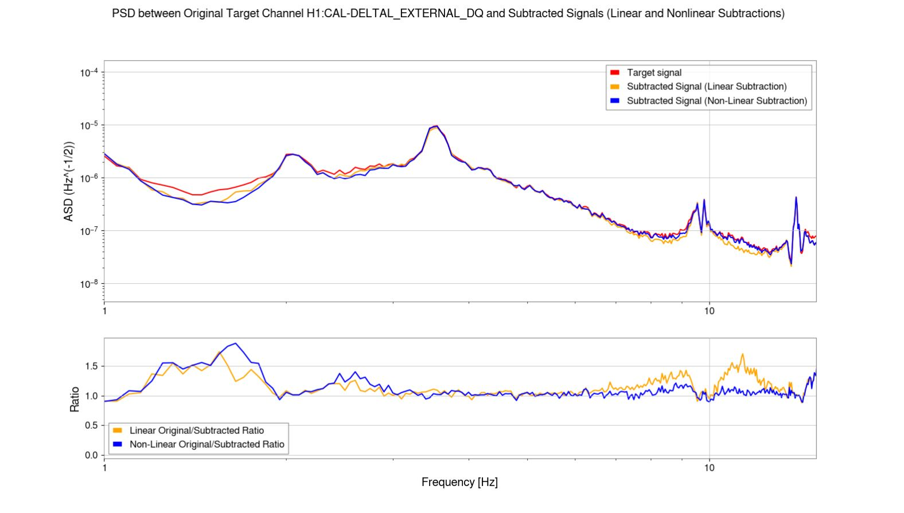
Results:
Time Domain Subtraction Plot:
PSD between Target Channel H1: CAL-DELTAL_EXTERNAL_DQ and Subtracted Signals (Linear and Nonlinear Subtraction)
ASD(Hz^(-1/2))
*algorithm doesn’t always converge; no guarantee you will get an optimal solution
Ratio
Frequency [Hz]

Slide 16
Is this Result good?
Original plan was to run algorithm through all of the O3 data
Takes a lot of time/computation
Goal is to do more subtraction in order to be able to be effective for study at lower frequency range
more possible channels relevant to the noise sources in the low frequency range should be assessed – mainly only the SUS and ASC channels were found in this project
Continuation of project ☺

Slide 17
Acknowledgements
A special thanks to:
Dr. Gabriele Vajente (mentor)
LIGO Summer Undergraduate Research Fellowship
Research Experiences for Undergraduates (REU) Program of the National Science Foundation

Slide 18
Thank you for listening!
Any Questions?
Contact: liny10@my.erau.edu

Slide 19
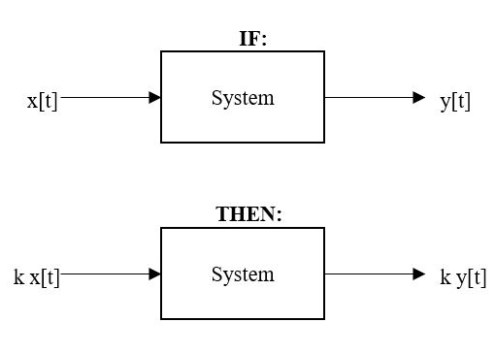
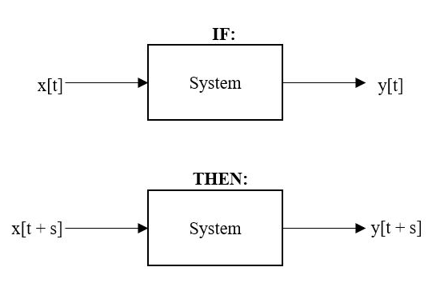
Linear/Nonlinear System
System – process in which an output signal is produced as a result of the response to an input signal
Additivity
Homogeneity
Shift Invariance
Linear and Time Invariant System

Slide 20
Linear and Time Invariant System
$$x\left(t\right)= k_{1}x\left(t−t_{1}\right)+k_{2}x\left(t−t_{2}\right)+…+k_{i}x\left(t−t_{i}\right)$$
Properties:
Additivity
Homogeneity
Shift Invariance
$$x\left(t\right)= \sum_{i=1}^{N}{k_{i}x\left(t−t_{i}\right)}$$
$$x\left(t\right)= \int_{0}^{∞}{k\left(τ\right)δ\left(t−τ\right)dτ=(k∗h)(t)}$$

Slide 21
“Target” Strain Channel (Supplemental)
$$h(t)$$
The target channel is the channel that we want to subtract the noise from
For this project, utilize: CAL-DELTAL_EXTERNAL_DQ
produces the calibrated strain signals that are corrected below 10 Hz
Advantage: the only channel currently that contains calibrated strain below 10 Hz.
Disadvantage: less accuracy than the GDS-CALIB_STRAIN channel, which was the target channel that was originally used for subtracting noise between 10 and 30 Hz

Slide 22
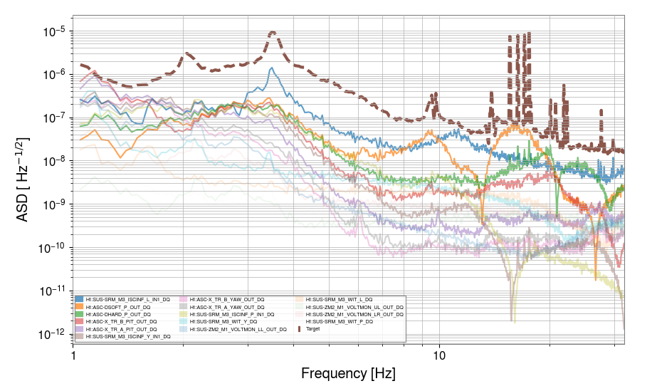
(supplemental) Results:
Contribution plot:

Slide 23
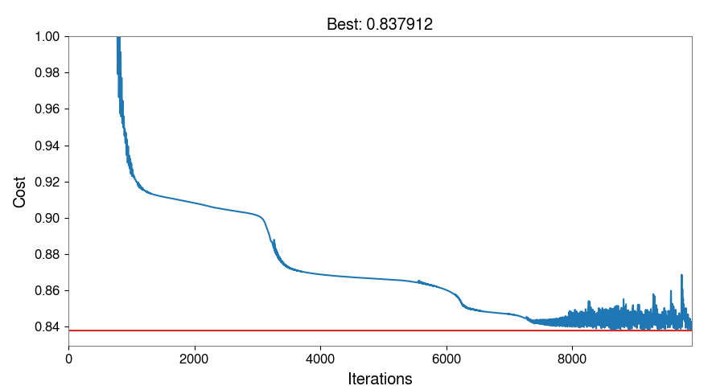
(supplemental) Results:
Cost Function:
Optimized parameter is the minimum value that is calculated by the cost function
Algorithm doesn’t always converge

Slide 24
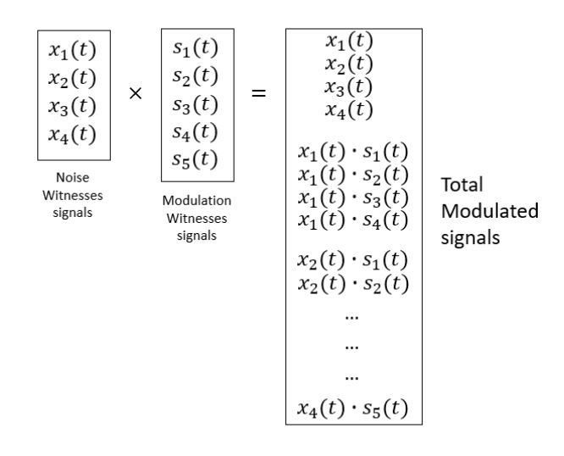
(Supplemental) Modulated Signals

