Slide 1
Calibrating the Spectrum of GW Detectors
J. Kissel for the LIGO Calibration Team, and the LIGO-VIRGO-KAGRA Scientific Collaboration

Slide 2
LISA vs. LIGO: A Fundamentally Different Calibration Problem
After reading Oct 15th Meeting Minutes, and references in bonus material,
 | LIGO (2nd Gen) | LISA
Typical SNRs | 2 to 50 | 200 to 5000
Time in band | Milliseconds | Years
GW Frequency Band | 20 - 2000 Hz | 20 uHz - 20 mHz
Complicated Control System around GW DOF? | Yes | No
Sampling Rate | 16 kHz | 16 Hz
Resonant Cavities? | Yes | No
Technique to derive GW signal | Optical Interferometry | Time Domain Subtraction
Analysis Time-scale | Near Real Time | Offline, over years
n Signals | several distinct per day at best | Full of “foreground noise”
Is it worth me telling you how LIGO calibration is done?
If so, jump to bonus slides with this helpful cow.

Slide 3
Nora ASKs: How does LIGO do it?
IT = “Who’s responsible for requirements on how accurate / precise calibration must be?”
“Detector/Calibration Teams” ask “how good does the calibration need to be?” of the “Science/Astrophysics Teams”
“Science/Astrophysics Teams” ask “how good can the calibration be?” of the “Detector/Calibration Teams”
Perennial problem in the “low person power limit” (or “lots of person power over dispersed community limit”), and when those teams that aren’t comprised of both experts from both teams: can’t figure out where to start such a hard problem!
We at LIGO know this operational issue well.
LIGO has only just recently (in the past ~3 years) begun to tackle establishing cohesive requirements ”meeting in the middle.”

Slide 4
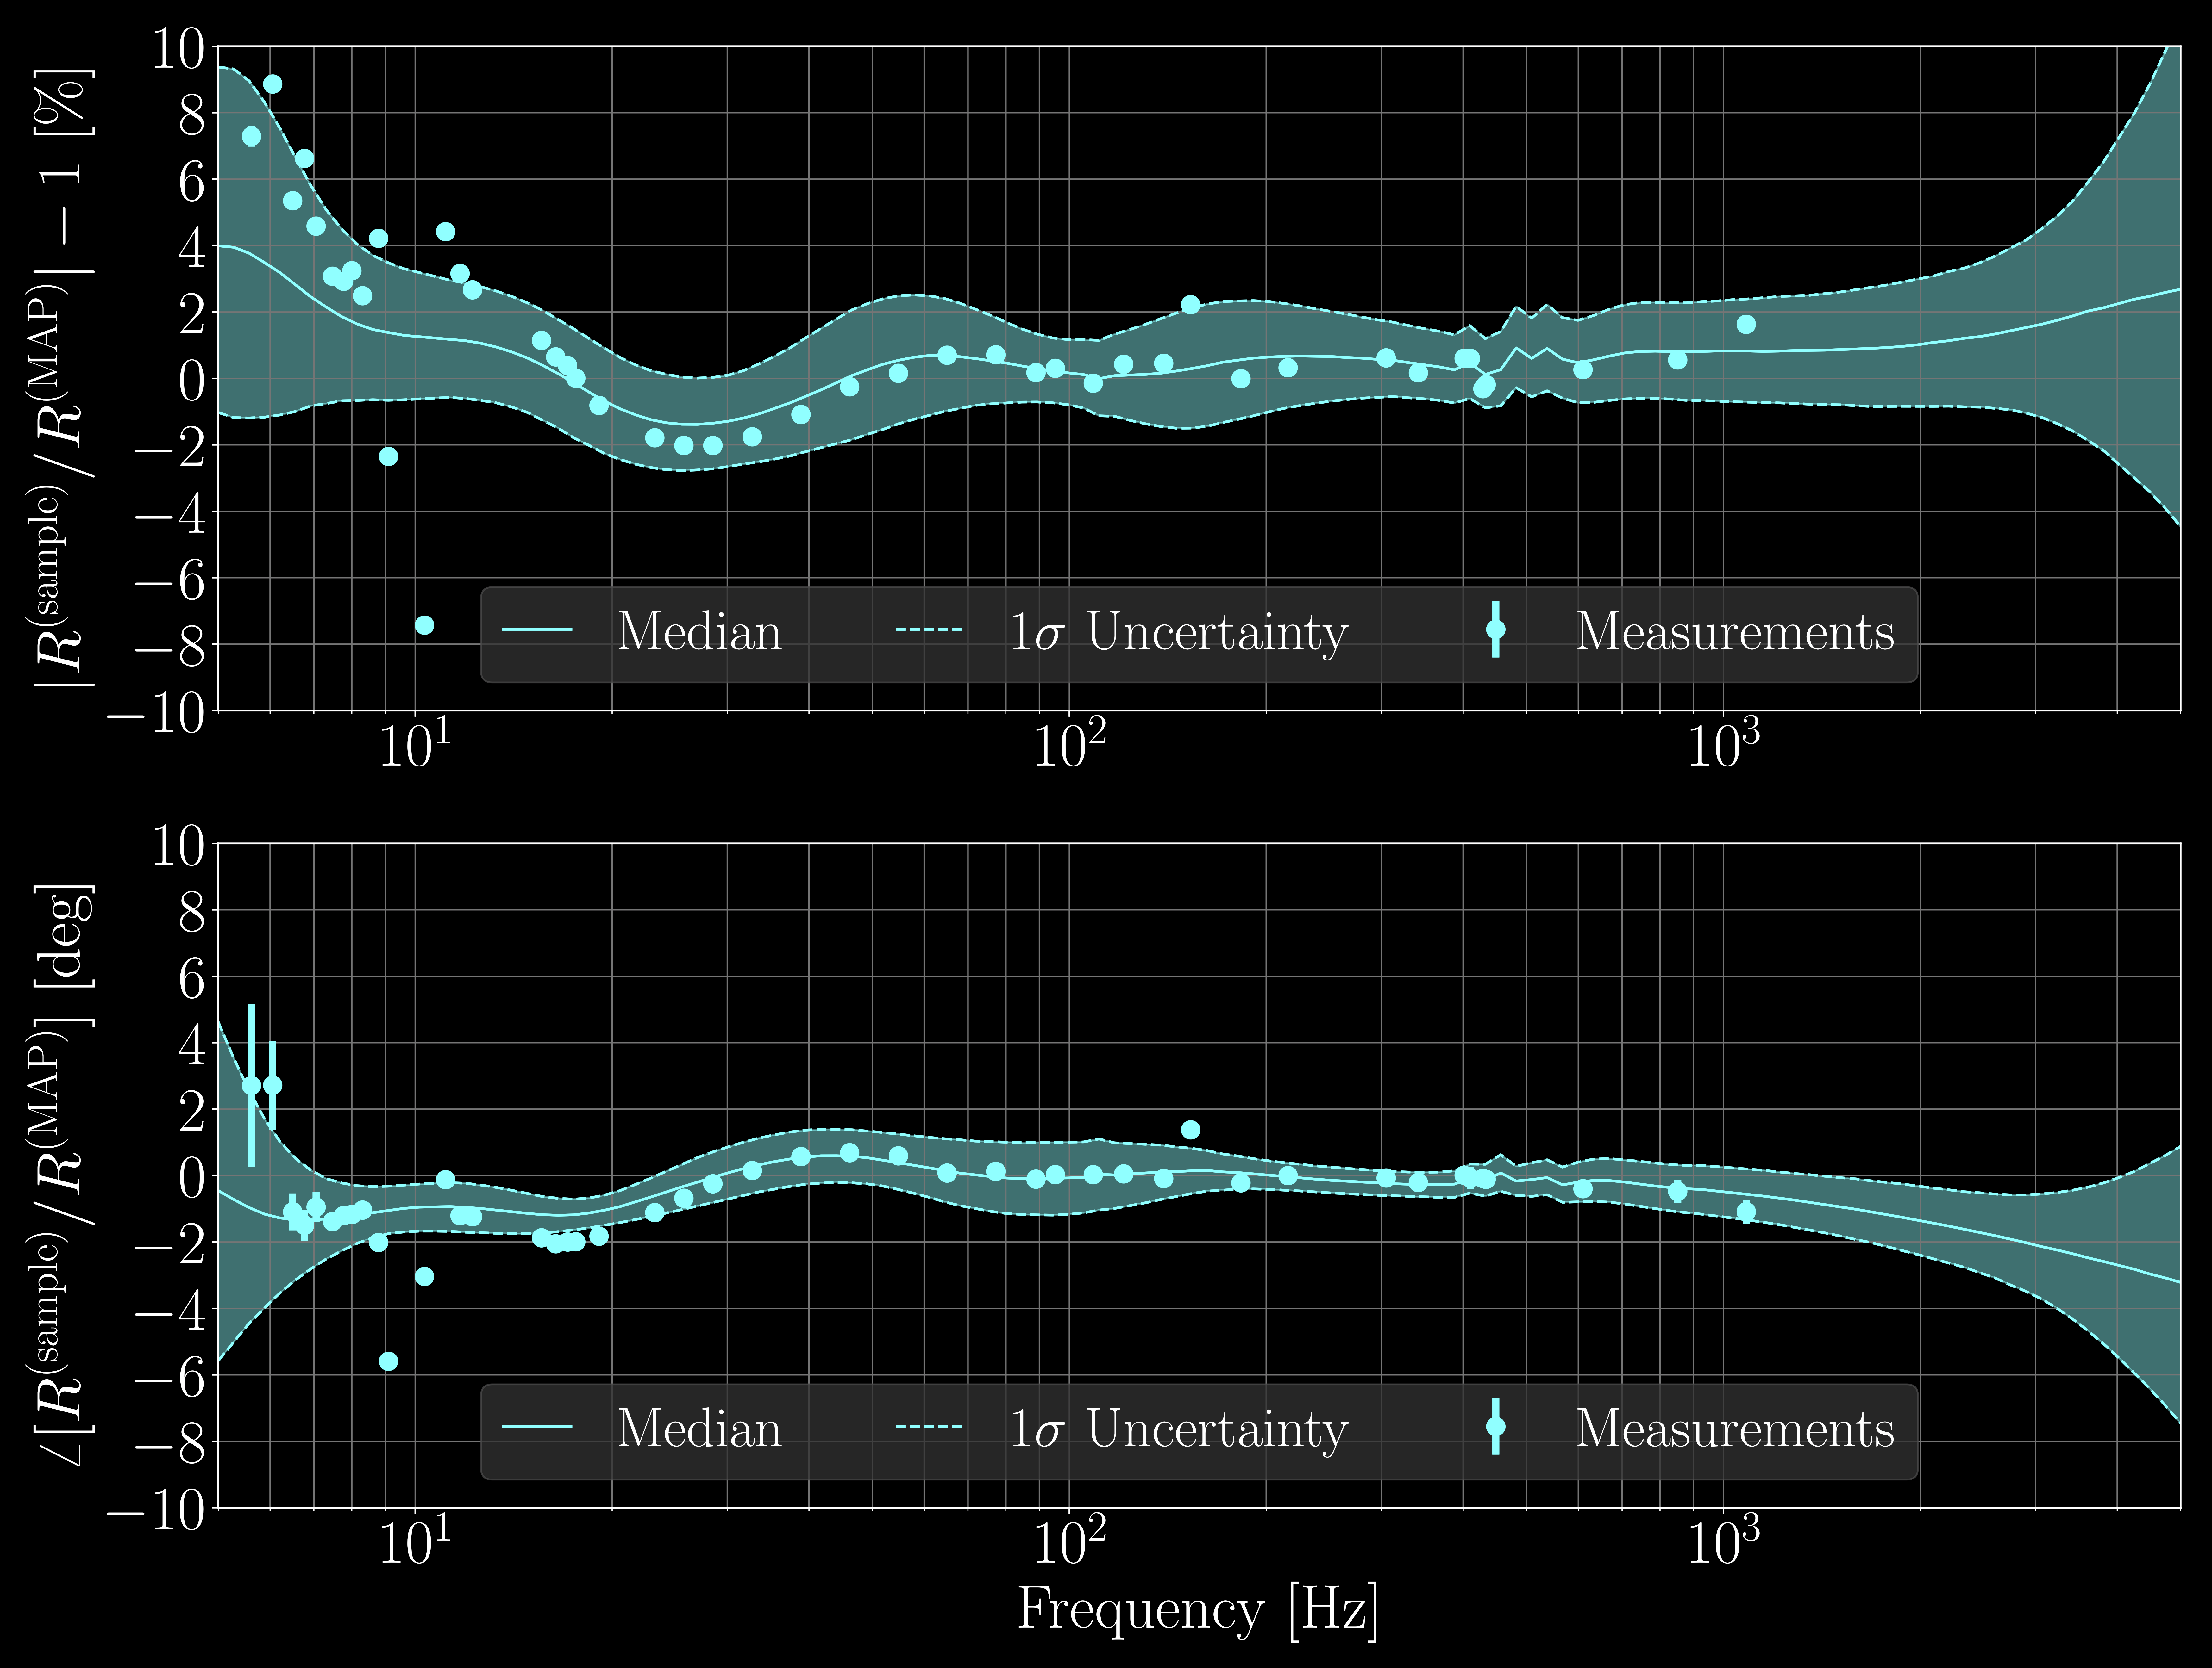
How the (typical) Answer is presented
Meas.
η_{R} =
______________
Direct Measurement
Model
Magnitude, (η_{R} – 1) (%)
Estimate
68% ci
Measurement uncertainty is shown, just tiny compared to 68% CI …
Phase (η_{R} – 1) (deg)
Estimate pretty accurate, so why is 68% C.I. so large?
From CQG 37.22 (2020): 225008.

Slide 5
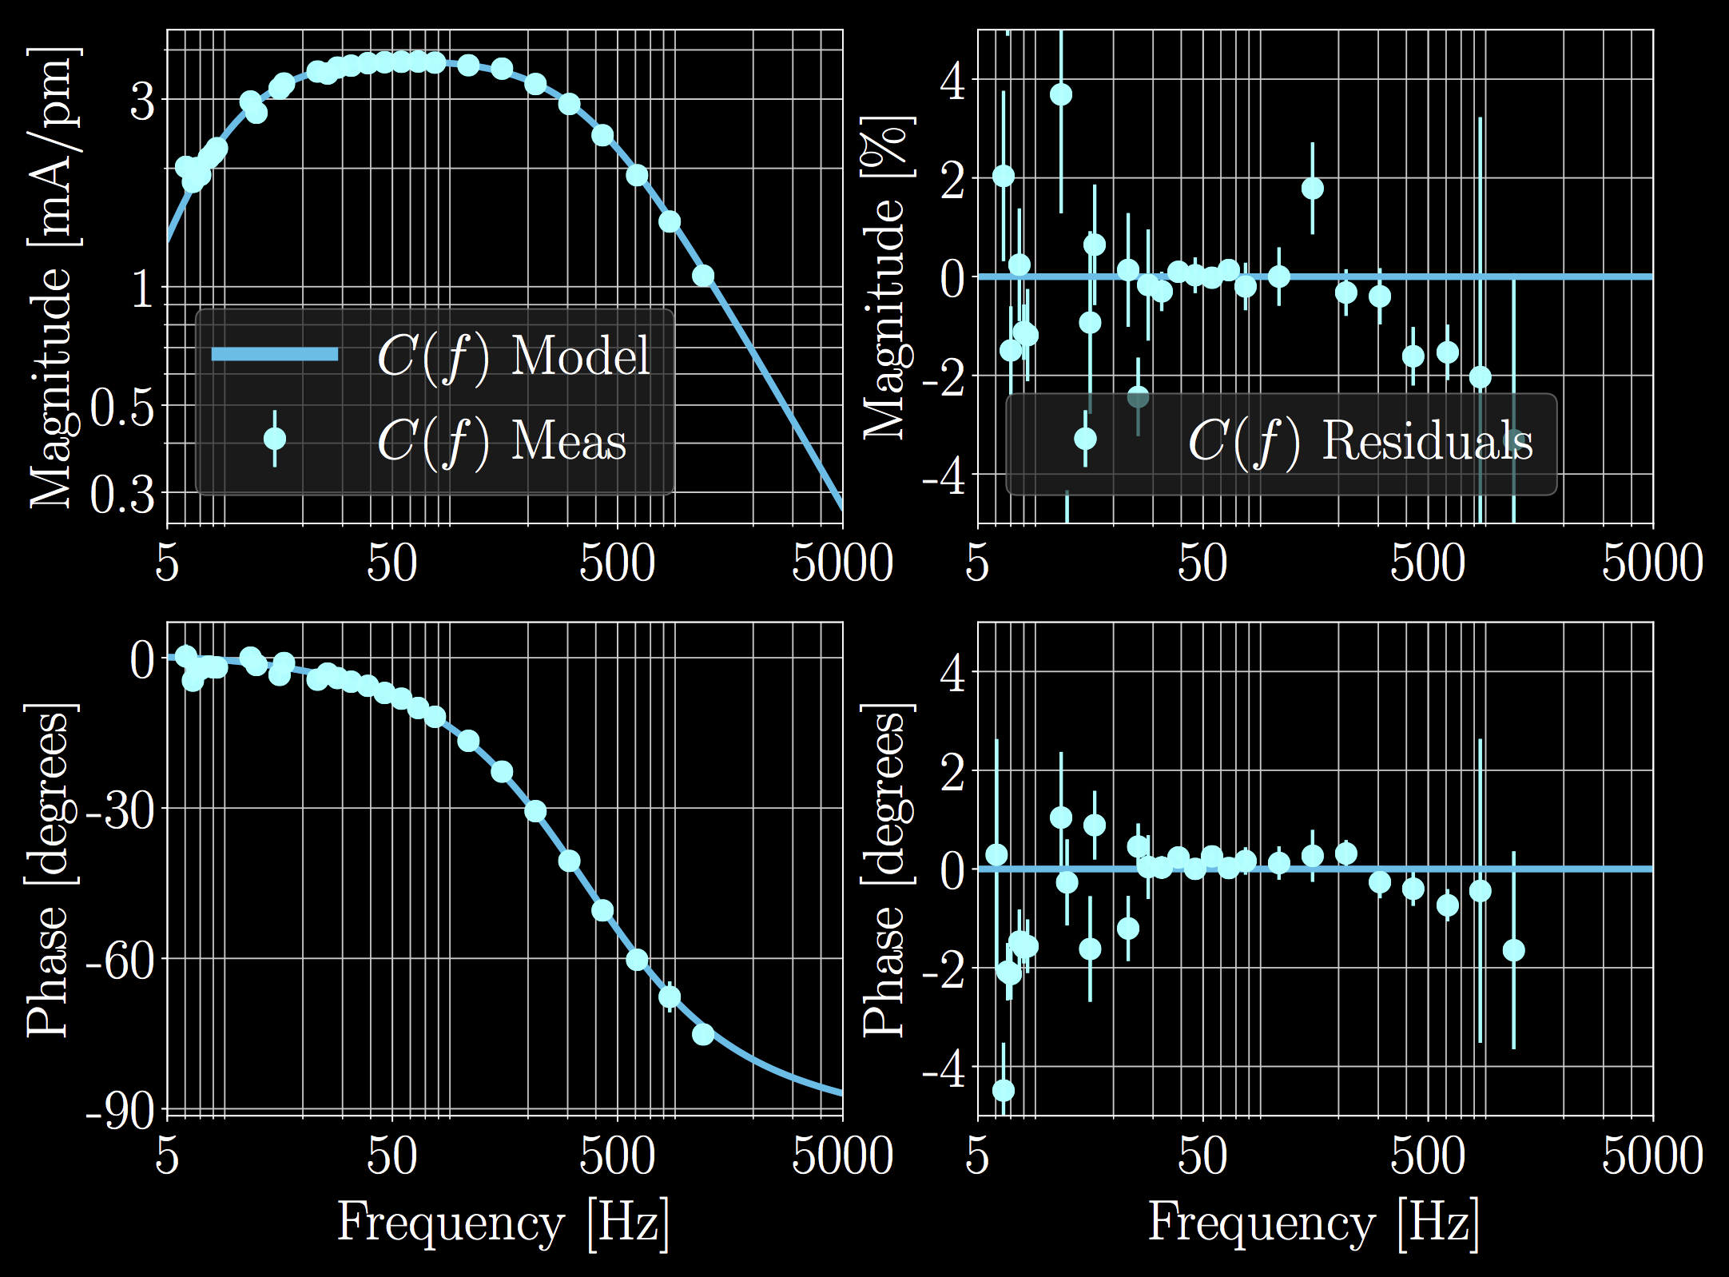
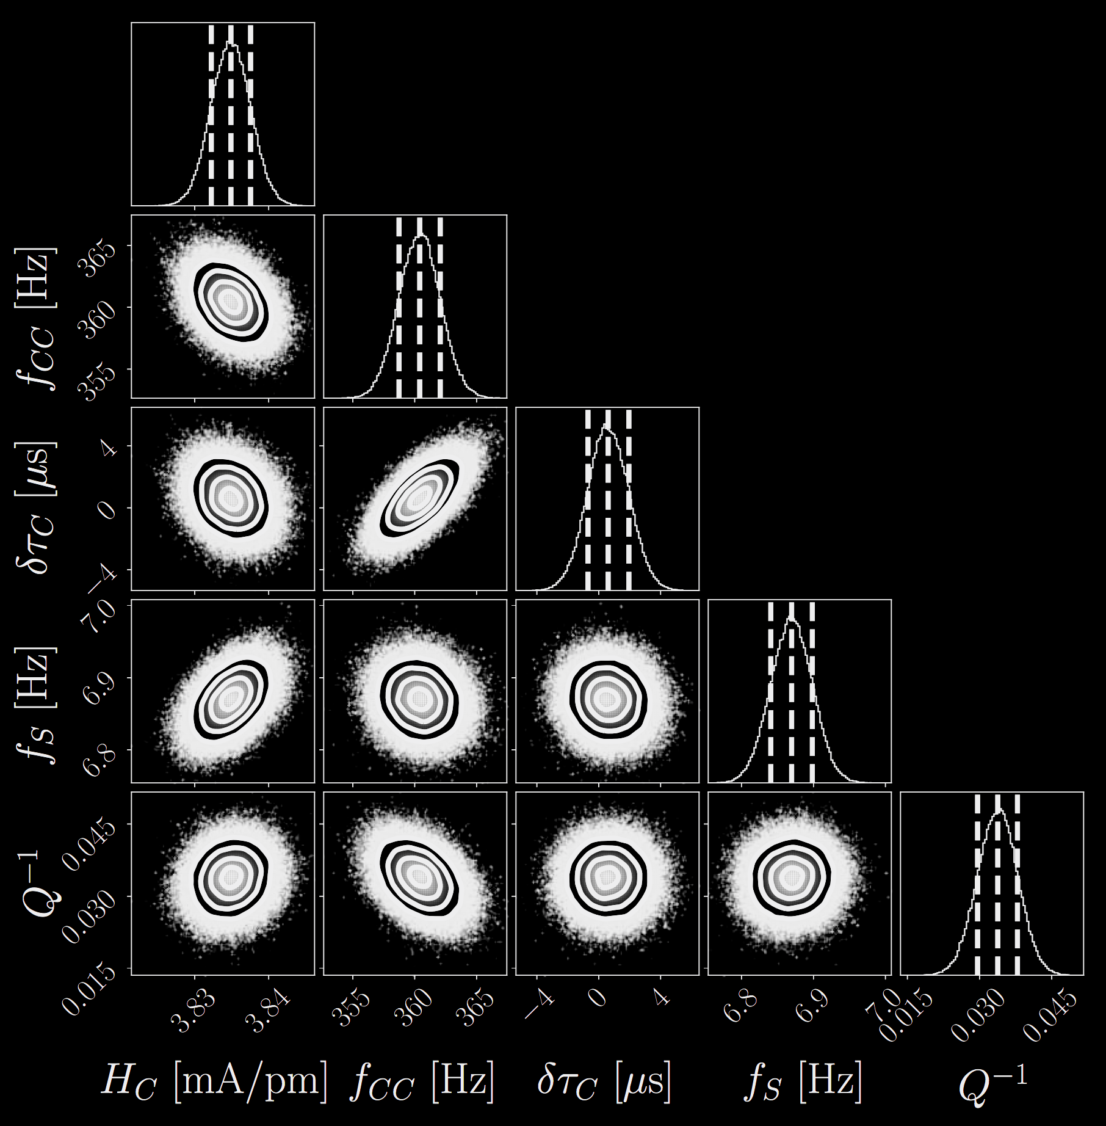
Watch your Language
Statistical uncertainty: MCMC posteriors to the model parameters sampled to form a sample response function.
Systematic Error:
Any residual, statistically significant, frequency dependence
Fundamental reference error

Slide 6
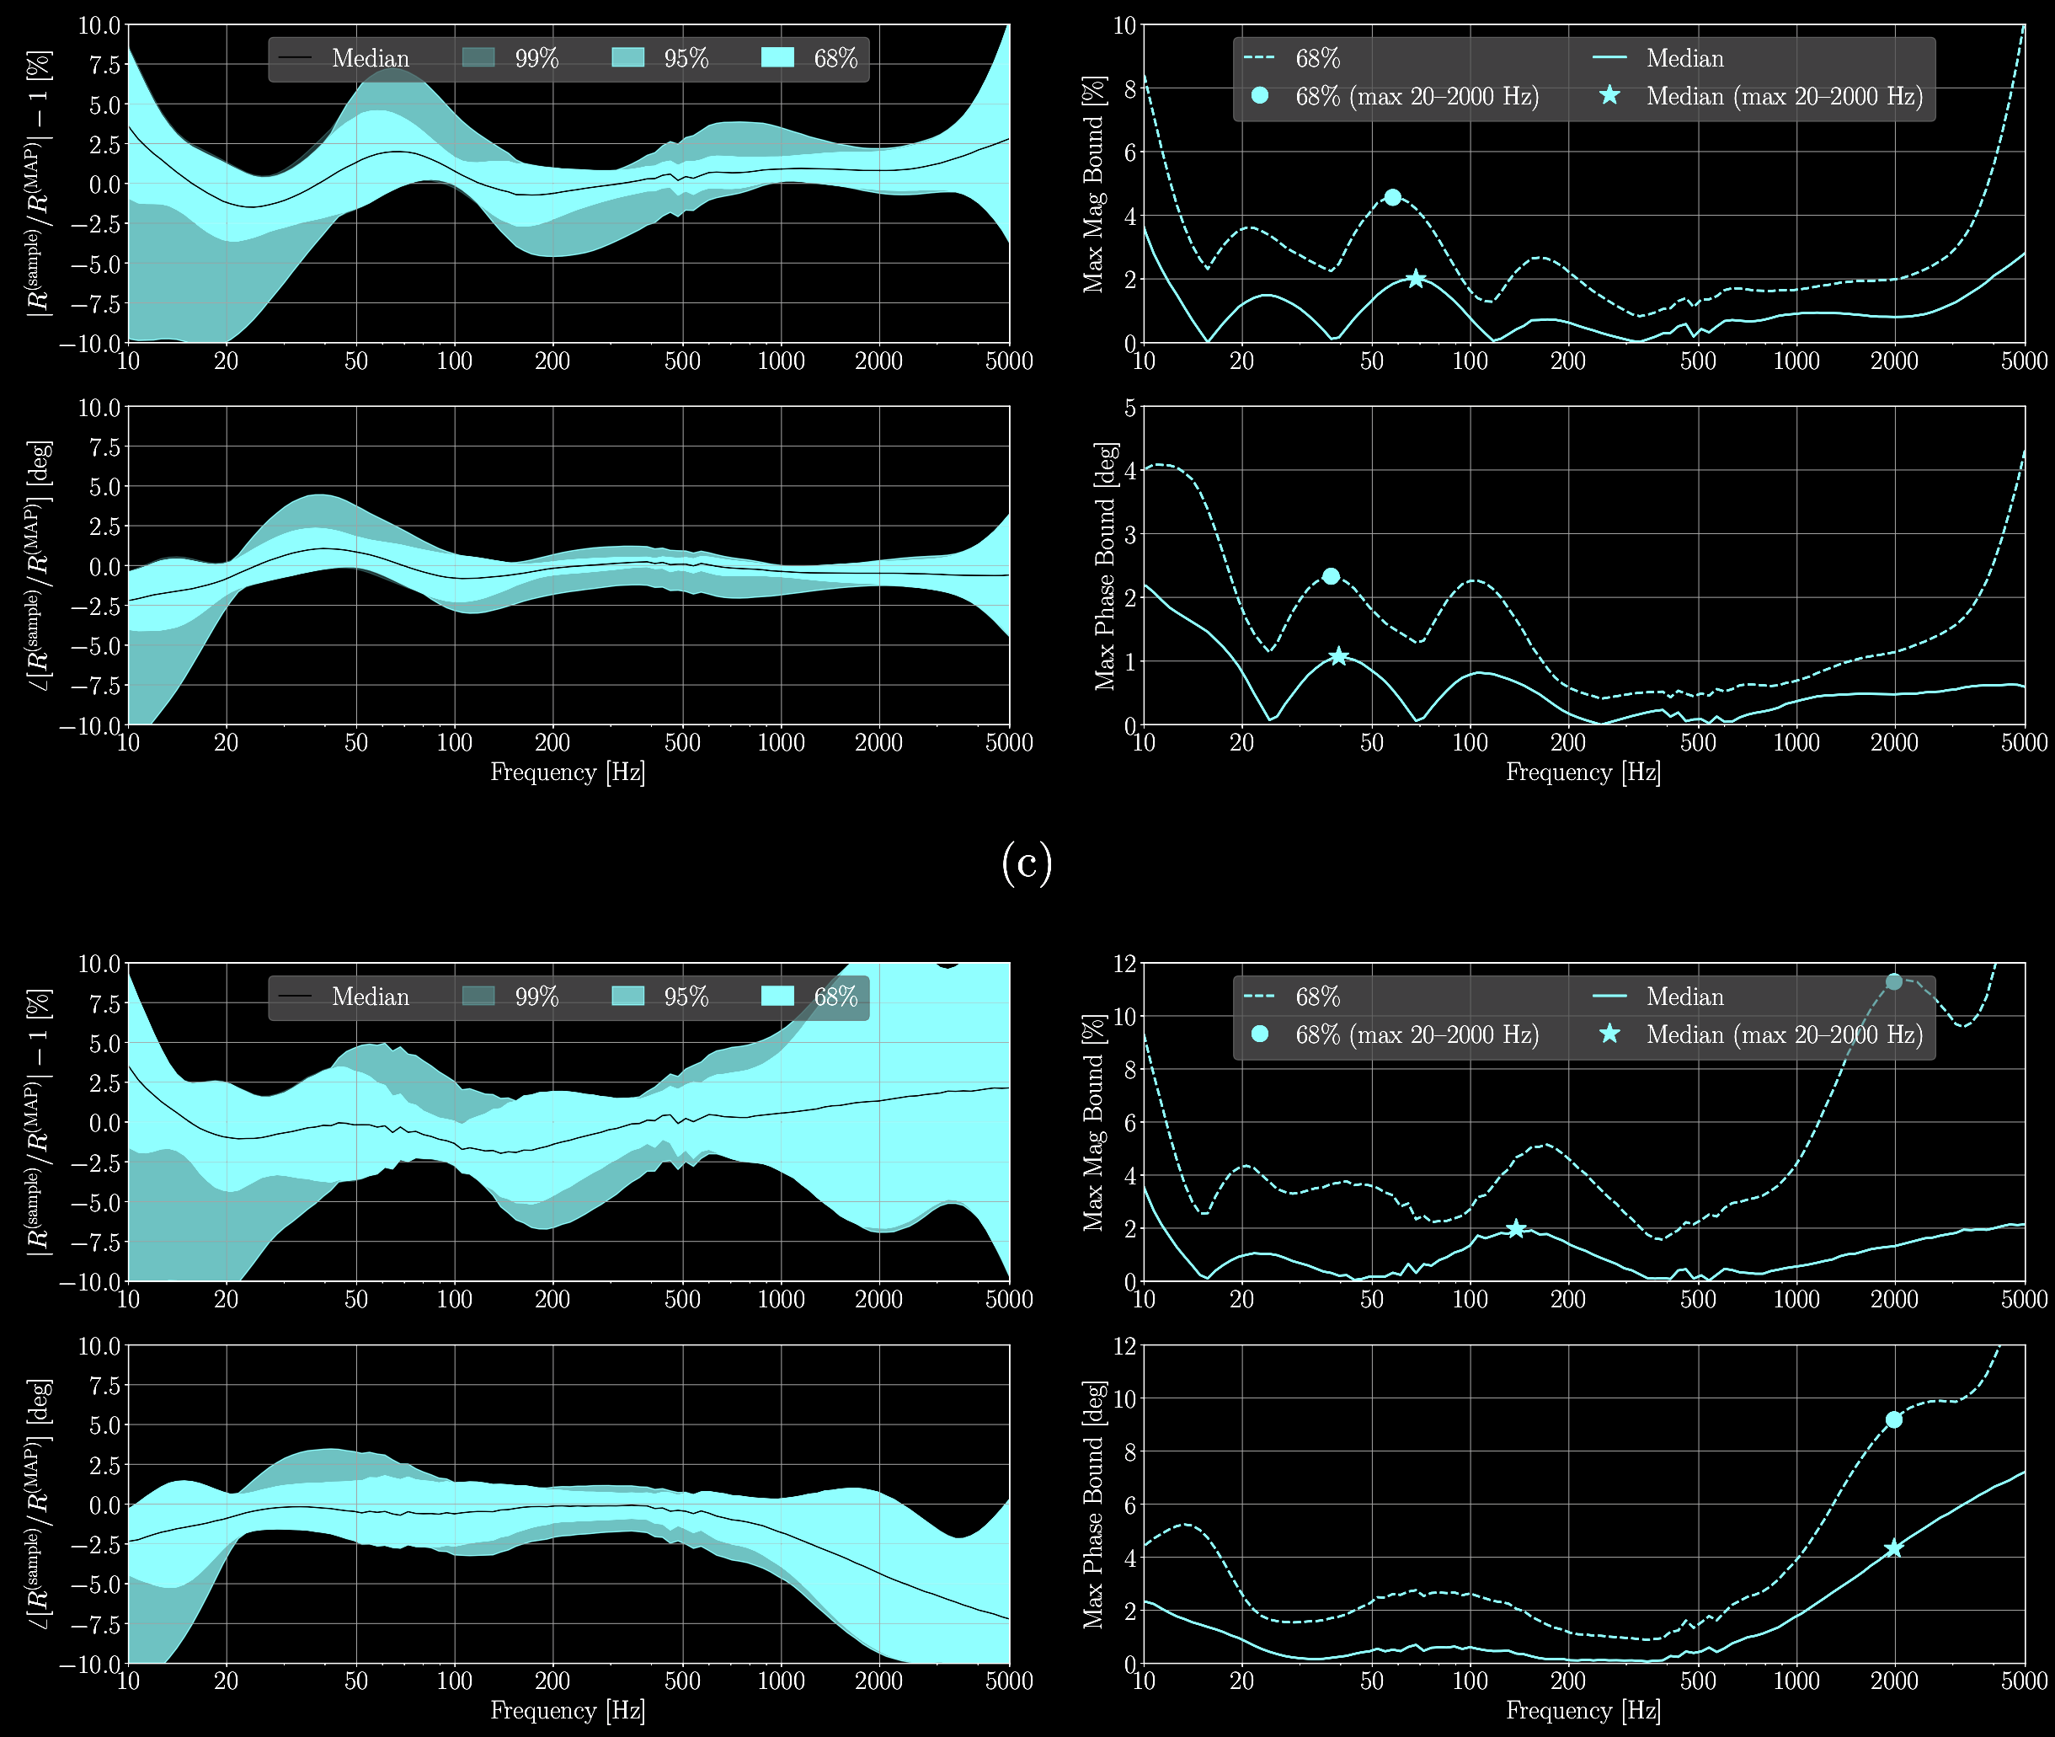
Its complicated AND Librarianship is key
In general, systematic error and its associated confidence interval is:
complex-valued,
frequency-dependent, and
time-dependent —
either continuously in time but on time scales much slower than gravitational wave signals, or
discontinuously changing at discrete times over a long observing period with those times defined by planned or unplanned detector hardware/electronics changes over the course of the observation period.
What’s shown here is a discrete change after 1 week
The LISA team will have to keep track of this over a decade.
From arxiv:2107.00129

Slide 7
Back to NORA’s question: Some Light Reading
2005- 2010:
Prototyping of a true absolute references CQG 26.24 (2009): 245011. CQG 27.8 (2010): 084024.
Understanding how to calibrate the power recycled detectors with all its quirks, and estimating systematic error from residual between open loop gain measurement vs. model Nucl. Instrum. Methods 624.1 (2010): 223-240.
2015-2016:
Calibrating dual recycled detector for the first time (before we were prepared, honestly) PRD 95.6 (2017): 062003.
Development of a fully Bayesian-friendly physical model of systematic error PRD 96.10 (2017): 102001.
But: A physical model of calibration errors involves many (physical detector parameters), believed to be intractable to include. So – make toy models, and approximate. https://dcc.ligo.org/LIGO-T1400682/public
2016-2018:
Perfecting the absolute reference. Rev. Sci. Instrum. 87.11 (2016): 114503. CQG 38.1 (2020): 015009.
Develop the formalism to a random list of “instantiations of error curves” that match the real distribution and track the underlying physical parameter instantiation PRL 116.24 (2016): 241102.

Slide 8
Back to NORA’s question: Some Light Reading (con’t)
2018-2020:
Tracking physical parameters that inform random curves and importance re-weighting – makes the problem tractable for a few examples.
“Using events up through GTWC-2 and the level of calibration error estimated during the time of those events, is the estimate of astrophysical parameters changed when we “turn on” calibration errors? No. PRD 102.12 (2020): 122004.
“using a model of an SNR 50 BNS, with these levels of error, would it matter?” No. PRD 103.6 (2021): 063016.
“Using a model of an SNR 200 BBH, with these levels of error, would matter?” A bit, sky localization precision is degraded. PRD 102.12 (2020): 122004.
2021-present: expand the question space
“Worst of the worst of the worst” impact on inferring Hubble Constant: Let’s take some of the times of highest, funkiest systematic error in O3, apply it to a collection of toy BNSs with EM counterparts, but don’t account for systematic error – does it bias estimate? No. in prep. (2021)
What about unmodeled burst sources? in prep. (2022)

Slide 9
Still Open Questions
Continue to explore the parameter space of possible calibration error frequency dependence vs. source types vs. SNR
We’re contining on LISA-like SNRs for 3rd generation ground based detectors, and hopefully other astroparameter estimation systematics will reduce.
“Payne Conjecture” detector errors and gravitational wave frequency evolution evolve entirely different in frequency. Tough for them to be confused for one another.
Hierarchical estimates – physics and cosmology parameters derived from collection of event parameters, each influenced by calibration error in (non-statistically fluctuating) different ways
Refine statements of impact on Hubble Constant (less specific “perfect” events as toy examples)
Explore impacts on test of general relativity
See “what if?” bonus slides
And yet after all this work – we feel the need to have great calibration anyways to be prepared for the “unknown unknowns” of unexpected gravitational wave sources.
Sometimes the push for calibration accuracy is from understanding the detector noise
“Are we at 140 or 142 Mpc?”

Slide 10
Where LIGO Experience Might Help
All things related to photodetector signal chain calibration (not just “anti-aliasing filters”)
Prior to ADC:
Optical beam splitter ratio?
Sensitivity of Quantum Efficiency to Temperature?
Photo-diode transimpedance amplifier? (poor compensation of frequency response)
Photo-diode whitening filter? (poor compensation of frequency response)
Differential “prior to ADC” errors between different arms, impacting subtraction algorithm
You already mentioned differing ADC gains, but…
After the ADC
Computational delays within computer exchanges in one satellite?
Satellite to Satellite delays?
Space to Earth Delays?
Photodiode absolute reference?
Using a heterodyne signal, so is absolute power calibration on individual PDs not necessary?
Estimates of impact / cross-coupling of non-longitudinal DOF control systems? (Is there any way GWs can couple in to *other* DOFs, and then those *other* DOFs couple in to readout scheme?)
Antenna pattern as a function of frequency? CQG 25.18 (2008): 184017.

Slide 11
Bonus Material

Slide 12
HOW LIGO (AND ITS CALIBRATION) WORKS

Slide 13
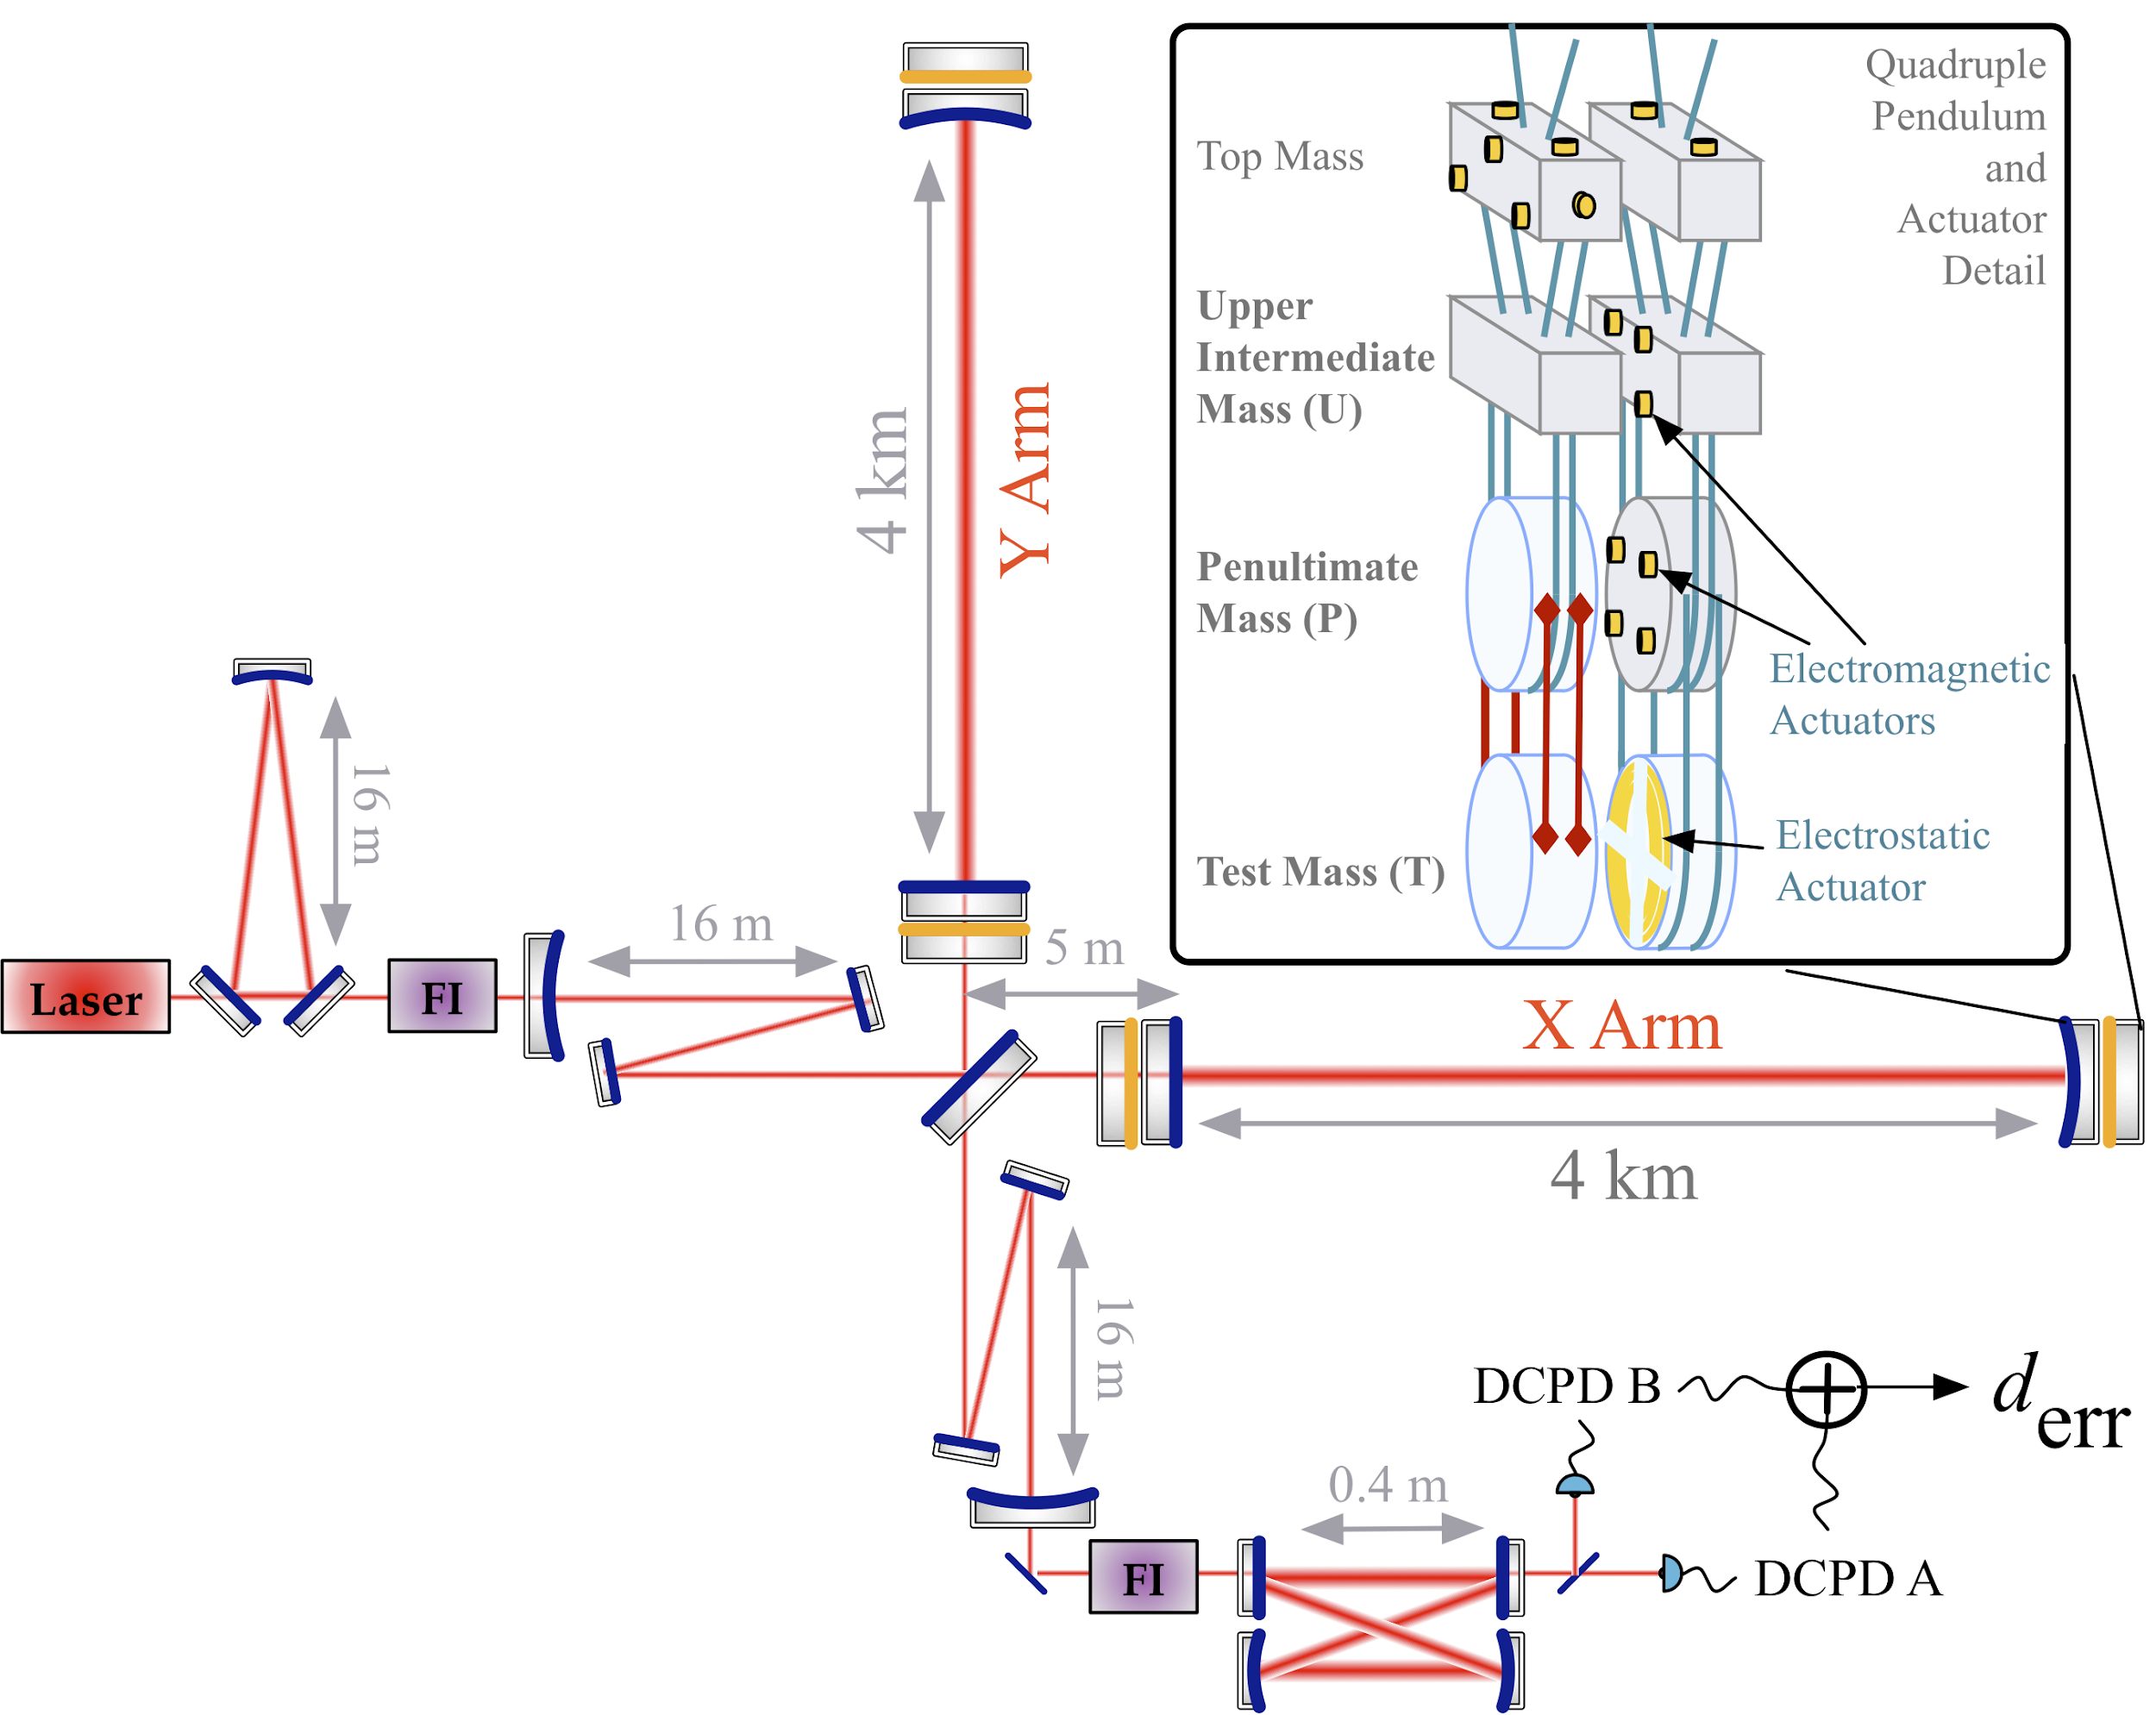
This is an IFO. An IFO says “DARM.”
Differential Arm Motion
Things not talked about in the “basics” of LIGO:
Signal recycling (which should actually be called signal extraction) cavity is coupled to, and improves the bandwidth of, the DARM signal
DARM ERR is the sum of two photodiode sensors, and we estimate strain without using the “DC” signal
Above ~1 Hz, the test masses controlled by only three of the four stages of the QUAD, and it’s arbitrary how many of which stage of which test mass suspension is driven

Slide 14
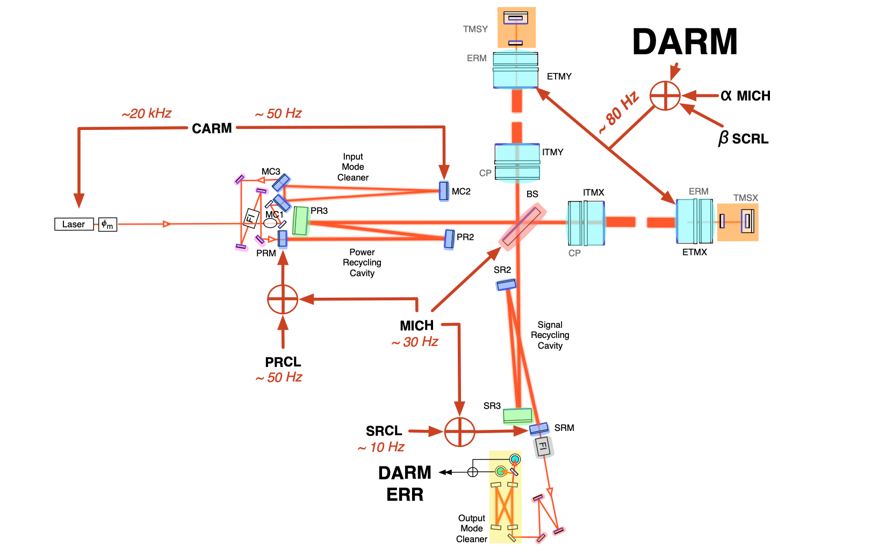
Dressed to Suppress
Global Cavity
Length Control
System
The detectors suspended optics must be held in place for DARM to be linear in terms of strain.
There are many, Many, MANY control loops that do that and suppress other noises, DARM is only one of them.
To calibrate for h(t), we must understand the DARM control loop system.

Slide 15
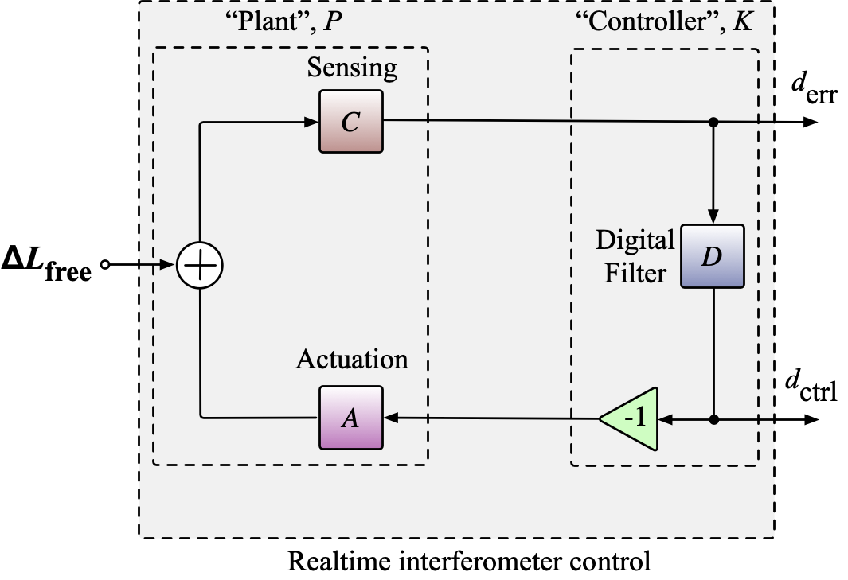
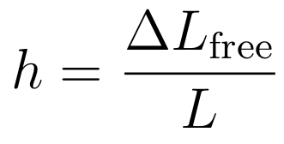
No control system, no gravitational waves
Feedback control systems usually:
a “plant” -- the thing you’re trying to control’s response to the control signal
the “controller” -- the filter(s) applied to the error signal to get the control signal.
For DARM calibration, we want an intermediate product within the plant: ∆L_{free} -- the displacement if there *wasn’t* a control system.
The “plant” split in to two parts, Actuation, A and Sensing, C
“Calibration,” fundamentally, is this process.
Characterizing and modeling the components of DARM control loop
Using the model to create filters to apply to the digital error signal
Understanding the systematic error and uncertainty in that model (and this the estimate).

Slide 16
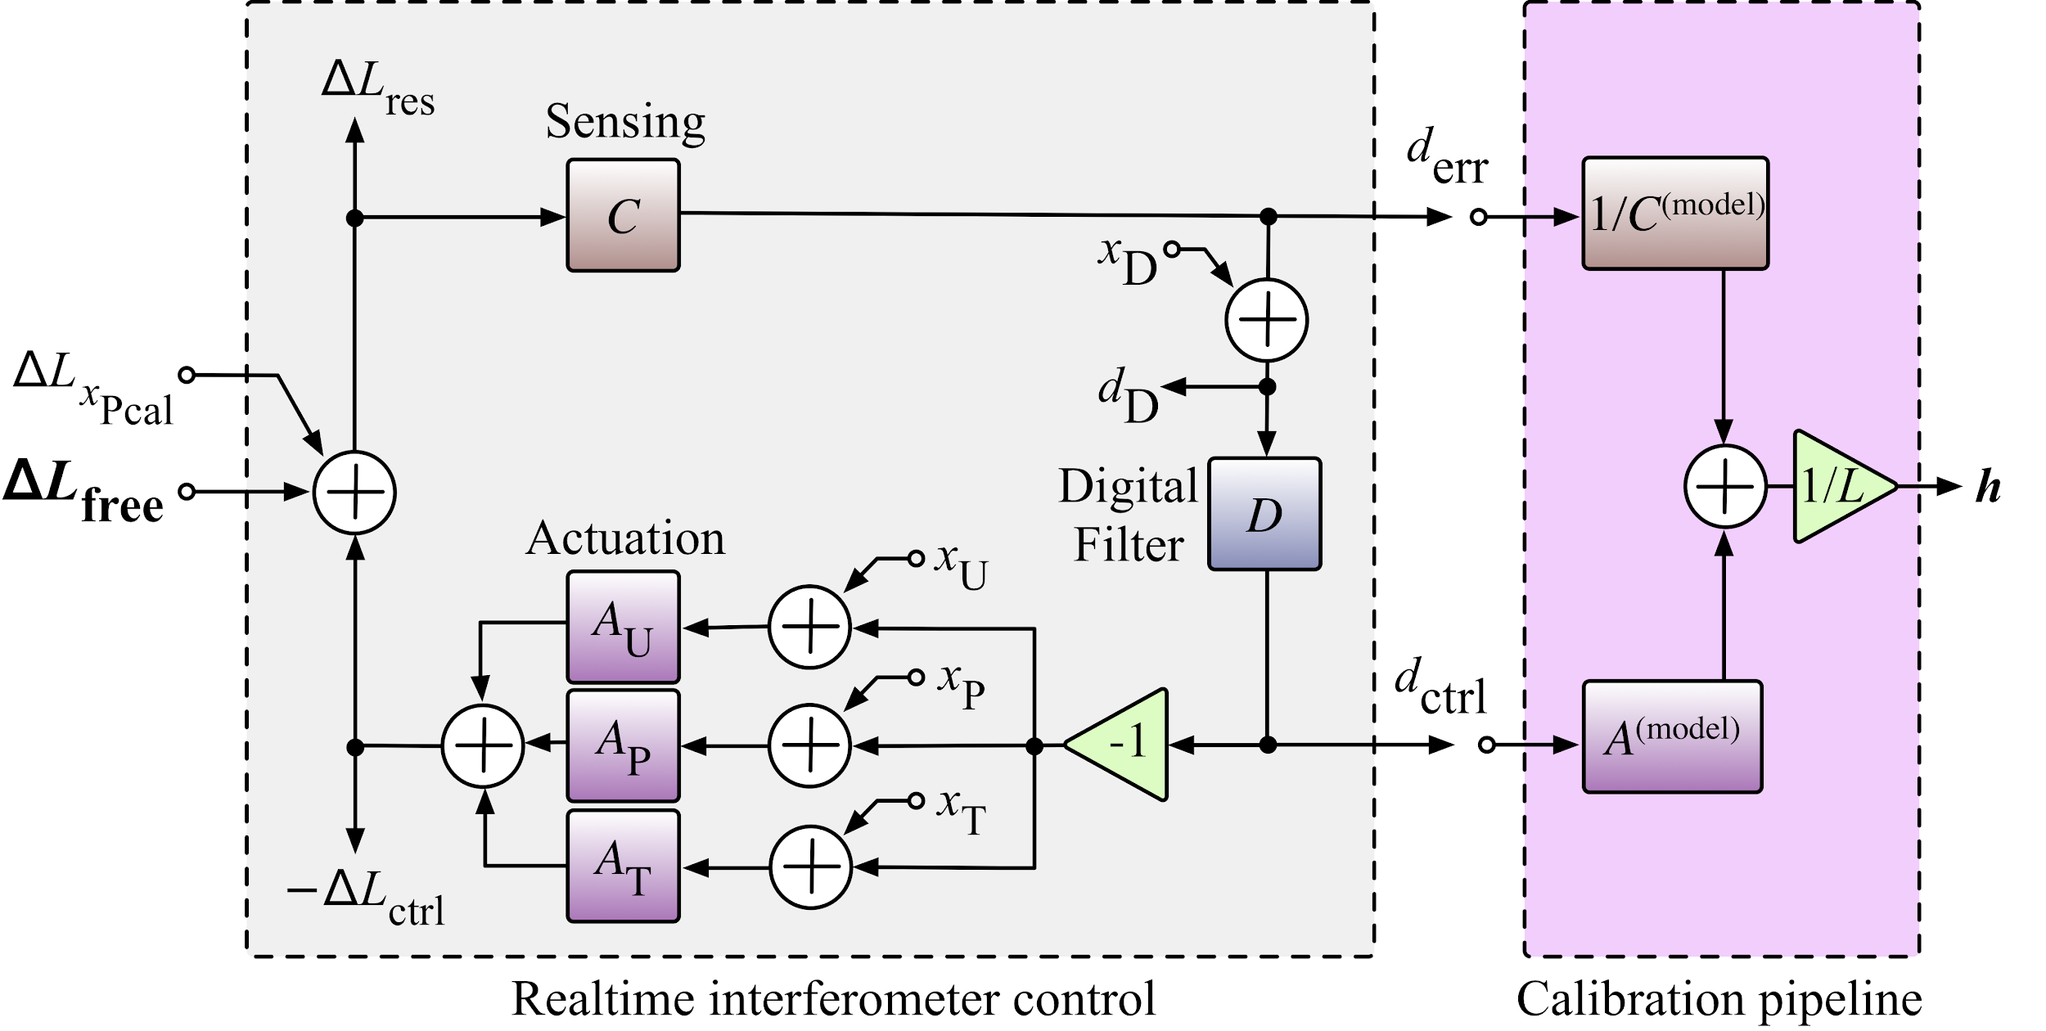
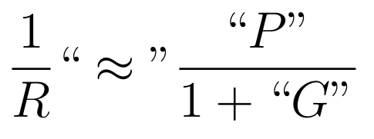
Producing h == Uncertainty in h
The response function
Which, expanded to,
with,
reveals
Systematic error or uncertainty in h is determined by error and uncertainty in C and the three components of A.
Error and uncertainty in h and R are the interchangeable in discussion.
is kinda like the traditional “loop suppressed plant”

Slide 17
But here’s the hard part...
If it were only this simple...
The DARM loop alone is far, Far, FAR more complicated than you’d ever want it to be.
And, you need to verify whatever you model with measurement so you can estimate the response function’s systematic error and uncertainty, where -- get to the 5-10% / 5-10 deg level, you must
re-create the offline model with real-time filters
understand each component of A and C to the level 1% / 1 deg or better
across the entire 5 to 5000 Hz frequency band,
in magnitude and phase,
over all observation times (which can and will be years long at times),
while the detector hardware/electronics/configuration is changing every few months to improve performance, with
limited subsequent time with the IFO, and
limited person-power whom are vulnerable to institutional memory loss and ever evolving software.
Oh, and A and C are composed of components that can only be measured by a fully functional detector are not only frequency dependent but slowly time-dependent!
“Service work” >> Precision Engineering.

Slide 18
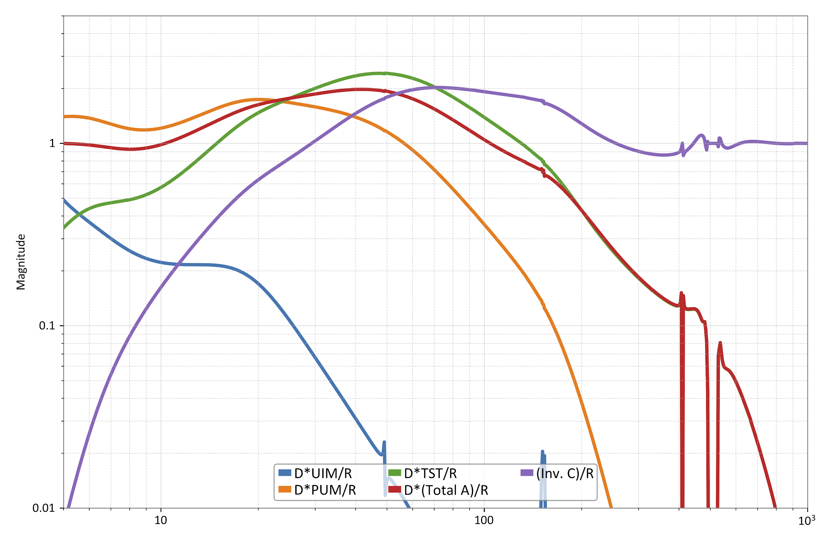
What Matters? Everything.
How does each function contribute to R?
At what frequencies is each important?
Divide each term in brackets above equation by R, and plot the magnitude.
Magnitude of the relative contribution of each component of R
Every component contributes more than 10% in a frequency dependent mix between 5 and 500 Hz!
100%
The Sensing Function matters contributes even below 10 Hz
The TST stage mixes with the Sensing at 500 Hz
Magnitude [ ]
10%
The UIM has mattered out to 150 Hz!
Curves for H1 O3B
1%
10
100
1000
Frequency [Hz]

Slide 19
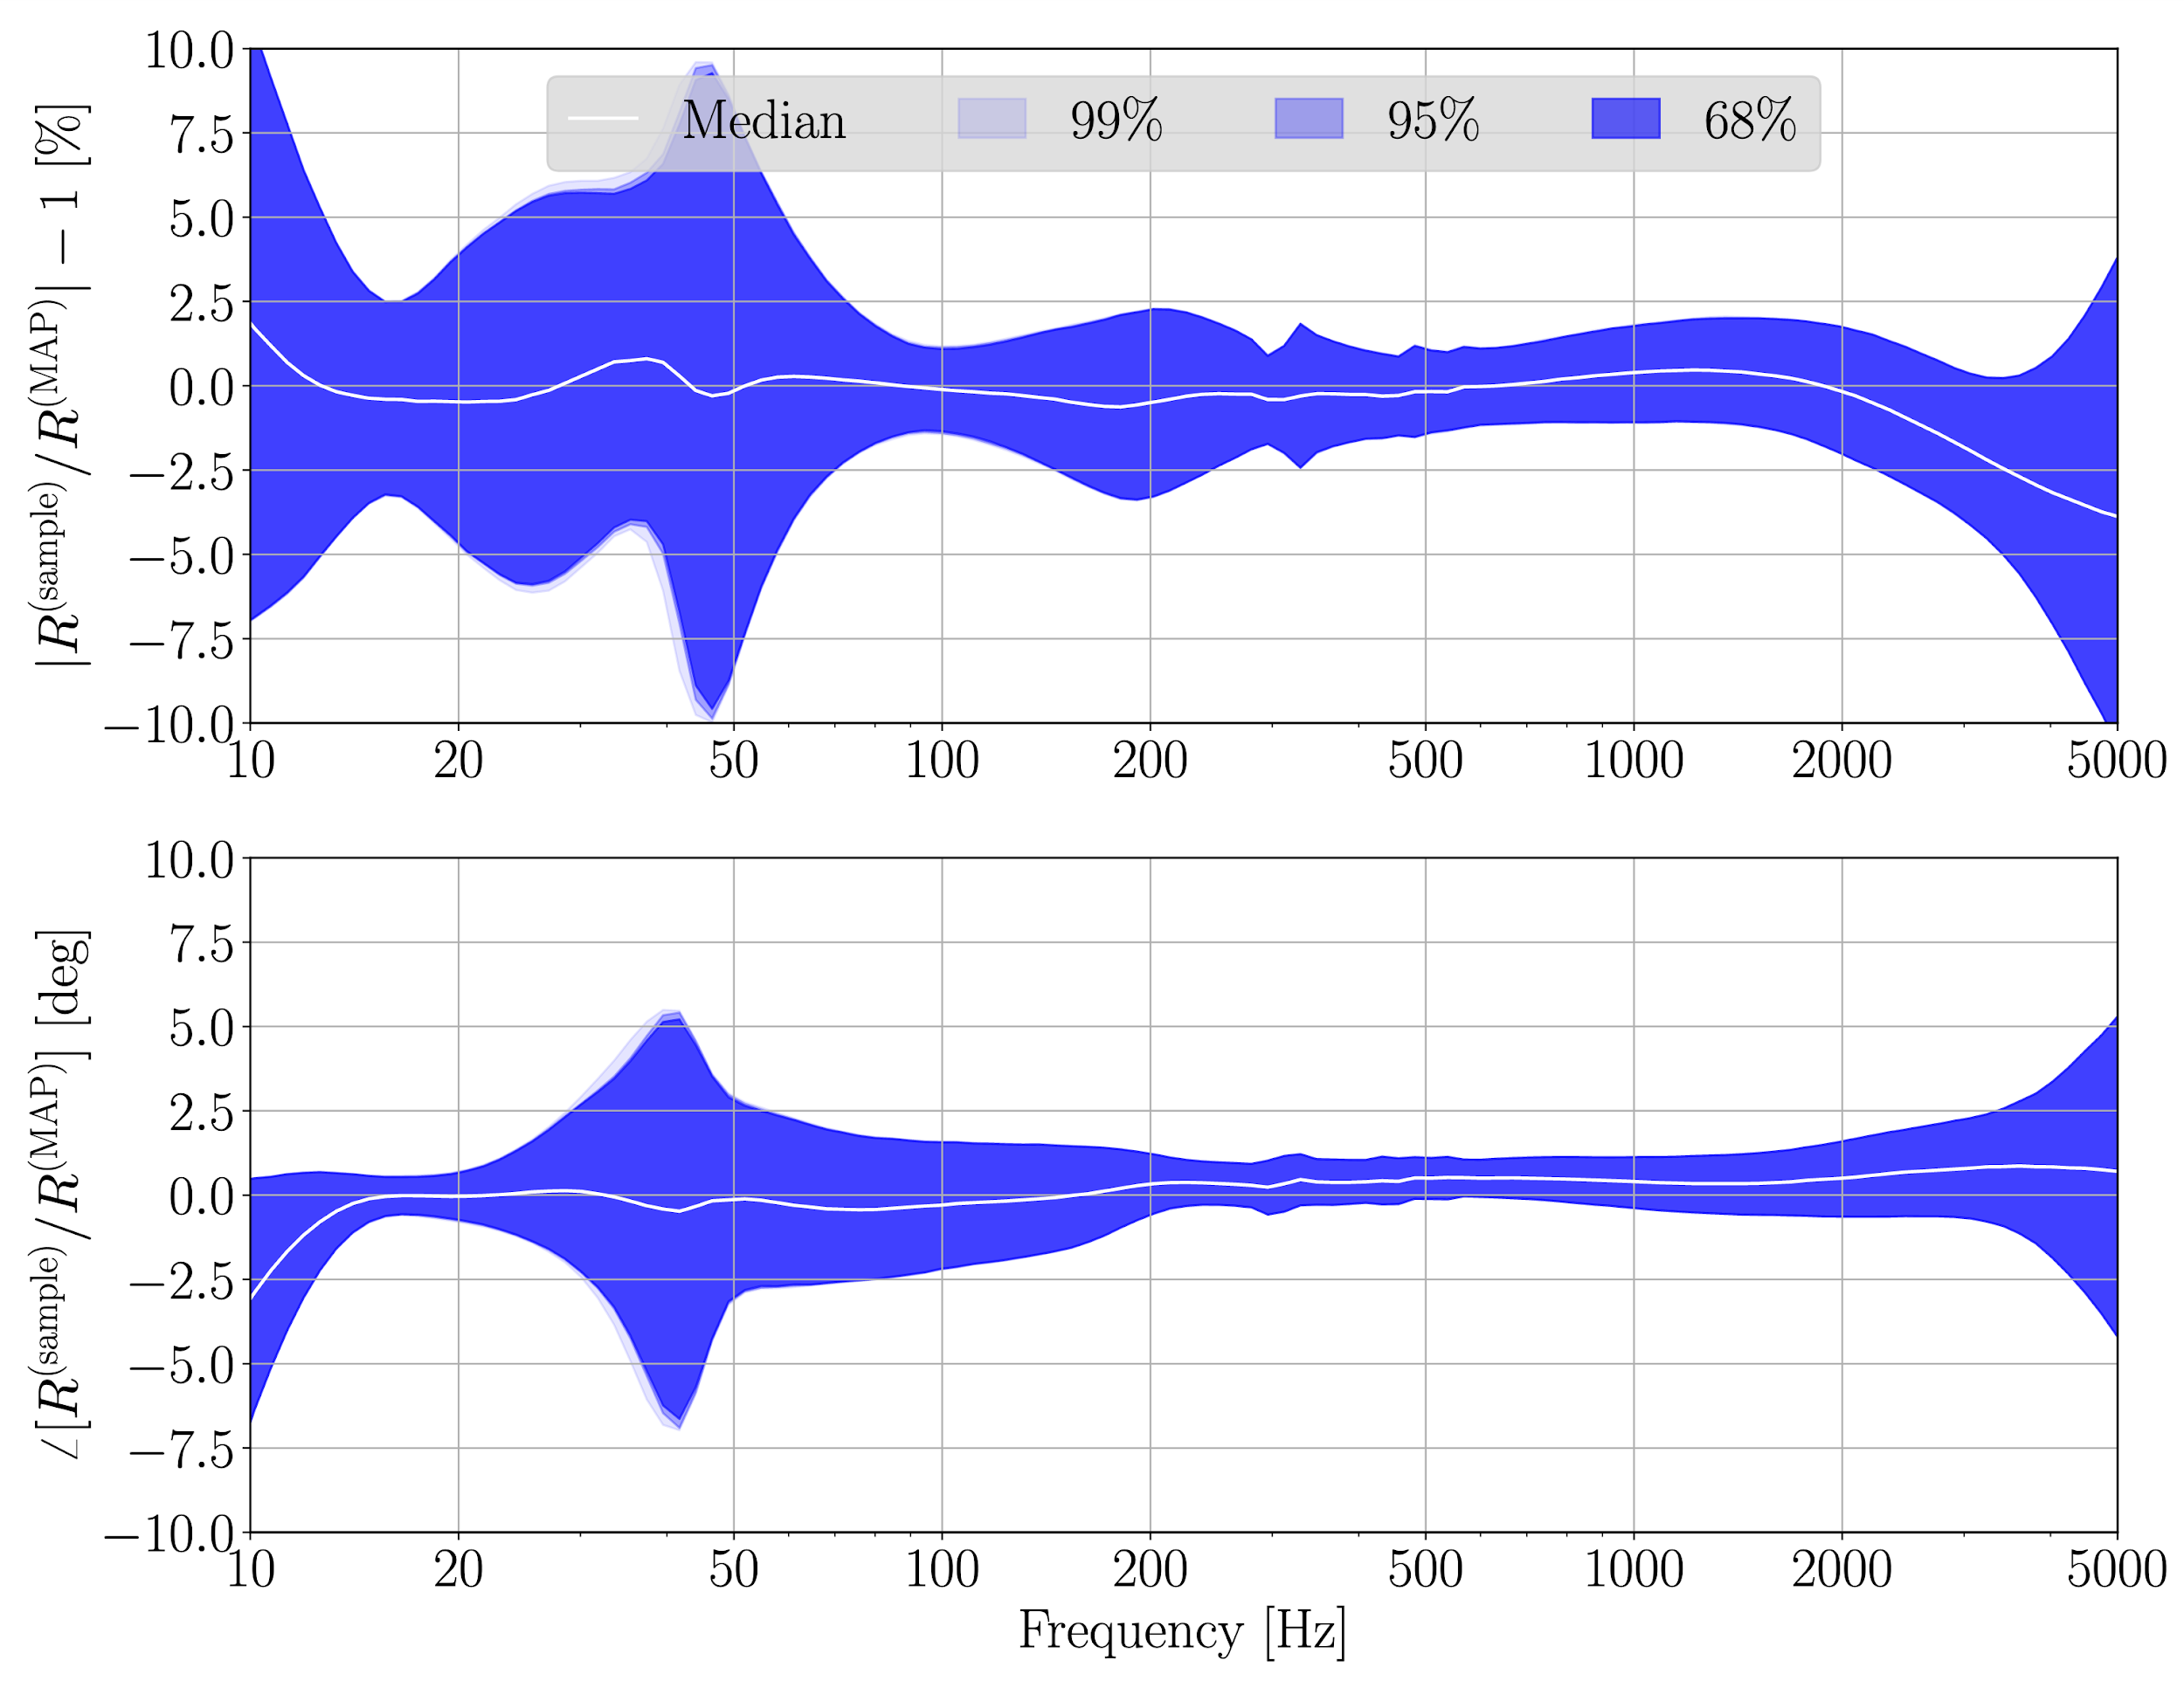
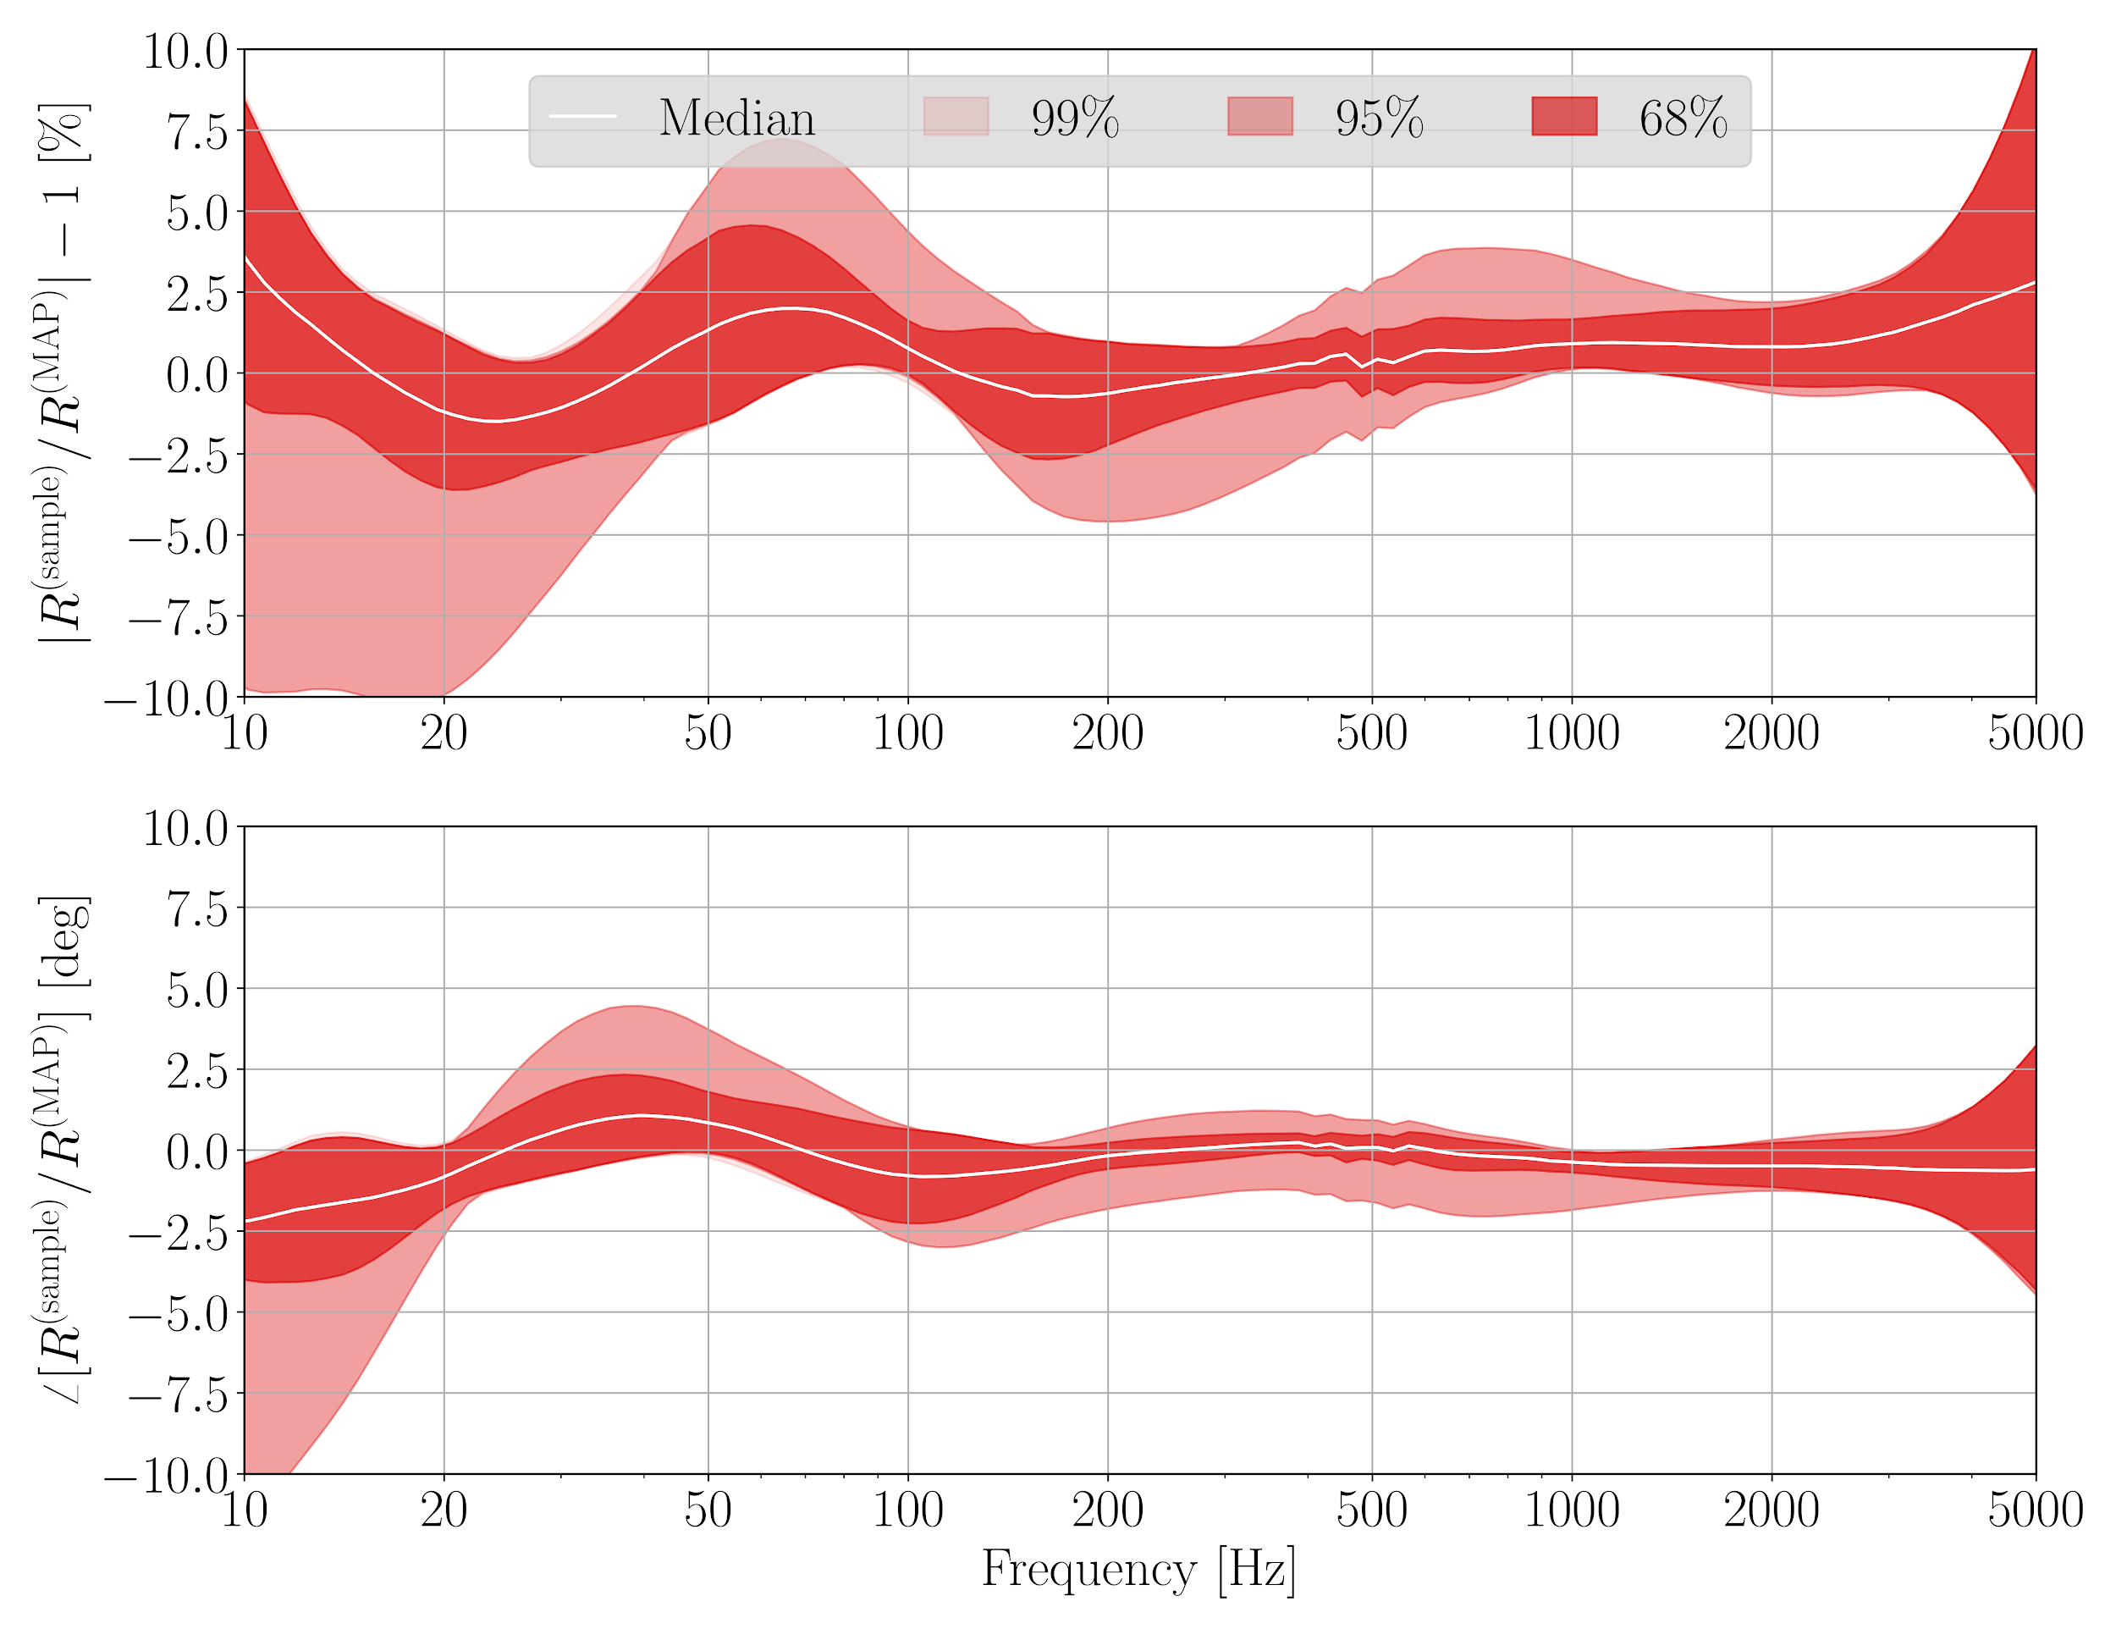
What’s the State of the Art?
This is our “final answer:”
The (relative), complex-valued, frequency-dependent, estimated systematic error in the model with assigned 68% confidence interval contours every hour of observation time.
Stack contours for month-long periods in which the detector is stable, and (at each frequency) compute percentile statistics to determine the 50th (the median systematic error), and the 16th and 84th (the 68% c.i.) percentiles.
Numerically evaluated distribution of error
Reference Model
O3B, Chunk 1
Nov 01 2019 to Jan 14 2020
O3B, Chunk 2, Period b
Feb 11 2020 to Mar 16 2020
For historical reasons, for long duration searches, and for “that one obligatory sentence in your paper” we quote a “worst case excursion from perfect over the entire frequency band” as a “better than XX% / YY deg.”
For each transient GW event, CBC parameter estimation group folds in a spline interpolation of these contours from the nearest hour.

Slide 20
What’s limiting the State of the Art?
The primary sources of systematic error are “things we thought we could ignore as negligible.”
Thermalization, detuning, and cross-coupling effects in the opto-mechanical transfer function in the Sensing Function -- especially at H1.
Poorly compensated electronics transfer functions and/or unexpected change in response from electronics configuration switch
Design choices in the actuation authority distribution -- especially at L1
Dynamics of the UIM
O3B systematic error is decidedly *not* limited by
The fundamental reference’s uncertainty or error (currently at 0.41 and 0.47%)
The number or SNR of measurements
HALP!

Slide 21
Absolute Displacement References

Slide 22
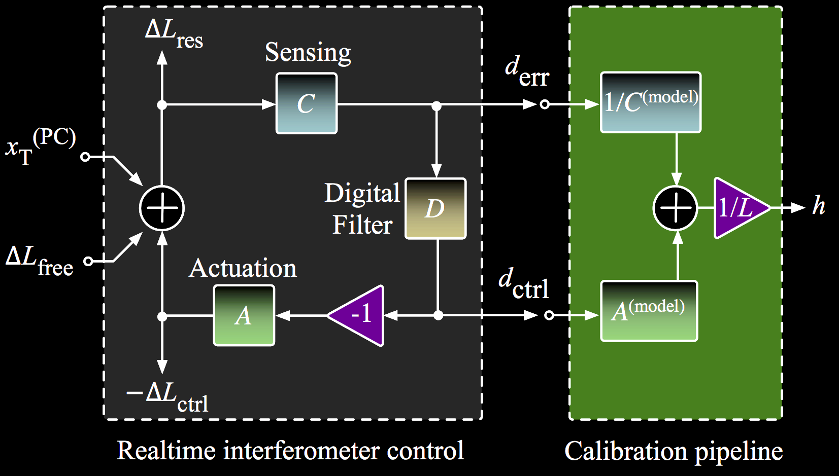
Absolute Reference: Radiation Pressure
RSI 87.11 (2016): 114503

Slide 23
The International Reference Exchange
“Working”
Standards
“GOLD”
Standard
ETMY
RX
TX
H
ETMX
RX
TX
“Propagation of reference” program, with over ~10 years of experience, led by Rick Savage at LHO.
KAGRA has already joined the reference comparison program. VIRGO has begun discussions of doing so.
Mitigates differential scale error between detectors (single event: Sky Position)
Still leaves vulnerability to common scale error (single event: Distance)
L
K
V
iLIGO: CQG 26.24 (2009): 245011.
aLIGO: RSI 87.11 (2016): 114503

Slide 24
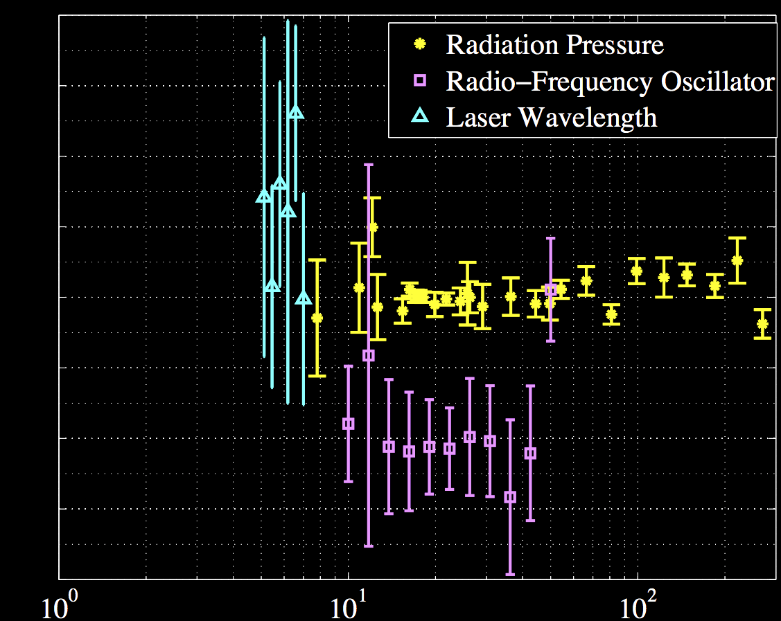
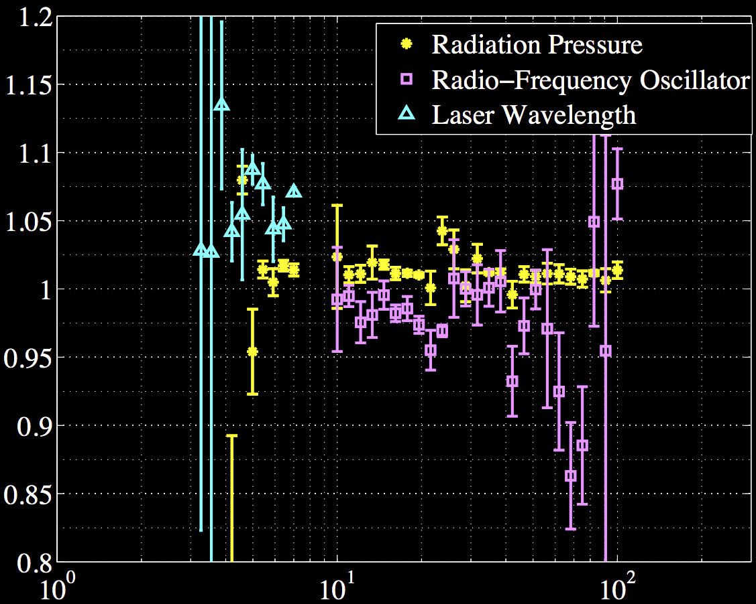
In-House PCAL Reference Check
FSM
FSM
PCAL
PCAL
ALS
L1
ALS
H1
Frequency
Frequency
Free-swinging Michelson doesn’t work well for LIGO. ITM must drive at PUM, too weak a drive.
Arm Length Stabilization is too noisy, and electronics weren’t well understood at the time.
Checks are not (yet?) precise.
Plans are to revisit this for O3.
Appendix of PRD 95.6 (2017): 062003.

Slide 25
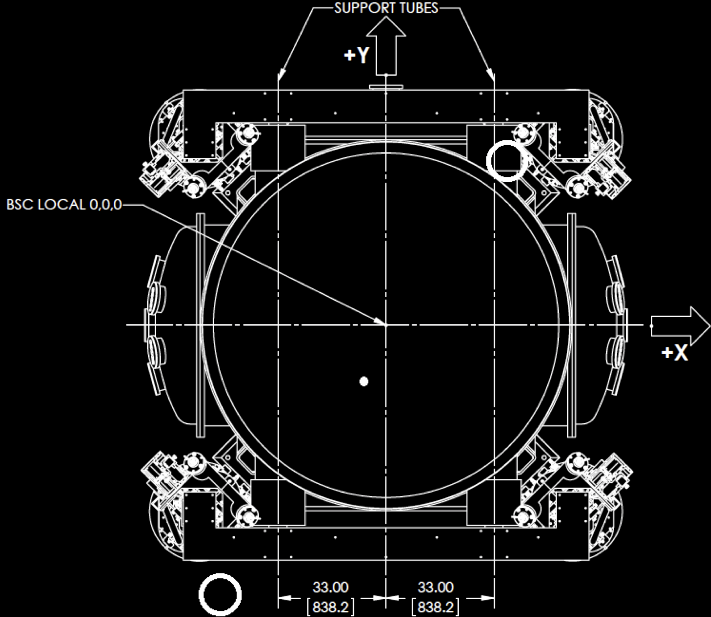
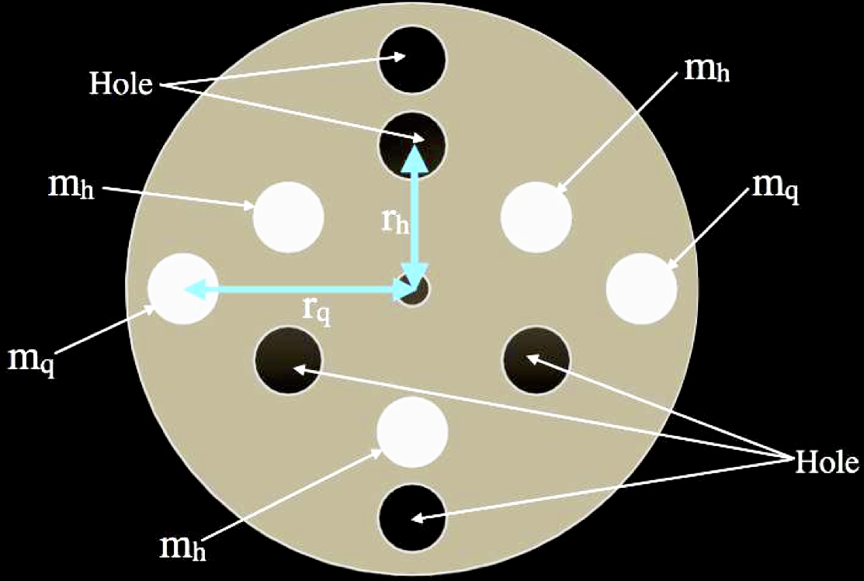
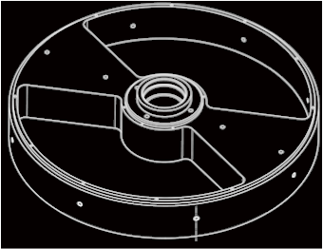
Terrestrial Detectors: The Next “New” Idea
m
Mirror
Newtonian Gravitational Calibrators (NCAL, GCAL) have recently (re)-picked up steam
In-theory a ~0.1% level reference
PCAL starts at ~0.5%
May be ready to corroborate PCAL by O3
2r
d
Basic Principle
m
x(t) = C cos(4πf_{rotor}t)/(d⁴ f_{rotor}²)
α
where C = (9G/32π²)(z ρ sin(α)(r_{max}⁴- r_{min}⁴)/4)
r_{max}
r_{min}
KAGRA – PRD 98.2 (2018): 022005.
VIRGO – CQG 38.7 (2021): 075012
LIGO – PRD 104.8 (2021): 082006.

Slide 26
Inspirational “what ifs”

Slide 27
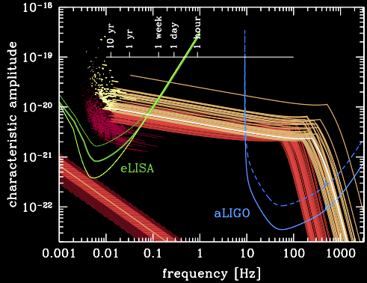
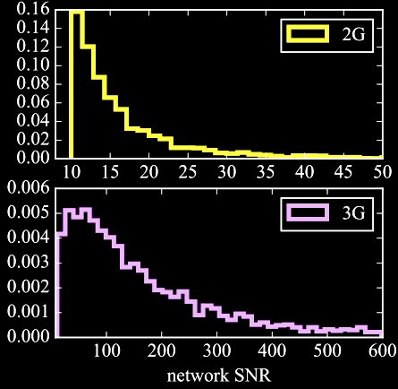
Inspiration
2G , 3G, Space, and PTAs
will have events with SNRs of O(~100)…
…Detector calibration must get better than ~1%
And if multi-band, we must understand each other’s systematic errors.
PRD 94.12 (2016): 121501
PRL 116.23 (2016): 231102

Slide 28
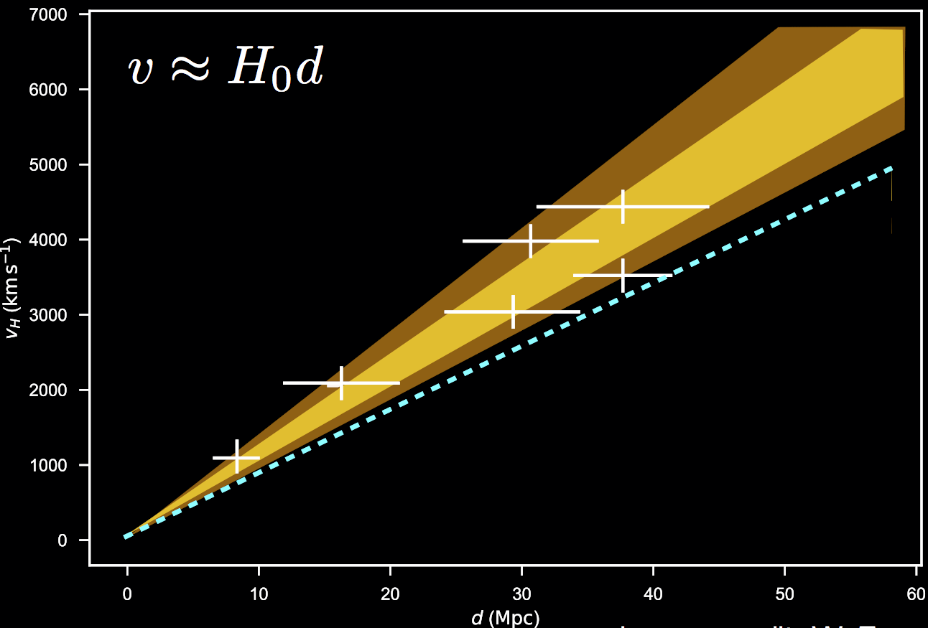
Cosmology and Correlated Systematic Errors
Toy Future BNS Detections…
Correlated Systematic
Error...
Reported H₀
True H₀
Could get H₀ wrong...
From G1800504

Slide 29
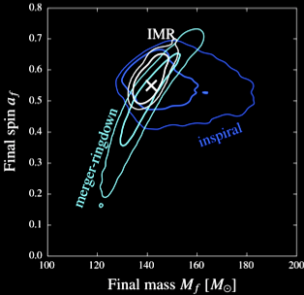
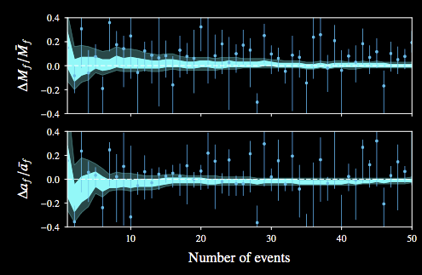
Tests of GR and Correlated Systematic Errors
Similar systematic error across events may lead you astray in GR consistency checks
Will not get SQRT(N) improvement, because calibration’s systematic errors (biases) are correlated b/w events.
Will need to consider calibration uncertainty and systematic error over several events, several observation runs as the detector hardware changes
CQG 35.1 (2017): 014002.

Slide 30
LISA RESOURCES (THAT I KNOW OF)

Slide 31
Time Delay Interferometry Papers
Tinto, Massimo, and Sanjeev V. Dhurandhar. "Time-delay interferometry." Living reviews in relativity 17.1 (2014): 6.
Hellings, Ronald W. "Elimination of clock jitter noise in spaceborne laser interferometers." Physical Review D 64.2 (2001): 022002.
Armstrong, J. W., F. B. Estabrook, and Massimo Tinto. "Time delay interferometry." Classical and Quantum Gravity 20.10 (2003): S283.
Tinto, Massimo, Frank B. Estabrook, and J. W. Armstrong. "Time-delay interferometry for LISA." Physical Review D 65.8 (2002): 082003.

Slide 32
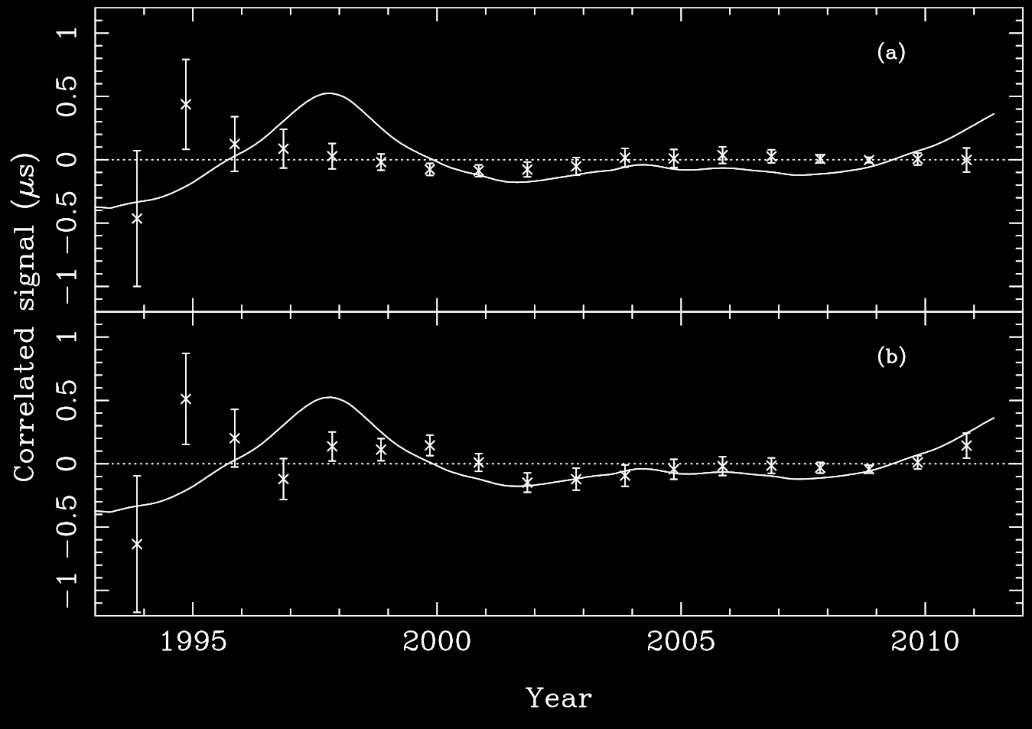
Example Timing System Systematics
Pulsar Timing Data, Systemic Errors in Solar System Ephemeris
TT(BIPMyy) - TT(TAI) ,
quadratic polynomial removed
Pulsar Timing Data, w/ modeled realization of GWB ~ 10⁻¹⁵ level
TT = Terrestrial Time
BIPM = Bureau International des Poids et Mesures
TT(TAI) = International Atomic Time -> Basis for UTC
TT(BIPMyy) -- updates / corrections, released over time
MNRAS 427, 2780–2787 (2012)

