Slide 1
Determining the Feasibility of Matched Filter Searches for Core-Collapse Supernovae
LIGO-T2200224-v1
Pavani Jairam
Mentor: Ryan Magee

Slide 2
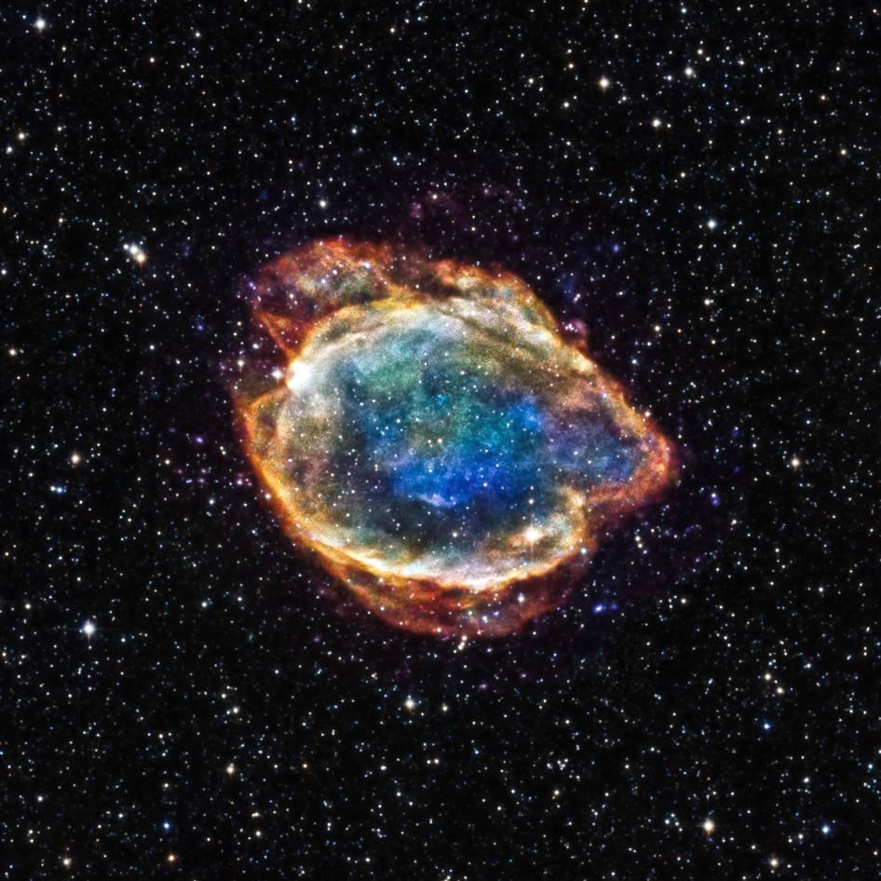
Gravitational Waves from Supernovae
Death of a high mass star
Rare, violent phenomenon - possible source of gravitational waves (GWs)
Accretion disks are gravitationally unstable
Mechanisms unknown
Neutrinos, photons, and GWs?
g-mode emission of proto-neutron star (PNS)
Random bursts from the accretion disk inflows
Goal: determine whether matched-filter searches can be used for detecting GWs from supernovae
Credit: NASA
Notes:
Gravitational pressure and degeneracy pressure balance each other - degeneracy pressure limit met
As the collapse of the core accelerates, there is a bounce when the nuclear forces become repulsive, creating a shock wave through the outer layers of the star.
Supernova - high energy process

Slide 3
Motivations
Stochasticity underlying issue for modeling supernovae
Current supernova searches
Weakly modeled
Algorithms used: Principal Component Analysis, machine learning, coherent WaveBurst
Our approach:
Test feasibility of matched-filter searches
Cover parameter space of supernova
Notes:
Weakly modeled searches
Matched filter search, not generic search

Slide 4
Modeling Supernova Waveforms
Mimic random bursts from the accretion disk inflows
Damped harmonic oscillator with a random forcing
Differential equation models g-mode GW emission from Astone et. al (2018):
Parameters restrict omega
Acceleration causes randomness of model
Acceleration
Notes:
Model assumptions built into frequency evolution

Slide 5
Supernova Waveform Parameters
Parameter | Description
tini | start of the signal relative to the bounce
tend | end of the signal relative to the bounce
t2 | time that the frequency polynomial is maximum
f0 | frequency at the start of the signal
f1s | frequency of the signal one second after the bounce
fdriver | driving frequency
Q | ratio of energy stored to energy lost per cycle
Notes:
Parameters tied to physical nature of supernova
Set by simulation
triggers per unit time from random forcing / inflows
7 parameters, usually 4 used in normal search (which uses align components, spin)
Parameters drive from numerical simulations - paper follows, we test

Slide 6
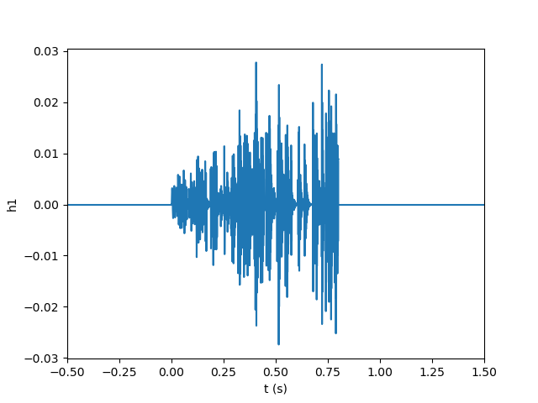
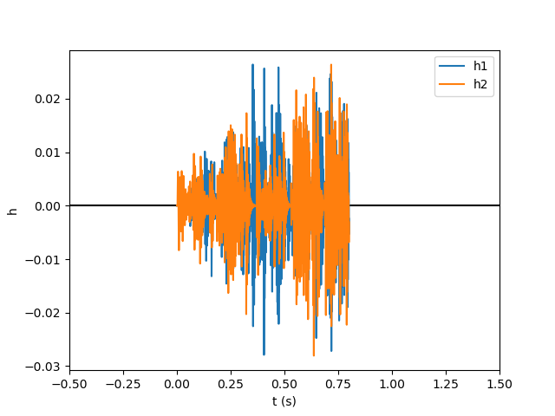
Comparing Supernova Waveforms
Simulated Parameters
tini | 0 s
tend | 0.8 s
t2 | 1.25 s
f0 | 100 Hz
f1s | 700 Hz
fdriver | 200 Hz
Q | 10
Same parameters, but different waveforms due to stochasticity
Notes:
randomness of model (cannot control directly)

Slide 7
Template Bank
Describes parameters interested in searching for
Cover 7-dimensional parameter space
Choose set of points with high similarity in parameter space
Sample space discretely
Notes:
Cover shape - cannot cover smoothly doing search at once
Sample manifold discretely

Slide 8
Maximizing Overlap Over Time
Quantify similarity between two waveforms
Value between 0 and 1 (0 is orthogonal, 1 is the same waveform)
Find time that overlap is maximized (match)
Fourier transform
Power spectral density (PSD)

Slide 9
Testing Feasibility of Matched Filtering
Methods:
Fix randomization and time windows, change one parameter
f0, f1s, fdriver, Q, t2
Smaller time windows -> expect higher overlap
Less perturbations with less time
7-Dimensional space
2-Dimensional space
Notes:
Test parameters - vary one at time
Want to be able to test smaller time windows

Slide 10
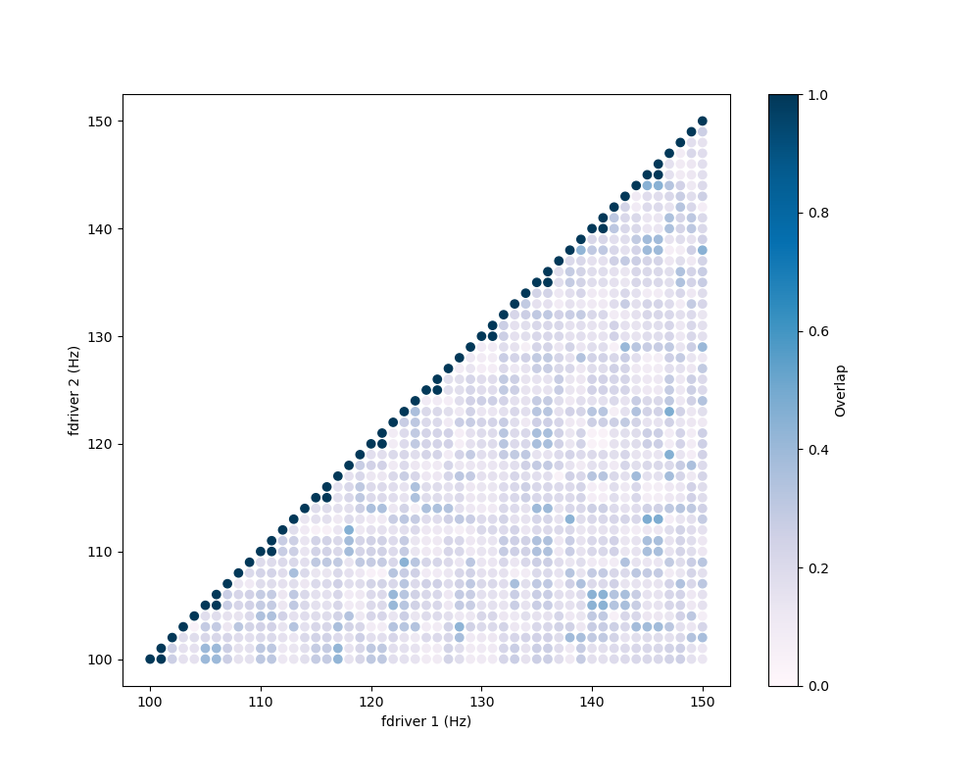
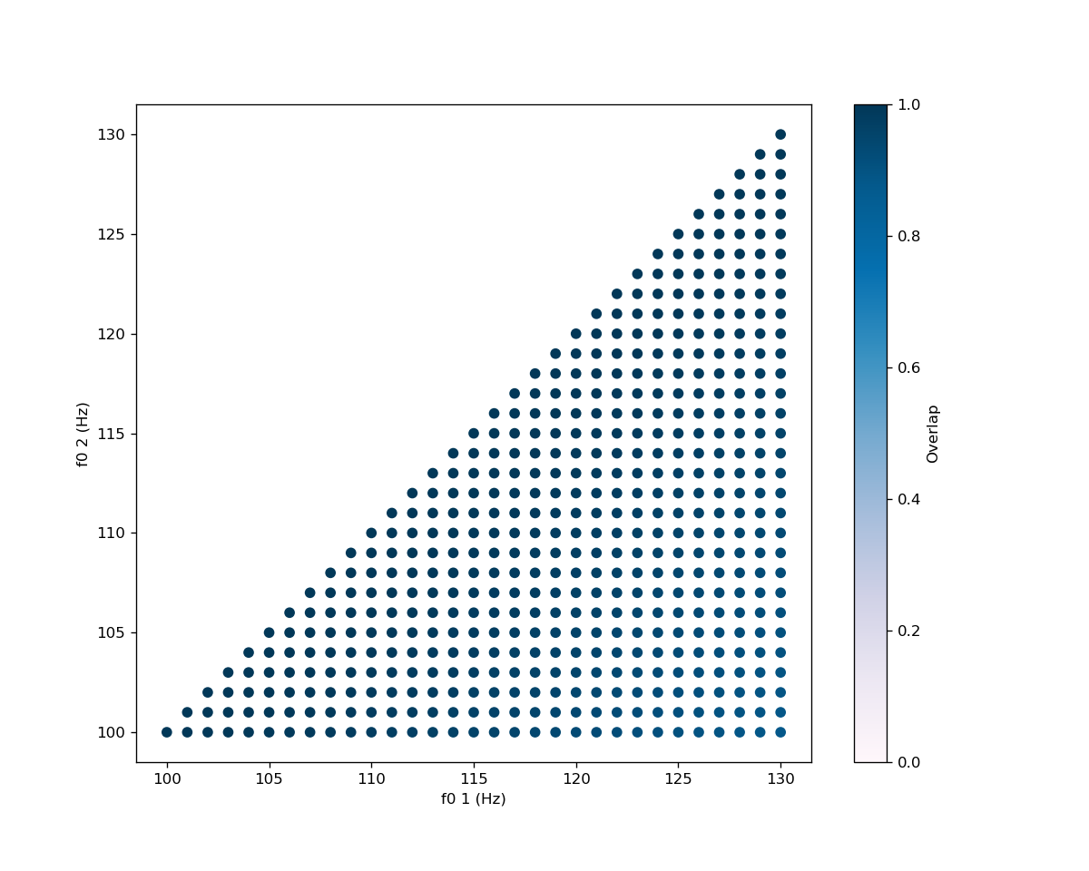
fdriver and f0 parameter spaces
Notes:
High overlaps are achievable with this model
Things are looking good for creating a template bank

Slide 11
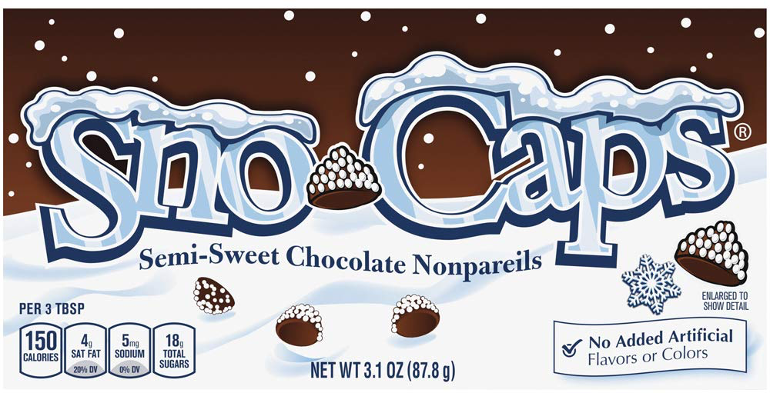
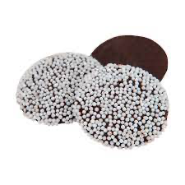
SNoW CaPS
SuperNova Waveforms for Calculating the Parameter Space
waveform.py
snoverlap.py
snowbank.py
Goal: Generate template bank for 7-dimensional parameter space of supernovae
Notes:
General process of code - generate waveform like before, script to generate overlap, then template bank generation
Distinct connected parts of the project
Make a waveform
Quantify similarities
Develop sampling algorithm
All parts dependent on previous part

Slide 12
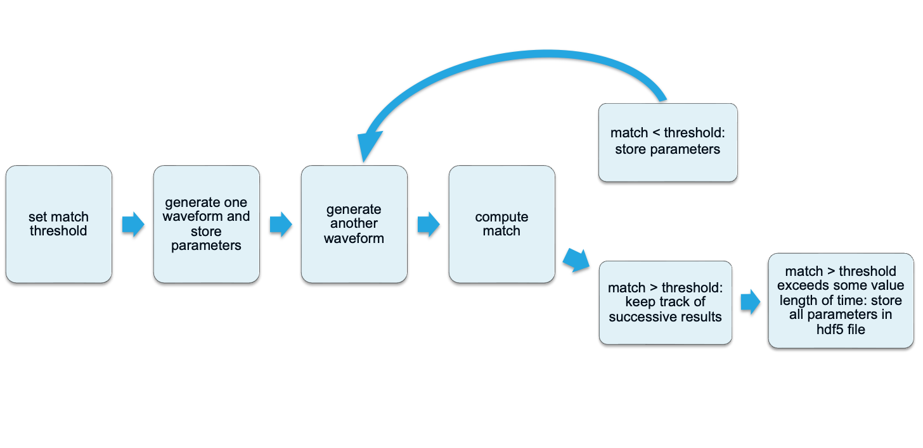
Template Bank Algorithm

Slide 13
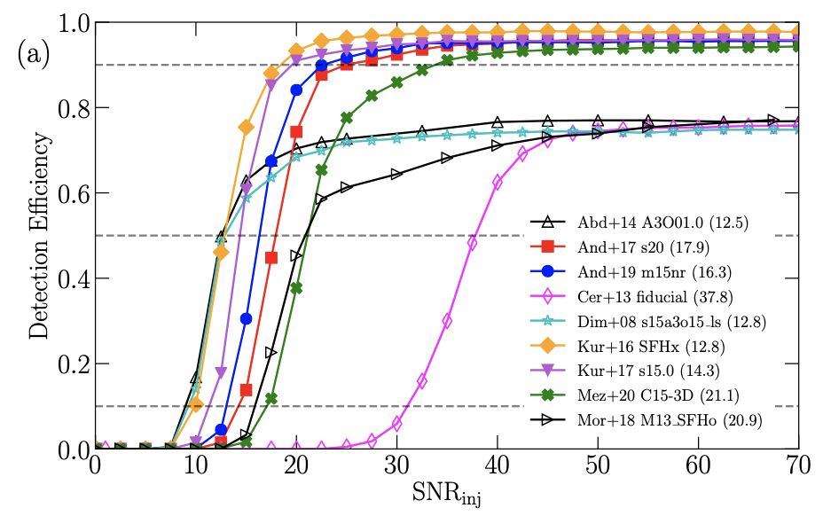
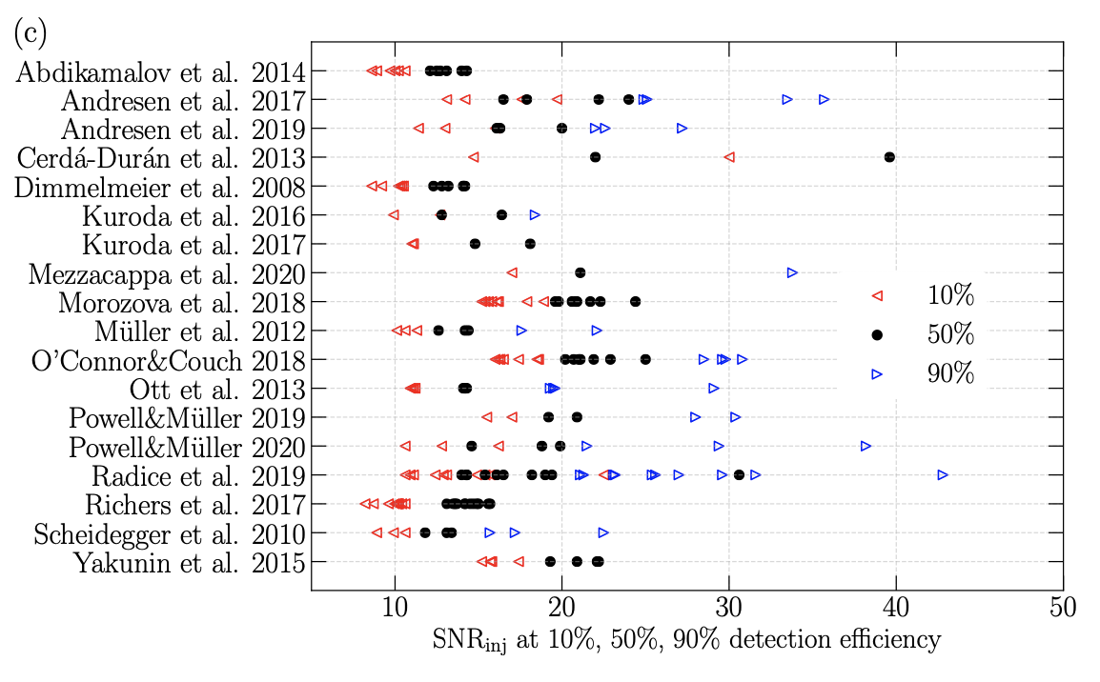
Astrophysical searches
Shorter signals are easier to detect
Achieve banks with match > 0.97 within 1,000-10,000 realizations
A recent review on SN detection strategies...
Credit: Szczepańczyk et. al (2018)
Notes:
Even with randomization, high overlaps are achievable
Not much signal loss w high match
Shorter signals - higher efficiency as shown in Szczepańczyk et. al (2018)

Slide 14
Conclusions and Future Work
Matched filtering is feasible so far!
High overlaps are achievable for template banks
Randomized inflows and randomized time windows
Next steps…
Compare to numerical relativity simulations
Compare Astone et. al (2018) based model to other models
Notes:
Compare to numerical relativity simulations - to see if model is general so far
Modeling emission well, low loss of signal

Slide 15
Acknowledgements
I would like to extend my thanks to:
Ryan Magee
Derek Davis
LIGO SURFs
Alan Weinstein
National Science Foundation
NSF REU Program
California Institute of Technology
LIGO Summer Undergraduate Research Program
LIGO Lab

Slide 16
Thanks! Any questions?

Slide 17
Backup Slides

Slide 18
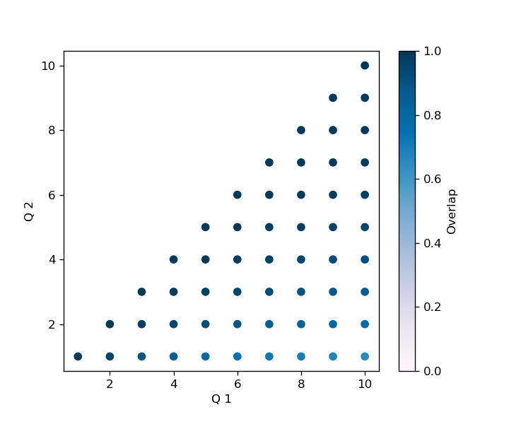
fdriver and Q parameter spaces
Notes:
Old plots from previous prez
Highlight that good overlaps are achievable w this model

Slide 19
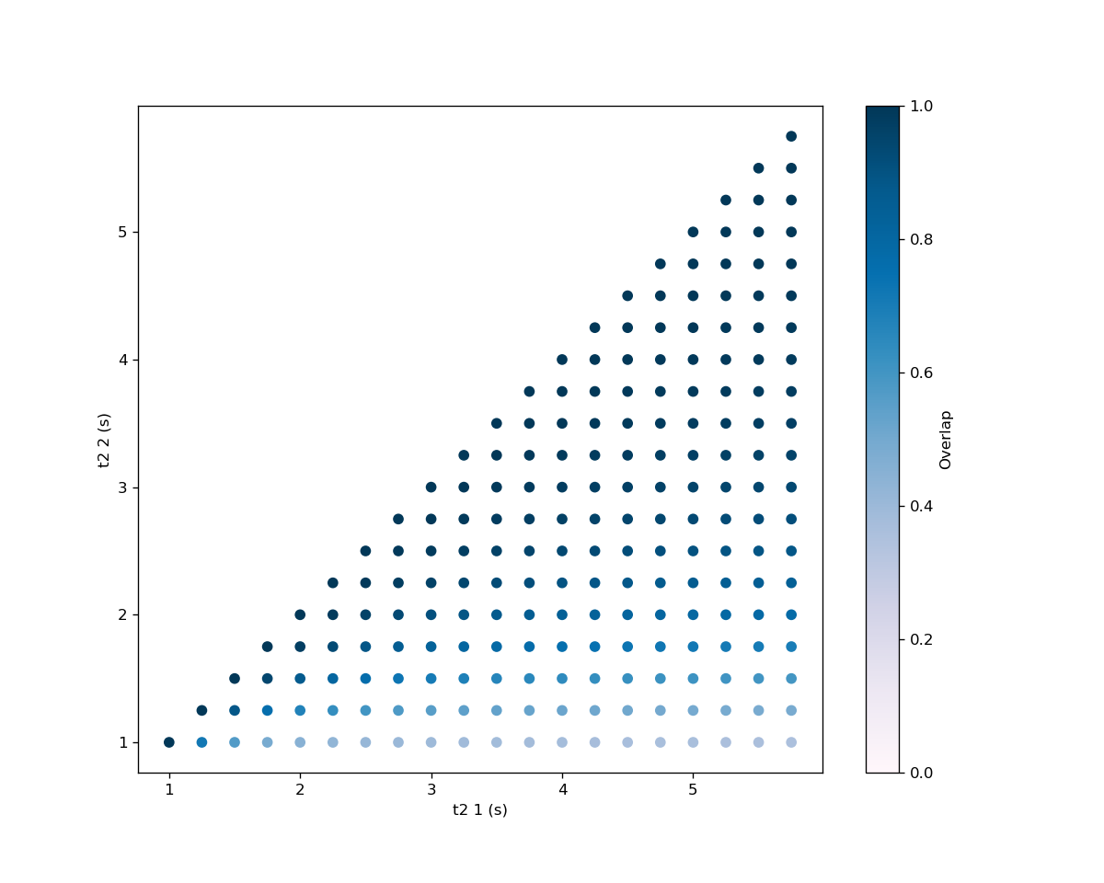
t2 and f0 parameter spaces
Notes:
New and improved

Slide 20
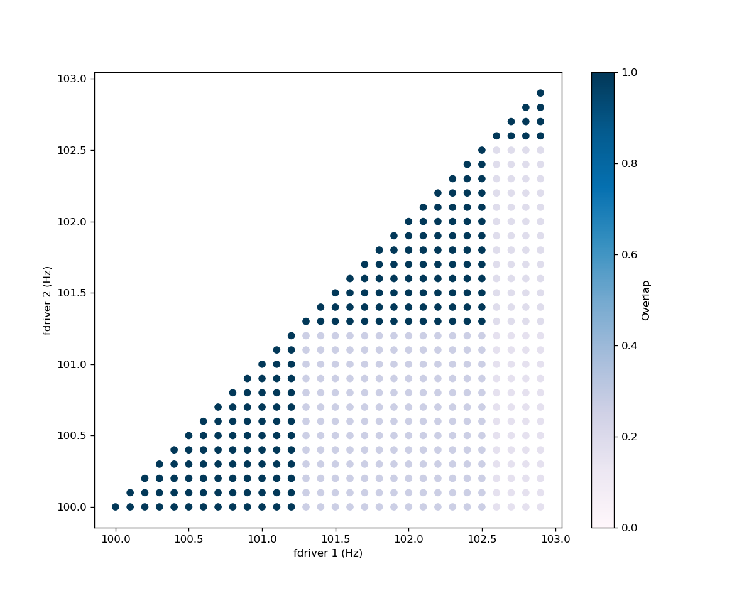
Smaller intervals of f0

Slide 21
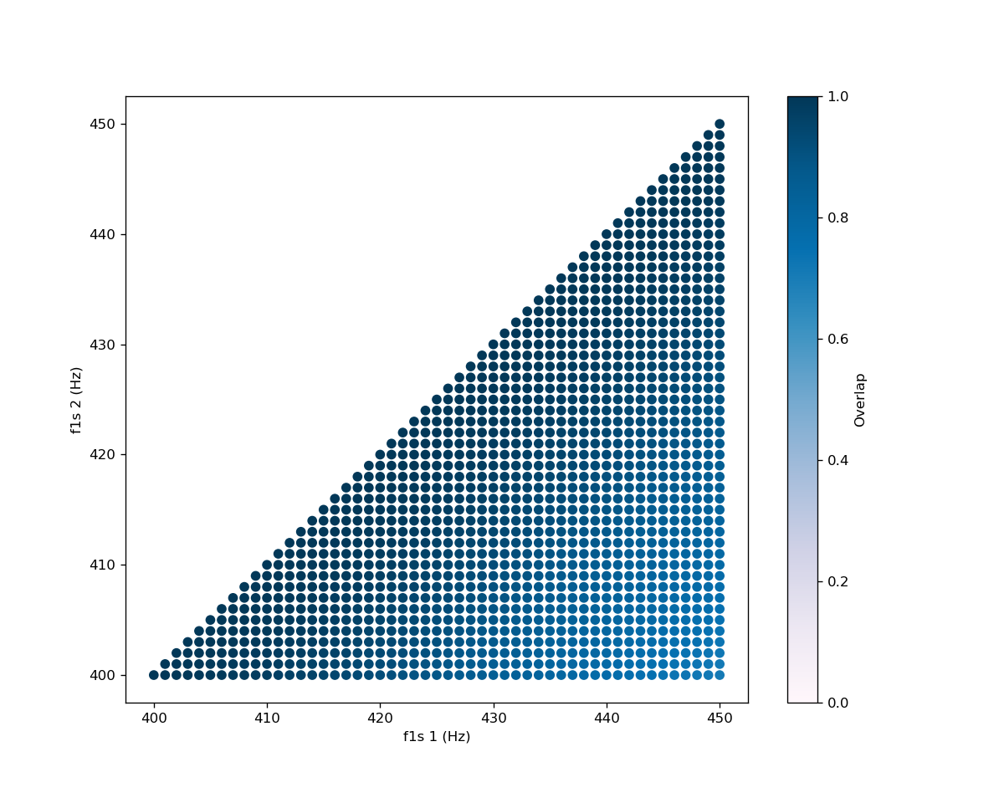
f1s parameter space
Notes:
New and improved

Slide 22
Optimizing Code
Generate many waveforms in short time
Original runtime of one overlap: ~4 sec
Downsampled from 16384 Hz to 2048 Hz
Divided out factor of 10 for the time step scaling
Decrease number of time shifts
Restructured code
New runtime: ~0.5 sec

Slide 23
Generating Template Bank
waveform.py
Generates one waveform realization
Based on Astone et. al model
snoverlap.py
Inputs two waveforms from waveform.py
Calculates match of two waveforms
snowbank.py
Saves array of waveform parameters in hdf5 file
Creates template bank
Utilizes two executables to create template bank and test the efficacy of the template bank
Notes:
Keep or saying everything on 11

Slide 24
References
[1] T. L. S. Collaboration and the Virgo Collaboration, (2016), 10.1103/PhysRevLett.116.061102.
[2] C. Messick, K. Blackburn, P. Brady, P. Brockill, K. Cannon, R. Cariou, S. Caudill, S. J. Chamberlin, J. D. Creighton, R. Everett, C. Hanna, D. Keppel, R. N. Lang, T. G. Li, D. Meacher, A. Nielsen, C. Pankow, S. Privitera, H. Qi, S. Sachdev, L. Sadeghian, L. Singer, E. G. Thomas, L. Wade, M. Wade, A. Weinstein, and K. Wiesner, Physical Review D 95 (2017), 10.1103/phys- revd.95.042001.
[3] K. Nakamura, S. Horiuchi, M. Tanaka, K. Hayama, T. Takiwaki, and K. Kotake, Monthly Notices of the Royal Astronomical Society 461, 3296 (2016).
[4] A. Burrows and D. Vartanyan, Nature 589, 29 (2021).
[5] D. M. Siegel, A. Agarwal, J. Barnes, B. D. Metzger, M. Renzo, and V. A. Villar, “”super-kilonovae” from massive collapsars as signatures of black-hole birth in the pair-instability mass gap,” (2021), arXiv:2111.03094 [astro-ph.HE].
[6] K. Rozwadowska, F. Vissani, and E. Cappellaro, New Astronomy 83, 101498 (2021).
[7] “LIGO, Virgo and KAGRA Observing Run Plans,” https://observing.docs.ligo.org/plan (2022), [On- line; accessed 15-May-2022].
[8] P. Astone, P. Cerdá-Durán, I. D. Palma, M. Drago, F. Muciaccia, C. Palomba, and F. Ricci, Physical Review D 98 (2018), 10.1103/physrevd.98.122002.

Slide 25
References (cont.)
[9] S. K. Sahay, “Studies in gravitational wave data analysis,” (2002).
[10] T. A. Apostolatos, Phys. Rev. D 52, 605 (1995).
[11] “GSTLAL psd.py,” https://git.ligo.org/lscsoft/gstlal/-/blob/master/gstlal/python/psd.py.
[12] B. Allen, W. G. Anderson, P. R. Brady, D. A. Brown, and J. D. E. Creighton, Phys. Rev. D 85, 122006 (2012). [13] M. J. Szczepańczyk, J. M. Antelis, M. Benjamin, M.Cavaglià,D.Gondek-Rosińska,T.Hansen,S.Klimenko, M. D. Morales, C. Moreno, S. Mukherjee, G. Nurbek, J. Powell, N. Singh, S. Sitmukhambetov, P. Szewczyk, O. Valdez, G. Vedovato, J. Westhouse, M. Zanolin, and Y. Zheng, Physical Review D 104(2021), 10.1103/physrevd.104.102002.
DDMF

