Slide 1
Testing Mass Distribution Estimation
of Binary Black Hole Mergers
Jingyi Zhang, Smith College
Mentors: Alan Weinstein, Jacob Golomb
LIGO SURF 2022
DCC: T2200254
Notes:
Greetings,
Mentors,
Project name

Slide 2
Notes:
Here is the plot that shows almost all the currently known stellar blackholes and neutron stars
Blue is gw, pink is more traditional electromagnetic wave observation
As a side note LIGO have 90 detections of BBHs so far, and we use rough 70 of them for our analysis that have lower uncertainty (flase alarm rate)
We can really see that LIGO enabled us to detect a lot more blackholes, and it also expand the range—larger mass and redshift range
Enable us to look at stellar black hole as a population, what is the blackhole population as a whole?
We might what to ask the question:
What is the possible mass range of BHs?
Is smaller one more common or larger ones more common? And now we have some guess on that

Slide 3
+
Pulsational pair-instability supernova (PPSN)
Initial Mass Function
(IMF)
Image Credit: NASA, ESA, CSA, and STScI
Notes:
Currently, the most common used model that describe black holes is motivated by two things
IMF of of stars. What it says is that the mass distribution of stars follow a power law, and smaller stars are more common and and the number of stars significantly drop with increasing mass.
Now, LIGO detect stellar black holes. Larger stars create larger black holes. We anticipate that stellar black holes should also follow a similar power law as the imf
PPSN. Very large stars, about 100 to 150 Msun would undergo explosion. No matter what the starting mass is , the remnant is a 45 Msun black hole, this process create a peak at the higher mass end of the black hole mass distribution. (Mention the picture from JWST, southern ring nebula, planetary nebula)
This goes both ways. We can study the blackhole population it self, how they formed, in what environment, through what channel do they form
We also get information about massive star evolution
Form the motivation, we have our mass model

Slide 4
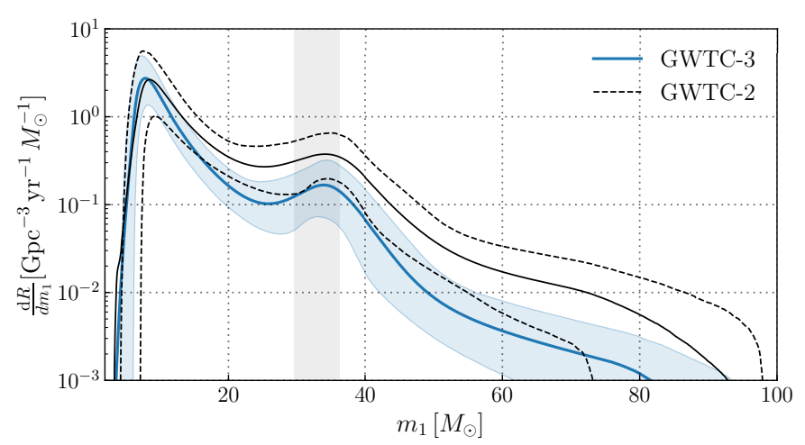
The Model
s
Notes:
We also have non-parametric models
Different motivations: broken IMF, high-lowmass cutoff (neutron star/blackhole boundary, hirerachical mergers, or random process we don’t know)
Here we show the mass distribution estimation/posterior using the powerlaw + peak model
The blue one is based on GWTC3, the black one is based on GWTC2
The shaded region is the 90 percent confidence interval
With more events in GWTC3, the uncertainty is smaller, and the features(especially the peak) are more prominent

Slide 5
$$𝓛\left(d | Λ\right)∝\frac{\prod_{i}^{N}{\int{dθ_{i}𝓛\left(d_{i} | θ_{i}\right)p\left(θ_{i} | Λ\right)}}}{{p_{det}\left(Λ\right)}^{N}}$$
Hierarchical Bayesian Inference
Notes:
I’m not going in to detail how we do the math here, but basically what we did is just take all our observation, estimate their property
Take these individual properties, generate a whole bunch of models based on our theory and use Bayesian theory to tell us how they behave
And now maybe you see there is some problem here: ppsn peak not in the right place
There’re still a lot that we don’t know yet.
Maybe there are more unexpected features, maybe our model needs improvement, and this is where the testing kicks in

Slide 6
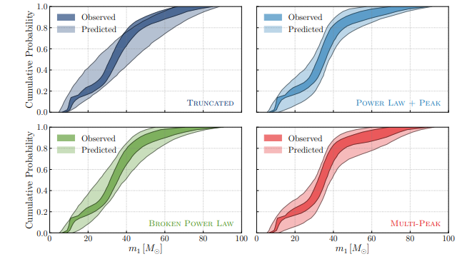
Leave-One-Out:
Which ones are the outliers?
How would they change the estimation?
Catch It!
Posterior Predictive Checks:
How good is our fit?
Does the model distribution looks like the estimated ones?
Which is a good model?
What’s This?!
Notes:
So exactly what am I testing? What do I do?

Slide 7
Notes:
So this is how leave one out tests work?
If we make a model prediction with all of them, we will have this,
We do that again and again, but each time, we exclude one events, and if the event is significantly different, aka outlier, we will have a very different result.
And our goal is this:

Slide 8
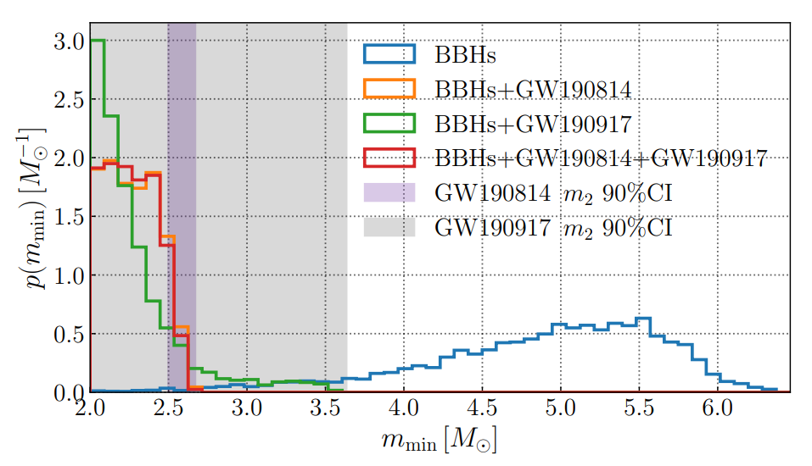
Leave-One-Out: The Known Ones
GW190814
GW190917
Significantly affect the minimum mass of stellar black holes.
Notes:
We have 69 events without these 2
Here is the known outliers.
The plot is a PDF
Basically no overlaps, meaning that the 69events in the blue curve can not predict the existance of these two outliers.

Slide 9
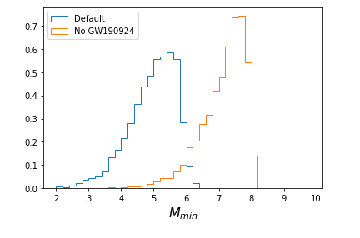
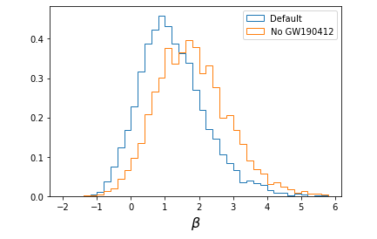
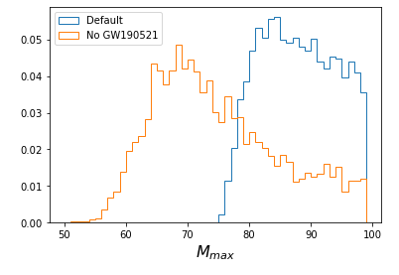
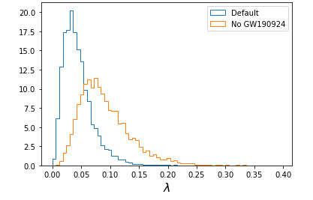
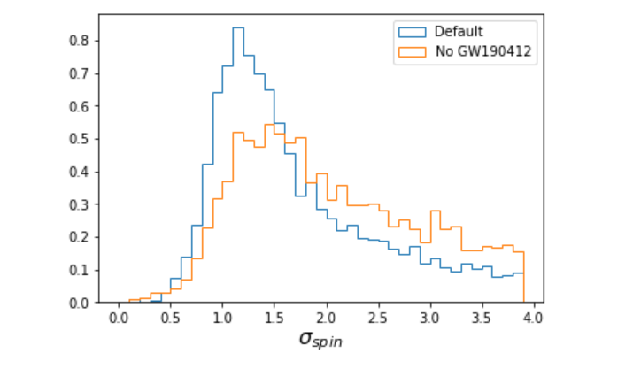
GW190924
Minimum Mass
Population In gaussian Peak
GW190521
Maximum Mass
GW190412
Mass Ratio
Tilt Angle
Notes:
Though we did not catch any outliers that are as significant as the previous two, there are some event of interests.

Slide 10
GW190924
Minimum Mass
Population In gaussian Peak
GW190521
Maximum Mass
GW190412
Mass Ratio
Tilt Angle
Notes:
GW190924 also have a low secondary mass.
Log scale

Slide 11
GW190924
Minimum Mass
Population In gaussian Peak
GW190521
Maximum Mass
GW190412
Mass Ratio
Tilt Angle

Slide 12
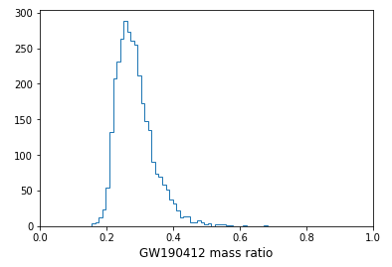
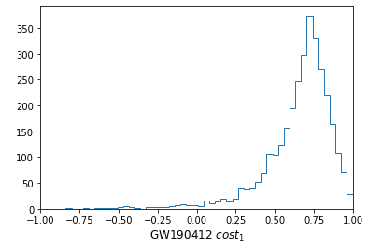
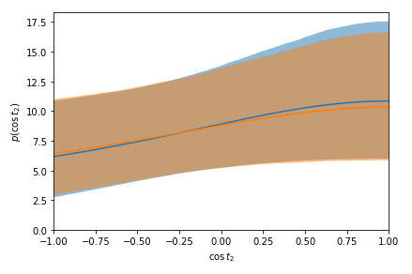
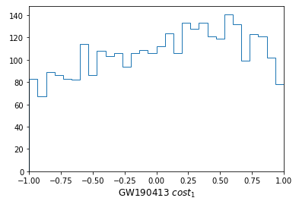
GW190924
Minimum Mass
Population In gaussian Peak
GW190521
Maximum Mass
GW190412
Mass Ratio
Tilt Angle
Mmin
Notes:
Not so much as an outlier but as an event with high constraining power.

Slide 13
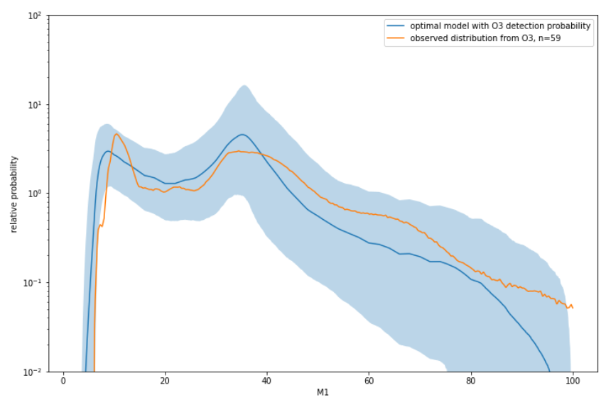
Posterior Predictive Checks: Initial Method
$$ℒ\left(d | Λ\right)∝\frac{\prod_{i}^{N}{P\left(d_{i} | Λ\right)}}{{p_{det}\left(Λ\right)}^{N}}$$
Take it out!
Notes:
Put the equation in

Slide 14
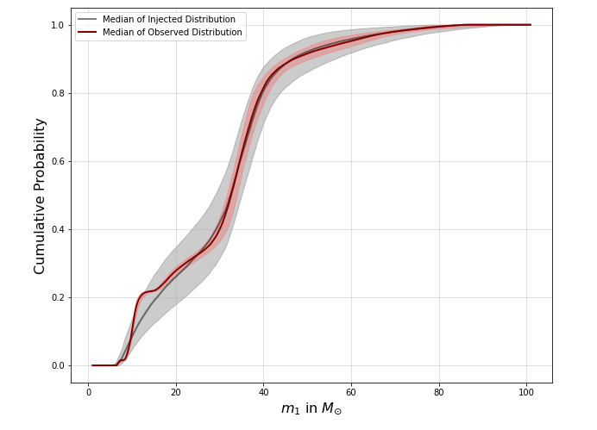
Posterior Predictive Checks: A Better Way
Sample Reweighting
$$π\left(θ\right)$$
From Population Inference
Predefined
“Uninformative”
$$p\left(θ | Λ\right)$$
Unified the Prior
“Power Law + Peak”
Notes:
Theta not lambda

Slide 15
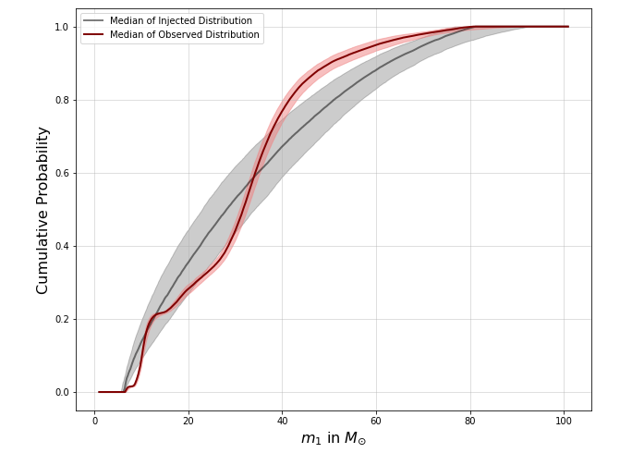
Posterior Predictive Checks: A Better Way
“Power Law + Peak”
“Truncated Power Law”

Slide 16
Summary: From Strain to the Universe
Black hole population tells us their formation channel and evolutionary path. Motivated by IMF and PPSN, we tested the Power law + Peak model.
Three potential outliers; GW190924, GW190521, and GW190412; are found; they could be evidence for multiple populations. Individual event can significantly lower the uncertainty—O4 will tell us more!
Posterior predictive checks shows under “Power Law + Peak” model, the observed and inferred population agree.

Slide 17
I am grateful for the support from: My mentors Alan Weinstein and Jacob Golomb, Ligo scientific collaboration, California institution of technology student faculty program, and the National science foundation. I also want to thank all of my fellow SURF students and all the graduate students and postdocs for this wonderful time.
Notes:
Ligo virgo logo
Nsf logo

Slide 18
Questions?

Slide 19
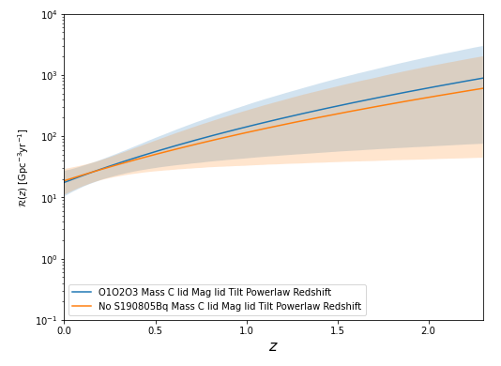
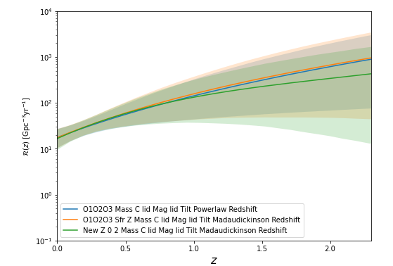
Redshift Evolution of Mass Distribution
GW190805 with redshift > 1
High constraining power
Madau-Dickinson Stellar Evolution Model. More accurate priors.

