Slide 1
GW strain calibration of LIGO detectors with high precision and low latencY
By: Naomi Shechter
Mentors: Ethan Payne and Dr. Alan Weinstein

Slide 2
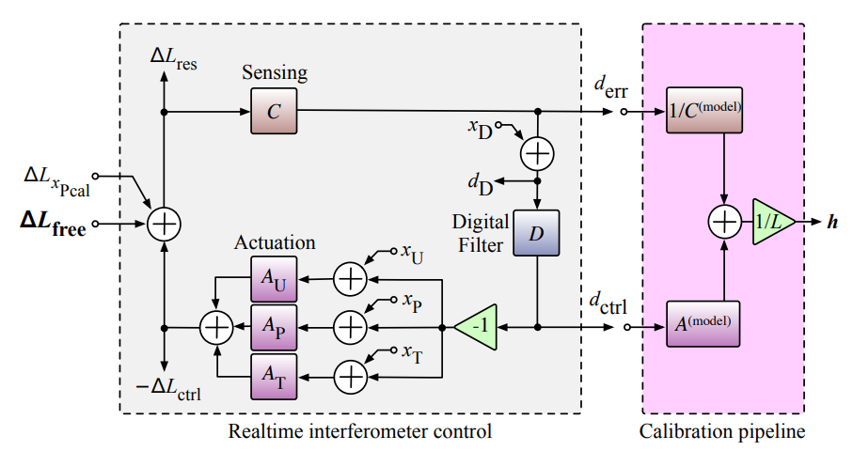
The Importance of Strain Calibration
One channel, out of thousands…
We want meaningful, unbiased results!
Multi-messenger / Parameter estimation
GR tests
Uncertainty: we know it to 2% in magnitude, 2° in phase. Photon Calibrators are our reference.
But our ‘measuring stick’ changes! Calibration helps us characterize Sensing, Actuation and the detector Response to strain.

Slide 3
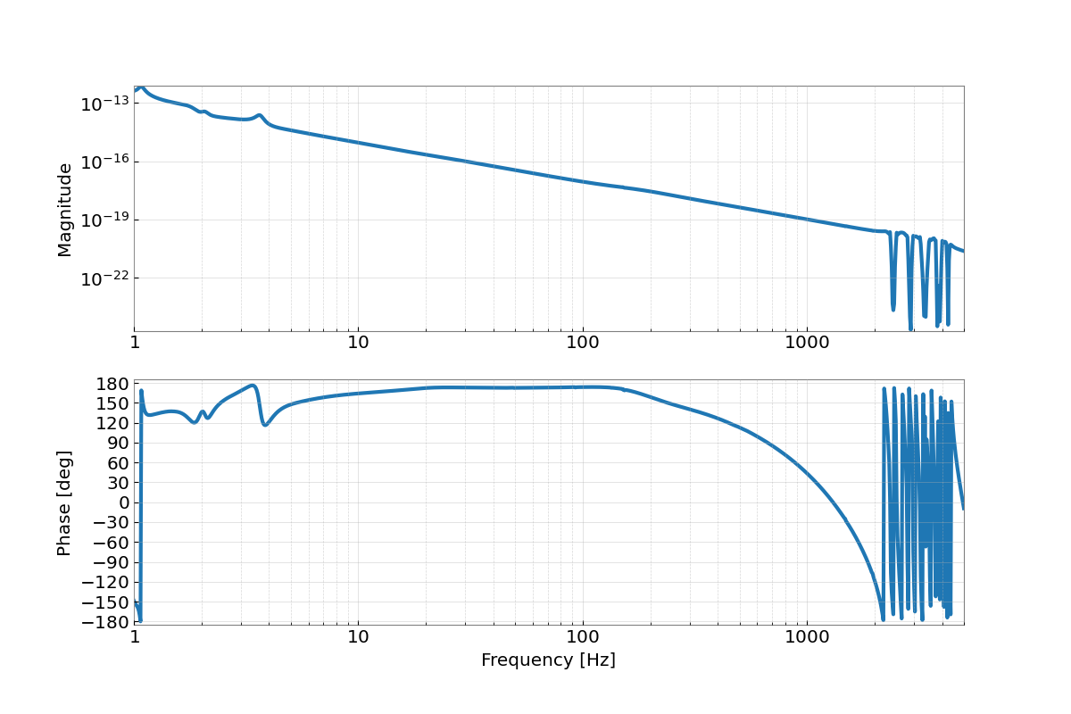
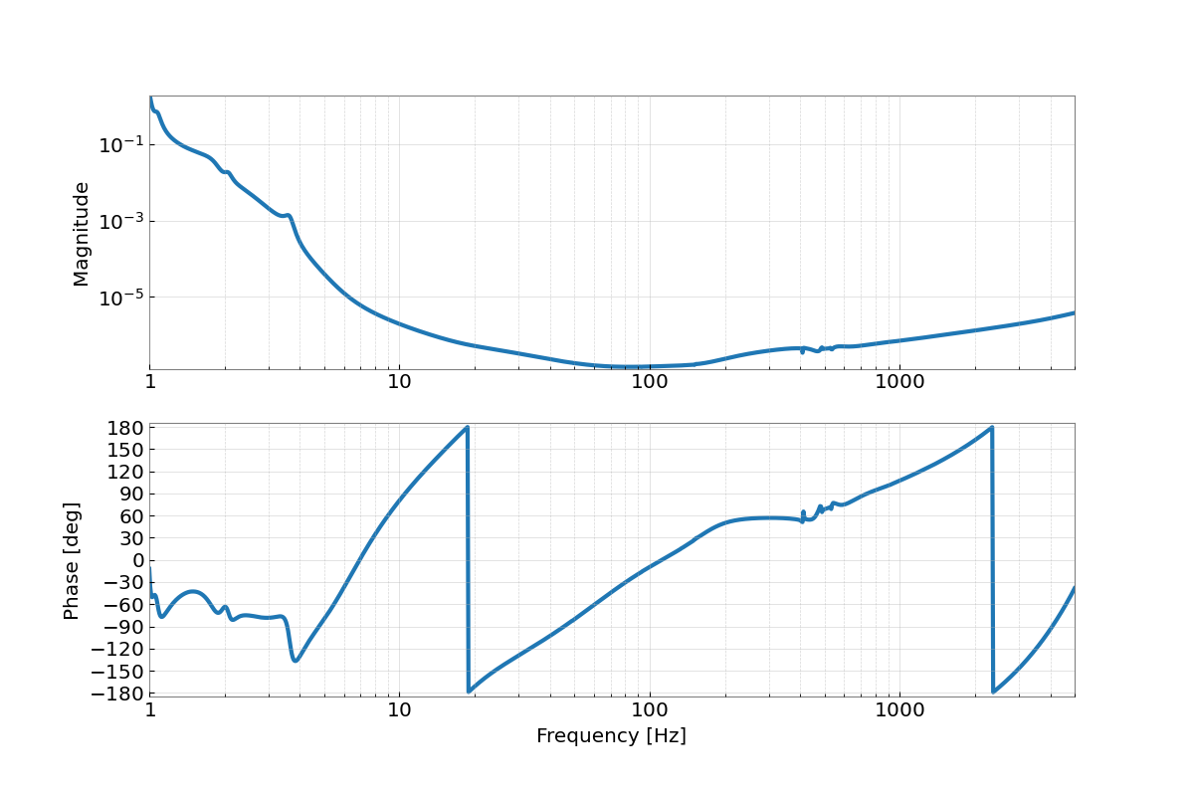
Sensing, Actuation, Response – 4/17/21
Decreases at f_cc (coupled cavity pole) – left side is unintended, due to signal recycling cavity!
Our actuation function attenuates lower frequencies to reduce seismic noise.
The response function.

Slide 4
The goal(S):
Background information.
Transfer old measurement files into pyDARM compatible .ini files.
Markov Chan Monte Carlo (MCMC): Bayesian Inference to determine parameters.
Gaussian Process Regression (GPR): characterize the uncertainty in parameters.
Uncertainty: combine the previous two methods.
Monitoring software
Time Dependent Correction Factors: the gain coefficient of the sensing function (k_c), actuation stage gain (k_tst, k_pum, k_uim), and the coupled cavity pole frequency (f_cc).
It should be a low latency, precise calibration uncertainty estimate, and the monitoring software should be both reliably and robustly, producing the estimate, diagnostics and any flags in less than an hour.

Slide 5
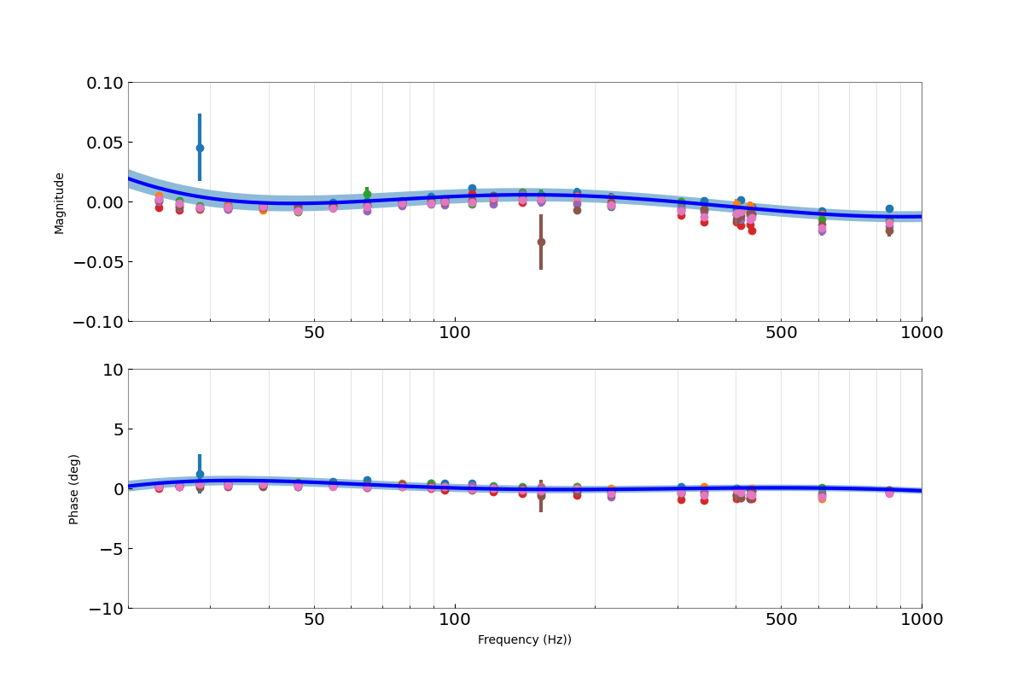
MCMC and GPR – 01/03/20
Maximizing likelihood function.
MCMC characterizes how well our data fits the model of the response function.
The points are all residuals.
Extract pole and gain parameters.
GPR takes full chain, interpolates and characterizes the uncertainty between the residuals and the model.
The envelope is ±1σ, so 32% of points should be encompassed.
When significant changes are made to a LIGO detector, we begin a new epoch, with a new model of the response function.

Slide 6
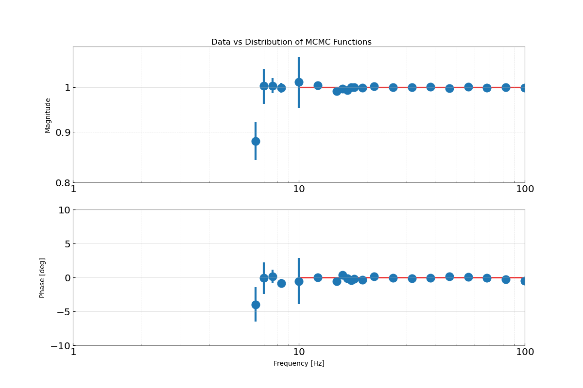
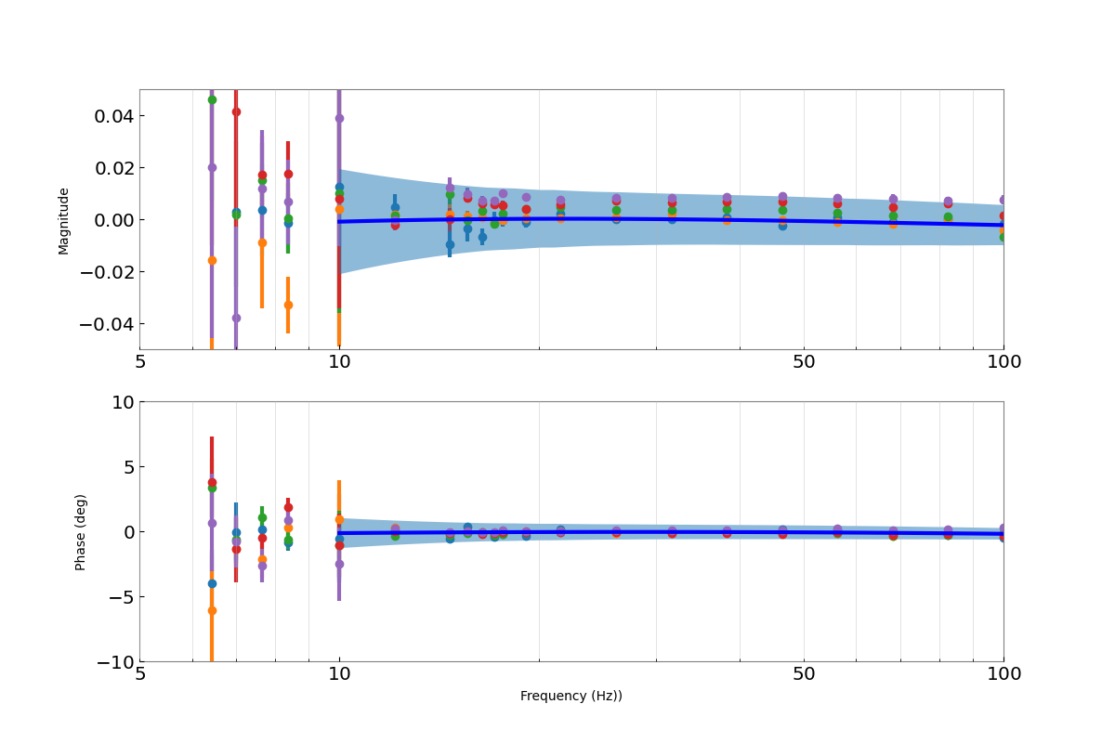
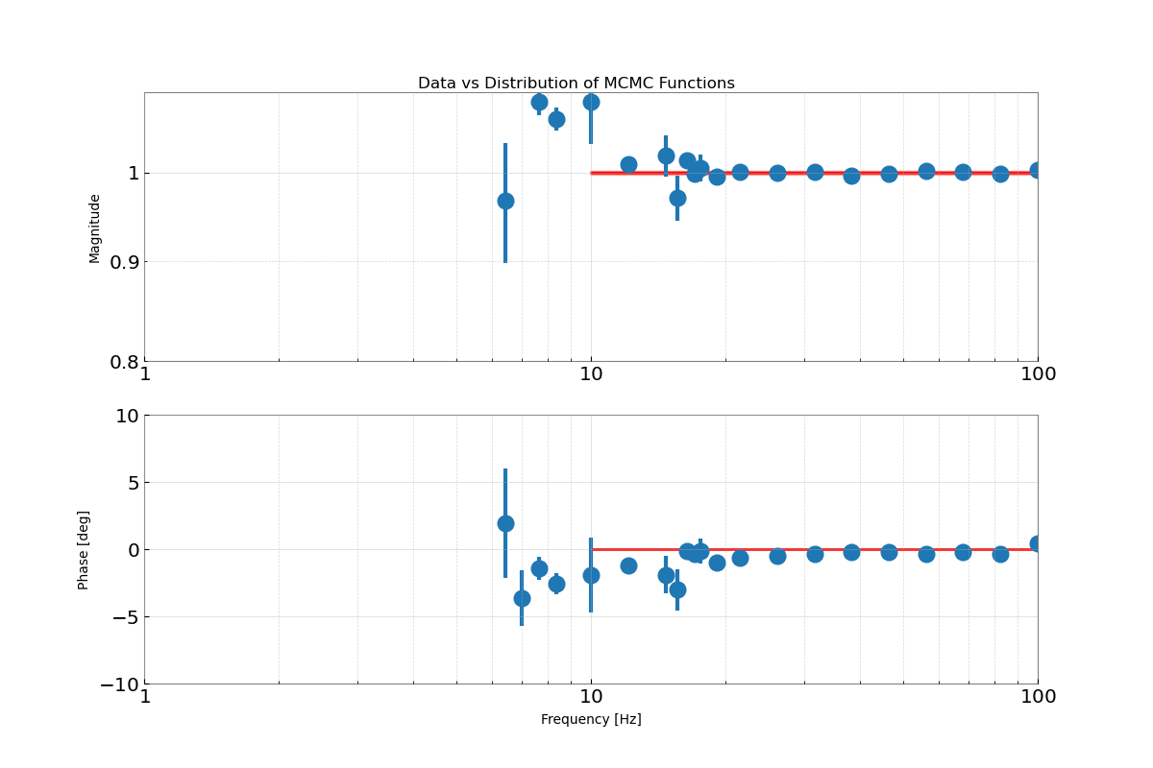
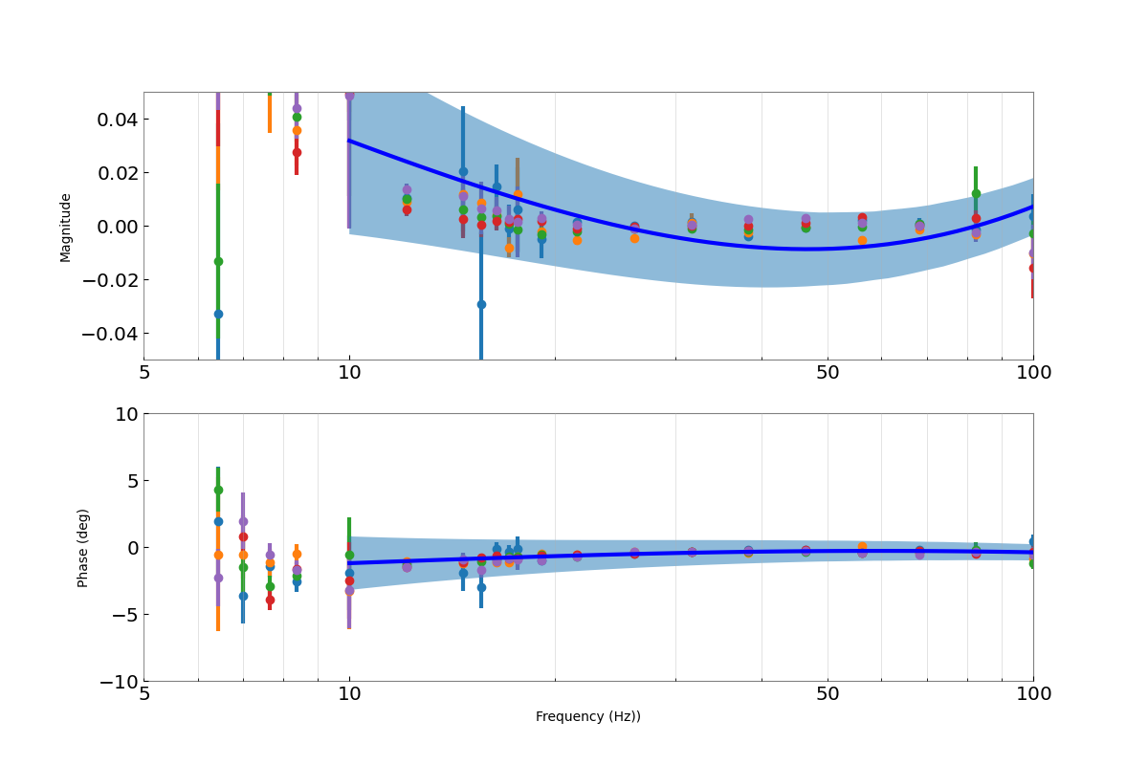
MCMC 01/03/20 GPR
<<< TST >>>
<<< PUM >>>

Slide 7
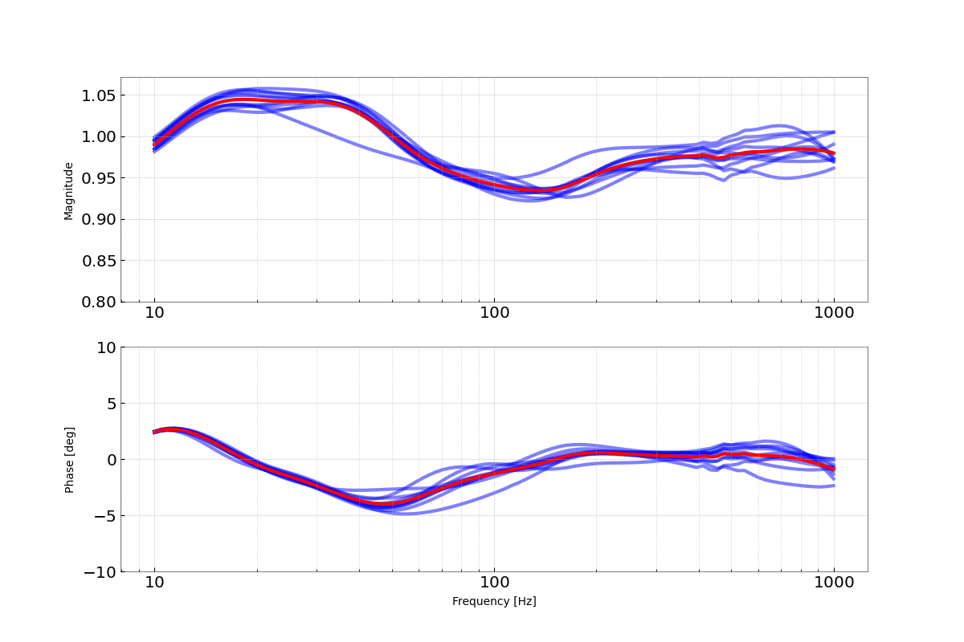
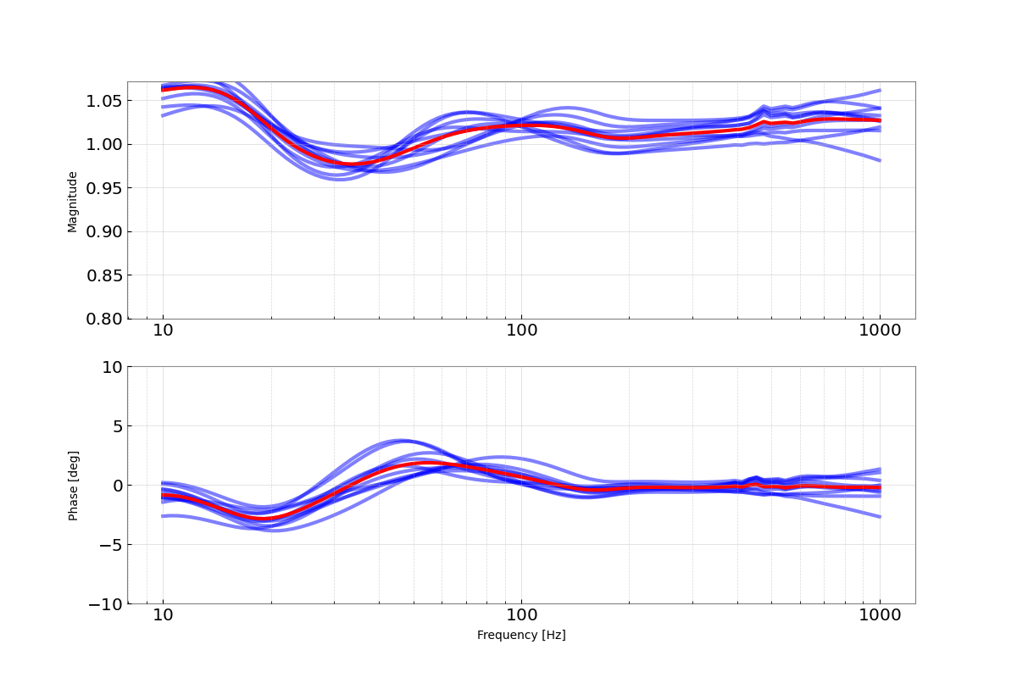
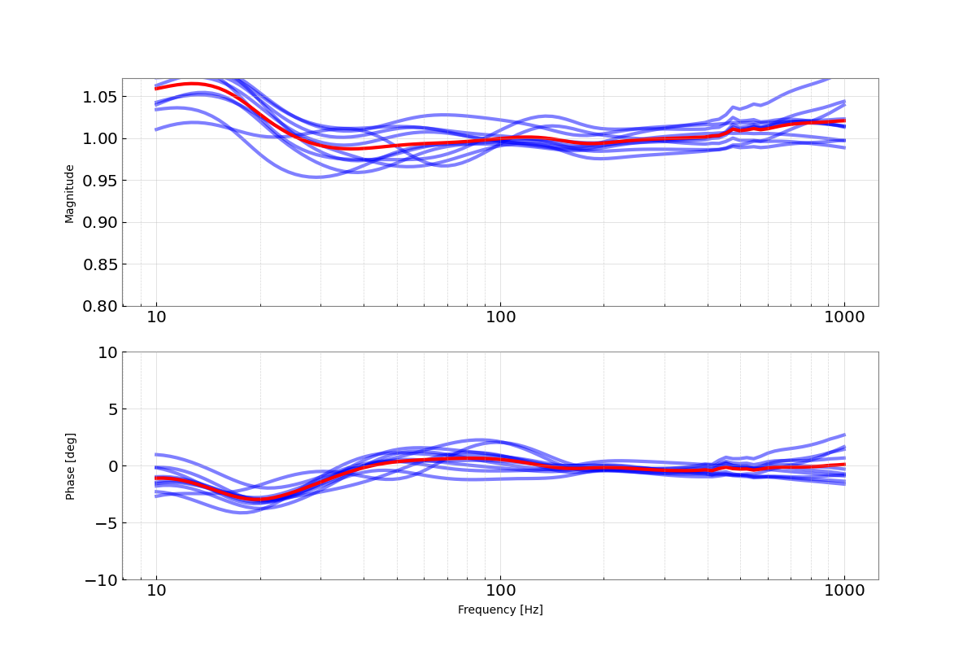
Uncertainty – 04/17 and 01/03
Sensing
Remember: MCMC, GPR are posterior distributions! Uncertainty samples these, divides by nominal response.
The red line is the average frequency dependent systematic error. We aim to correct for this in O4 and onward.
Actuation

Slide 8
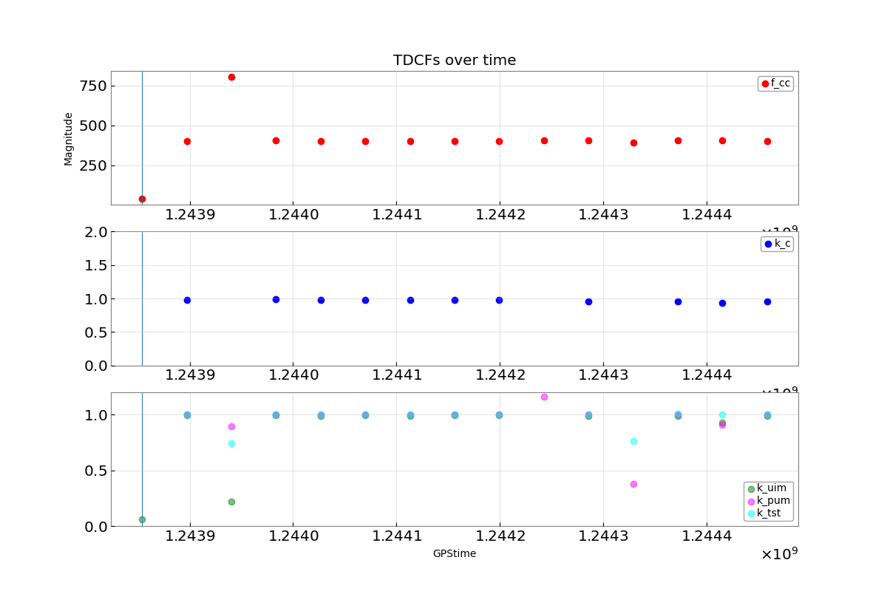
Monitoring – 06/06/19
Sampled TDCFs every 12 hours for a week after the measurement, informed by the MCMC and GPR’s previous estimates.
f_cc – sensing function bandwidth
k_c – sensing function gain
Due to changes in laser power.
k_uim / k_pum / k_tst – gain for the various actuation stages
Unknown detector behavior or flaw in TDCF calculation when not at Unity Gain.

Slide 9
In Summary…
Short Term:
Uncertainty needs to run faster!
Uncertainty for the UIM needs to be examined.
More monitoring plots (average systematic error over time, for example).
This summer, I worked to produce a precise, low latency estimation of the strain calibration and the corresponding uncertainty, along with a suite of diagnostic plots. My work will be actively used and built upon for O4.
Long Term:
O4 in March 2023.
Sub-1% level of uncertainty for tests of GR in the strong regime.

Slide 10
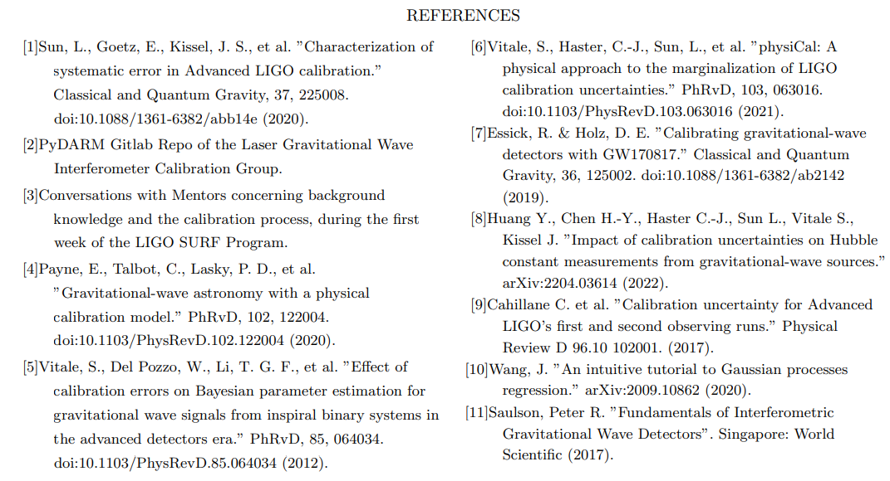
Acknowledgement
I acknowledge and thank the NSF for funding the Caltech LIGO SURF program for the Summer of 2022, and my mentors Dr. Alan Weinstein and Ethan Payne.

