Slide 1
Seismic State Identification with Machine Learning
Isaac Kelly
Notes:
Hello and thank you for your attention.
My name is Isaac Kelly; I’ve been working at UC Riverside under Dr. Richardson and Dr. Papalexakis, supported by Pooyan Goodarzi and Rutuja Gurav.
The focus of my work has been the application of machine learning techniques to seismic noise in the LIGO detectors in order to better understand the contributions of seismic activity to detector malfunctions such as glitches.

Slide 2
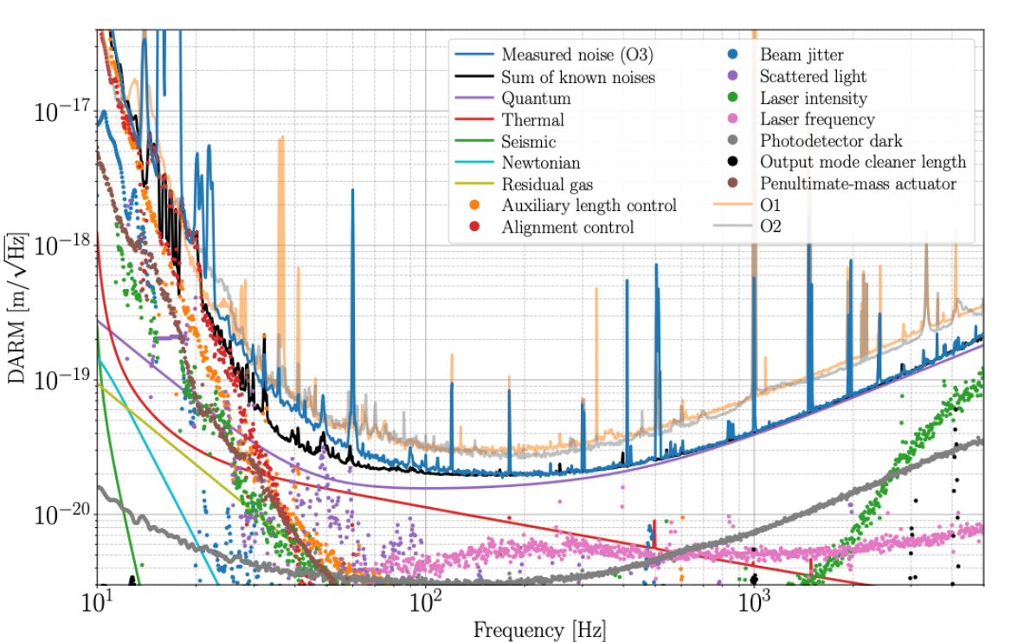
Seismic noise in LIGO
A.Buikema et al., Sensitivity and performance of the Advanced LIGO detectors in the third observing run; Phys. Rev. 102
Notes:
This chart should be familiar; it summarizes the limitations on detector sensitivity as a noise budget. Reducing any of these noise sources should improve detector sensitivity, with some sources being more important than others. You can see here that quantum shot noise is the biggest problem in the upper frequency ranges, while controls noise takes over at lower frequencies. Seismic noise is almost off the charts -- in the good direction; that means seismic noise barely contributes to detector noise.
Now, that begs the question: why do we care about seismic noise if it isn’t affecting the detector signal?
The answer is that it probably is!

Slide 3
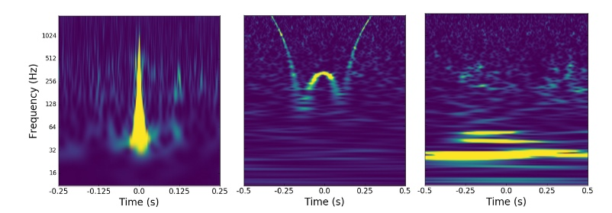
Glitches in LIGO
M Zevin et al., Gravity Spy, 2017
Notes:
LIGO experiences many different types of glitches in the strain signal, all of which are problematic. Some of them can completely hide a GW signal, while others might cause false triggers in the detection pipeline or add more uncertainty to a detection. A project called Gravity Spy works to classify this wide range of glitch types, of which we have some examples: blip, whistle, and scattered light.
Some glitch types have been matched to a physical cause (such as the raven event), but many more are not well understood.

Slide 4
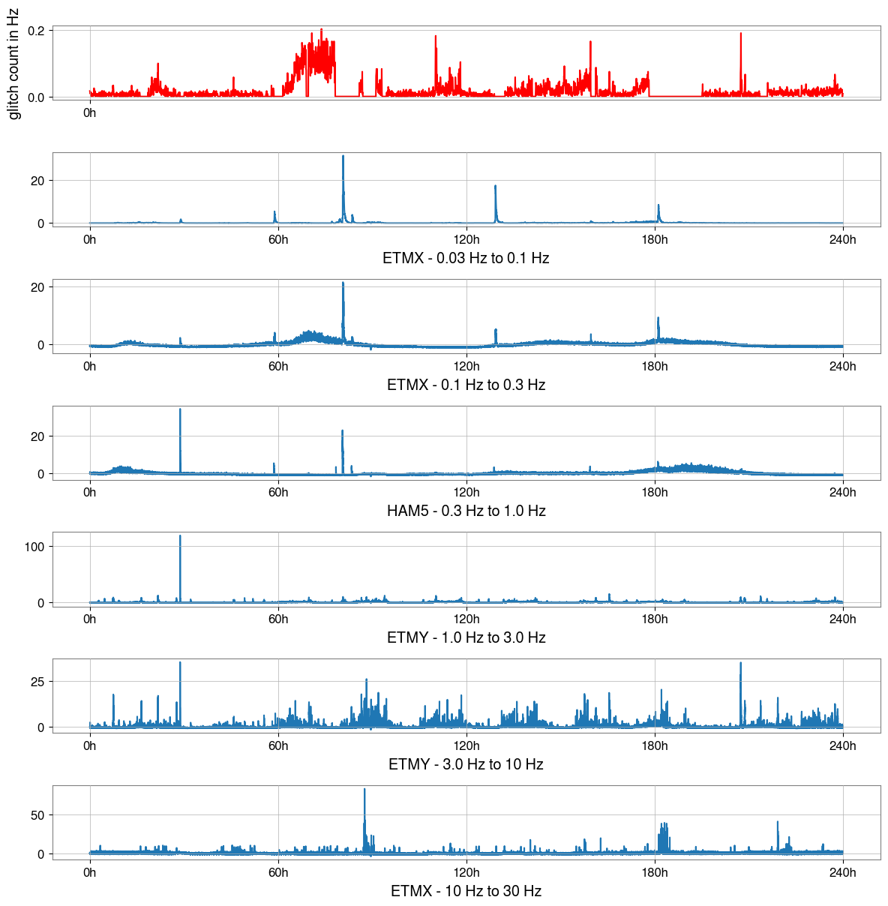
What are we looking for?
Earthquake
Microseism trend
Daytime noise spike
Notes:
So I’m hypothesizing that there’s a correlation between seismic activity and detector glitches.
To test that, we need to figure out what kind of activity is going on at a given time and measure the glitch rate at that time.
The first step, then, is determining the seismic state: what sort of activity is affecting the area.
Here is 10 days’ worth of seismic activity and glitches. While some peaks and troughs are apparent, it would be difficult to draw conclusions about any correlation from here.

Slide 5
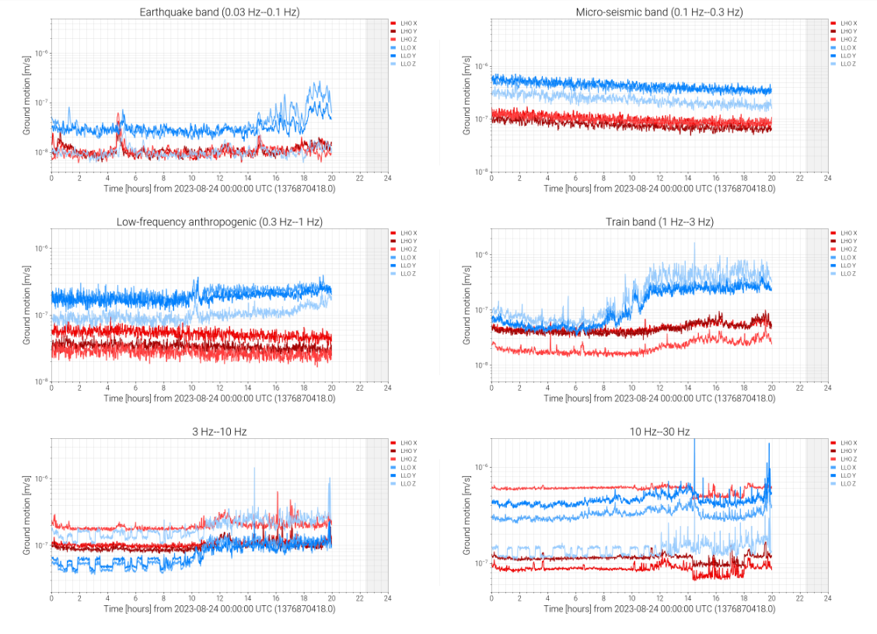
Project Objectives
Distill sensor data down to a single “status” indicator.
“The detector is: HAPPY”
This is HARD!
gwosc.org
Notes:
That analysis is really hard! We need to distill all that seismic data down to a single state at any given time.
Three big problems:
-Massive amount of data, hard for humans to process that much.
-Probably a nonlinear relationship -- resonances, couples
-And the last is a problem that makes the solution difficult. We don’t have a ground truth to compare to our results. So the method that we use needs to be pretty independent.
The solution to all these problems is machine learning.

Slide 6
Solution: Machine Learning!
-Identify events without “understanding”
-Process huge amounts of data without explicit programming
How useful are the results?
Notes:
Machine learning is a pretty broad term. Generally, it indicates a system where computers can “learn” without being explicitly programmed; simply by looking at data, the computer can draw some conclusions about the system.
This solves our problems nicely!
Computers are fast at math, so they can process all the data.
And machine learning tends to do well with nonlinear functions.
Thirdly, ML is excellent for exploration; it can pull relationships out of a dataset without “knowing” anything about the data.
So now we need to actually do our learning. This requires a whole pipeline, from data acquisition to presentation of results.

Slide 7
Pipeline structure
Notes:
Here’s how we’ll be implementing the machine learning system. Each of these steps is a whole problem in itself, all of which ended up solved!

Slide 8
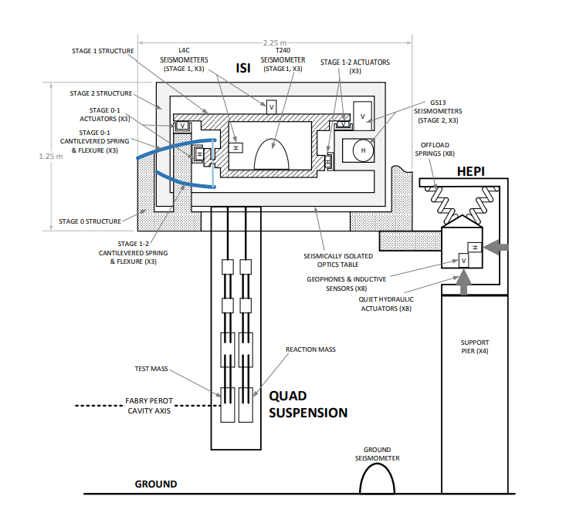
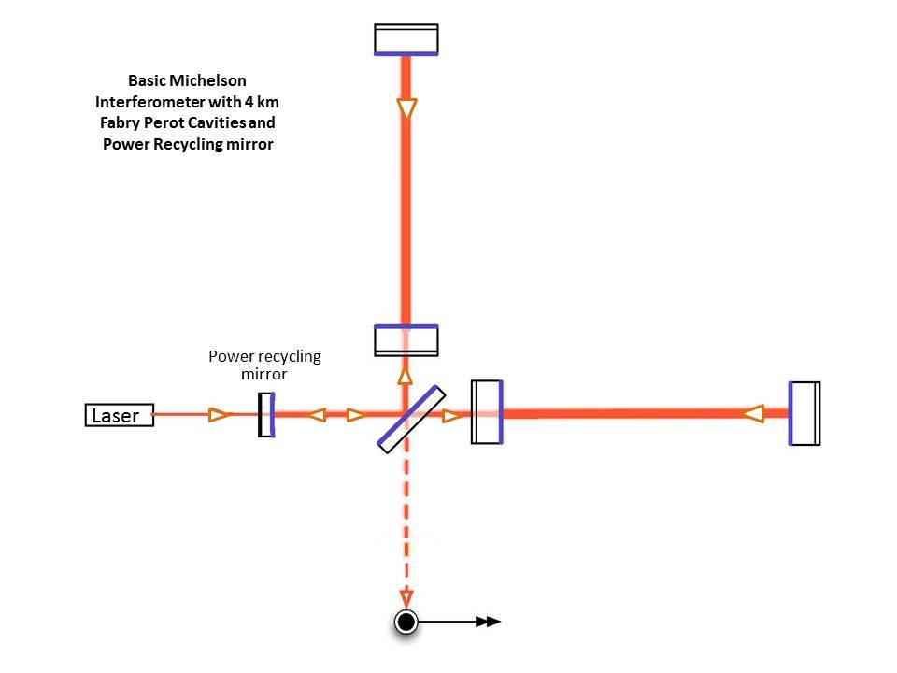
Data acquisition and segmentation
https://www.ligo.caltech.edu/page/ligos-ifo
Advanced LIGO, LSC, 2014; LIGO-P1400177-v5
Notes:
We’ve decided to use machine learning because we have too much data for people to handle.
But even the computers can’t handle an infinite amount. So one concern is creating a dataset of an acceptable size, so that we can run calculations quickly for experimentation but still get usable results.
I found that 72 hours of data is a fairly appropriate size; over this period of time, we are likely to see multiple different types of seismic activity, which is exactly what we need for the later steps. And this takes under an hour to process all the way from raw data to finished results.
I took seismometer data from multiple seismic isolation systems throughout LIGO; one in each of the end test masses, one in each intermediate test mass, and one in HAM5. Using these separate sensors lets us identify local and global events separately.
That seismometer data comes from the LIGO Network Data System, or NDS. The gwpy library, a most excellent Python toolkit for analyzing GW data, makes it easy to pull that data down in a convenient format; it’s already split into 6 separate bands using a band-limited RMS filter. These separate bands already do a fine job of splitting up known types of seismic activity.
We’ve got 5 seismometers and 6 different bands; that means a total of 30 channels of seismic data, in which we have one datapoint per second. Each of these is a separate but parallel timeseries.
Then we take those thirty timeseries and chop them up into segments of equal length, while keeping the channels parallel.
The result of this step is a set of consecutive time segments, each containing thirty timeseries of defined length. I used segment lengths between 30 seconds and 4 hours.

Slide 9
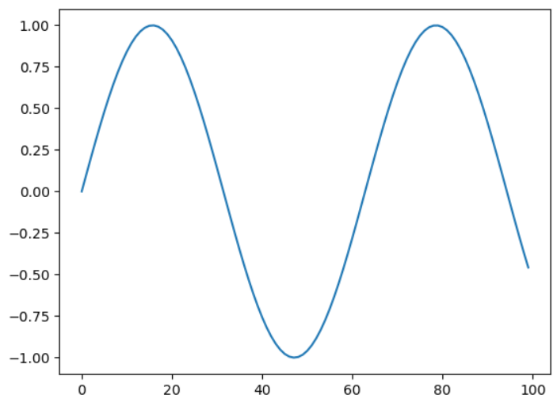
Feature extraction
Notes:
Feature extraction is an important part of many ML systems that work with timeseries data. It consists of a set of measurements (which we call “features”) that are taken from each piece of data; mean, maximum, median, entropy, least squares fit, that sort of thing. The idea is that we can represent a timeseries pretty effectively with a much smaller dataset; this makes every following step much more efficient.
One problem with feature extraction is that we’re throwing away the “real” data. So we could be losing useful information, or even adding noise, by using this process. So choosing which measurements to use is very important to keep the dataset in good shape.
I used two main feature sets: a comprehensive one, basically everything the library had to offer (about 700 features), and a minimal set with 9, as well as a couple more with a few more or a few less. Most of the analysis I’ll be showing is based on the minimal extraction.
This is an example of the results of feature extraction; we can turn this sine wave with 100 datapoints into 9 representative datapoints. We might be losing a lot of data, but we’re also using much less space, and that means faster computation!
The actual computational process is quite simple; just loading up the dataset (30 channels of seismometer data), running these tests on each one, and saving the result in the right place.
17 seconds vs 8 minutes.
Sum of values
Median
Mean
Timeseries length
Standard deviation
Variance
Root mean square
Maximum
Absolute maximum
Minimum

Slide 10
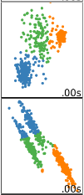
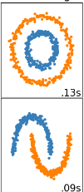
Clustering
“Clustering is a data mining technique where similar data are placed into related or homogeneous groups without advanced knowledge of the groups’ definitions.”
Saeed Aghabozorgi et al., Time series clustering -- A decade review, 2015.
Image source: scikit-learn documentation
Notes:
And now for the machine learning part of the pipeline, the slide you’ve all been waiting for: clustering.
I’ll start with a definition.
The important part here is that the algorithm doesn’t need any information besides the data it’s analyzing. This is perfect, because we don’t have any other information to give it.
So the clustering approach is a good one for our problem.

Slide 11
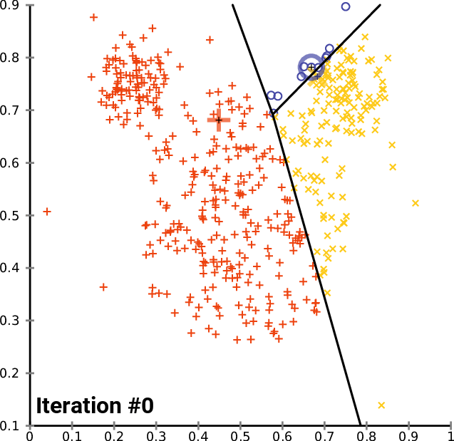
k-means clustering
Chire, CC BY-SA, Wikimedia Commons
Notes:
The specific algorithm we’re using is called k-means. This is a popular one because of its relative simplicity; it’s also old so it’s well studied and generally accepted. It separates the data it’s given into k different clusters, trying to minimize the squared Euclidean distance between each point in a given cluster.
After initially choosing some cluster centers, this algorithm runs in two repeated steps.
First, it places each point into the nearest cluster (in terms of squared Euclidean distance).
Then, it chooses new cluster centers by minimizing the squared distance to each point in the cluster.
Eventually the cluster centers stop changing, which means the algorithm has converged on some solution.
And there you have it; data divided by distance measures, and grouped according to similarity.
There are a few things to think about when using clustering in general, and k-means specifically.
Algorithm won’t necessarily arrive at the best result, local minimums are common esp. with complicated datasets.
Also the parameter k, for the number of clusters, is very important! If we ask the algorithm to make too many or too few clusters, we’ll end up with data being split up where it shouldn’t be, or two groups stuck together, and that will ruin the results. So a big part of this step is choosing a good range of values for k.

Slide 12
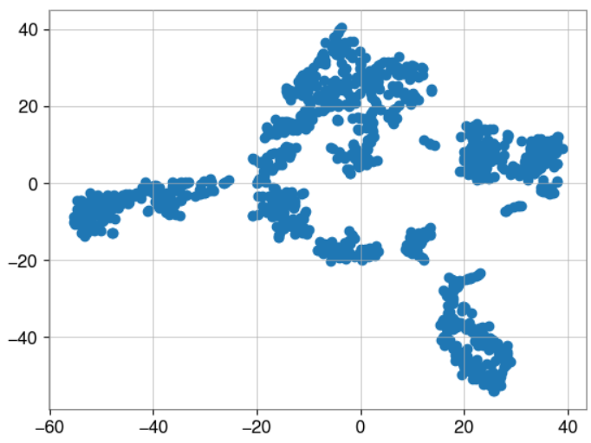
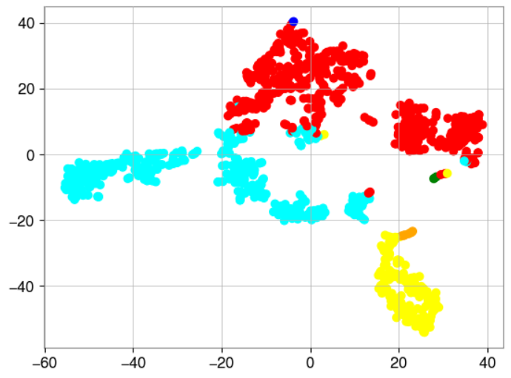
Visualization and evaluation
Notes:
Because our data has hundreds of dimensions before clustering, we can’t graph it directly, which makes it difficult to visualize. So I’ve run it through an algorithm called t-SNE (t-distributed stochastic neighbor embedding). This process transforms the many-dimensional dataset into a simple 2d space, where we can graph it easily.
Here we can see clear separation between some different groups.
But this graph is just a representation, and doesn’t necessarily translate to what a clustering algorithm can give us. It is, however, an excellent exploratory tool.
If you take a look at this t-SNE scatter plot, you can see 5 or 6 different blobs that we might like to separate into clusters; that points us towards using that value for k in the clustering algorithm. So we could try 6 different clusters.
Now, that looks pretty good. The algorithm’s done a good job of splitting up some groups, but some seem to overlap; the cyan-red boundary is especially unclear.
But that’s a very subjective evaluation. We need some objective way to measure how well clustering has worked.

Slide 13
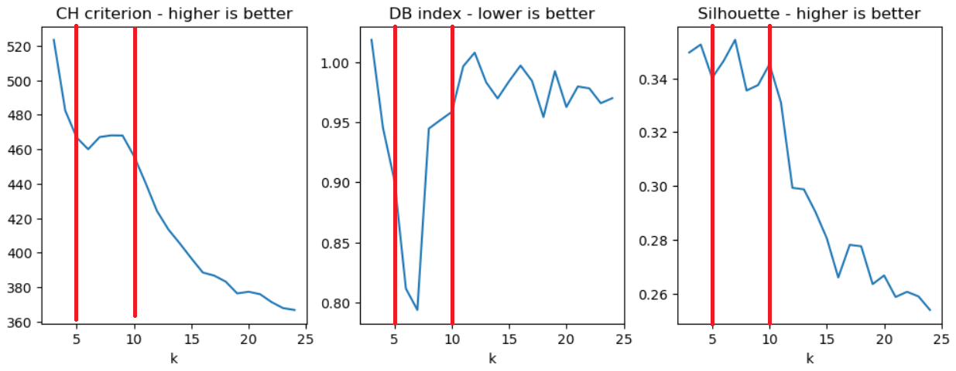
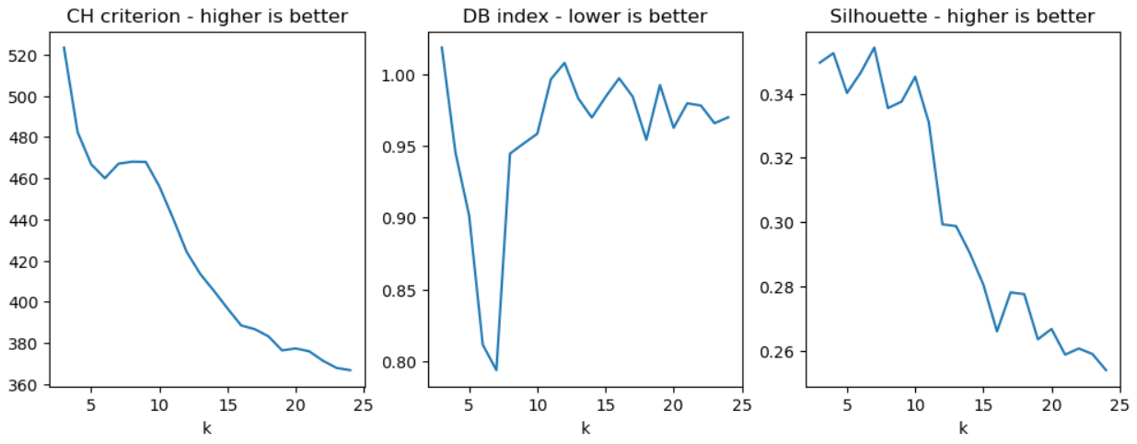
Intrinsic cluster evaluations
Notes:
Because we don’t have a “real answer” to compare to, what we’d call a ground truth, we don’t know how well the clustering reflects reality.
But we can look at how well the clustering worked mathematically; how well it separated and grouped our points.There are a few different algorithms for evaluating clusters; here I have examples of Calinski-Harabasz, Davies-Bouldin, and Silhouette.
CH is the ratio of between-cluster variance to within-cluster variance; we want to maximize this one.
DB is the average of between-cluster similarities; we want less similar clusters, so minimize this one.
And the silhouette score compares mean intra-cluster to mean nearest-cluster distances. This should be maximized.
I’ve calculated these scores for a range of k values, and this points to the range between 5 and 10 clusters. (click)
On the last slide, we saw pretty good results with 6 clusters; so far, we have agreement between what looks like a good cluster visually, and what is mathematically a good cluster.
Now, most implementations of k-means are not deterministic; two consecutive runs are not guaranteed to give identical results, so you can often have an ‘unstable’ result.

Slide 14
Stability of clustering results
Clustering stability: an overview - Ulrike von Luxburg
Notes:
And this is a great reason to use stability measurements to help choose a good range for k.
We can’t just compare result A to result B because the cluster numbers can be different (there’s no defined cluster 1 or 2).
But there are nice metrics like normalized mutual information and adjusted rand index that compare two results and tell us how similar the information contained is.
So I applied those metrics to 10 runs of each different k value, and here are the results.
Here the pattern is simple; past about k = 10 we get a significant dropoff in clustering stability.
Now there’s an excellent paper on clustering stability by Ulrike von Luxburg. The quick summary is that choosing a k value that is too high will cause instability because the algorithm will split up clusters. Choosing a value that is too low can also cause instability because clusters have to be combined. So stability will also help us determine a good range for k.
By combining the stability measurements with intrinsic cluster metrics, I’ve narrowed down the range for k to the range between 5 and 10. Any lower and we’re missing states, any higher and we end up with noisy, unstable clusters.

Slide 15
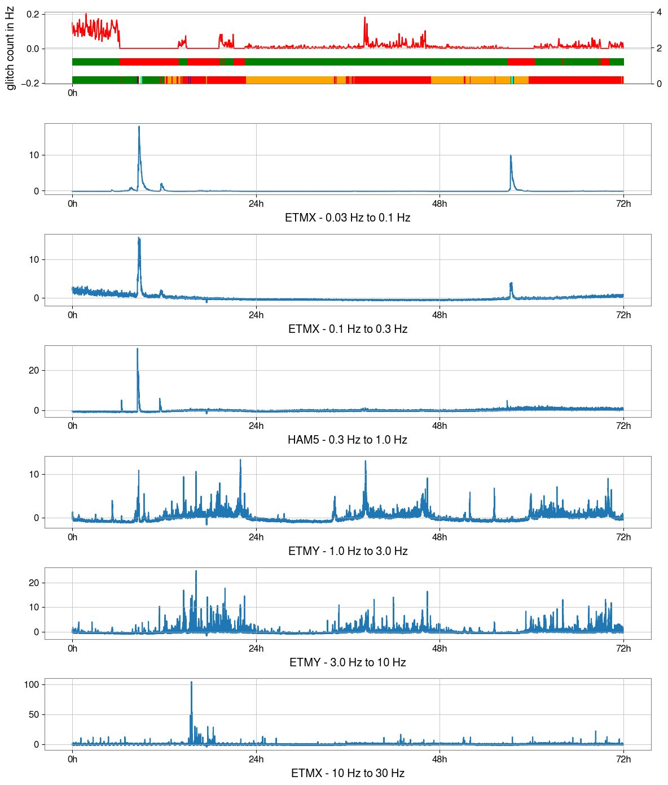
Glitch rate
Detector observing mode
Cluster
Earthquake
Microseism trend
Daily elevation
Notes:
With that narrowed range for k, we have everything we need to run the pipeline effectively and produce results.
So here are some results!
This is a 72-hour chunk of seismic data, run all the way through the pipeline with the parameters that I discovered; the minimal feature extraction, optimized initialization of the k-means algorithm, and k of 7 for 7 different clusters.
We’ve successfully identified multiple earthquake-type events, the daily anthropogenic noise elevation, and the falling edge of a microseism event.
This means that our clustering approach is already sufficient to determine the detector’s seismic state.

Slide 16
Glitch correlation
Notes:
And now that we have our seismic state information, we can correlate this with detector glitch rates.
red: 0.0195 glitches/second -- associated with daily anthro noise
orange: 0.0068 glitches/second -- nighttime, good level
green: 0.110 glitches/second -- end of microseism
So we’ve demonstrated two results.
First,

Slide 17
What can we do with this?
Different types of sensors
Look for lockloss correlations
Implement in detector status page

Slide 18
Acknowledgements
Notes:
I would like to thank the NSF and UC Riverside for funding my work; Caltech for organizing the SURF research experience; my mentors at UC Riverside for their excellent advice and guidance; and finally the LIGO collaboration for their excellent documentation of all aspects of the detector.
And special thanks to LIGO scientist Anamaria Effler for inspiring the question behind this project!

Slide 19
Thank you!

