Slide 1
University of Washington Seattle Eöt-Wash Group Overview
GWANW 2023
Michael Ross

Slide 2
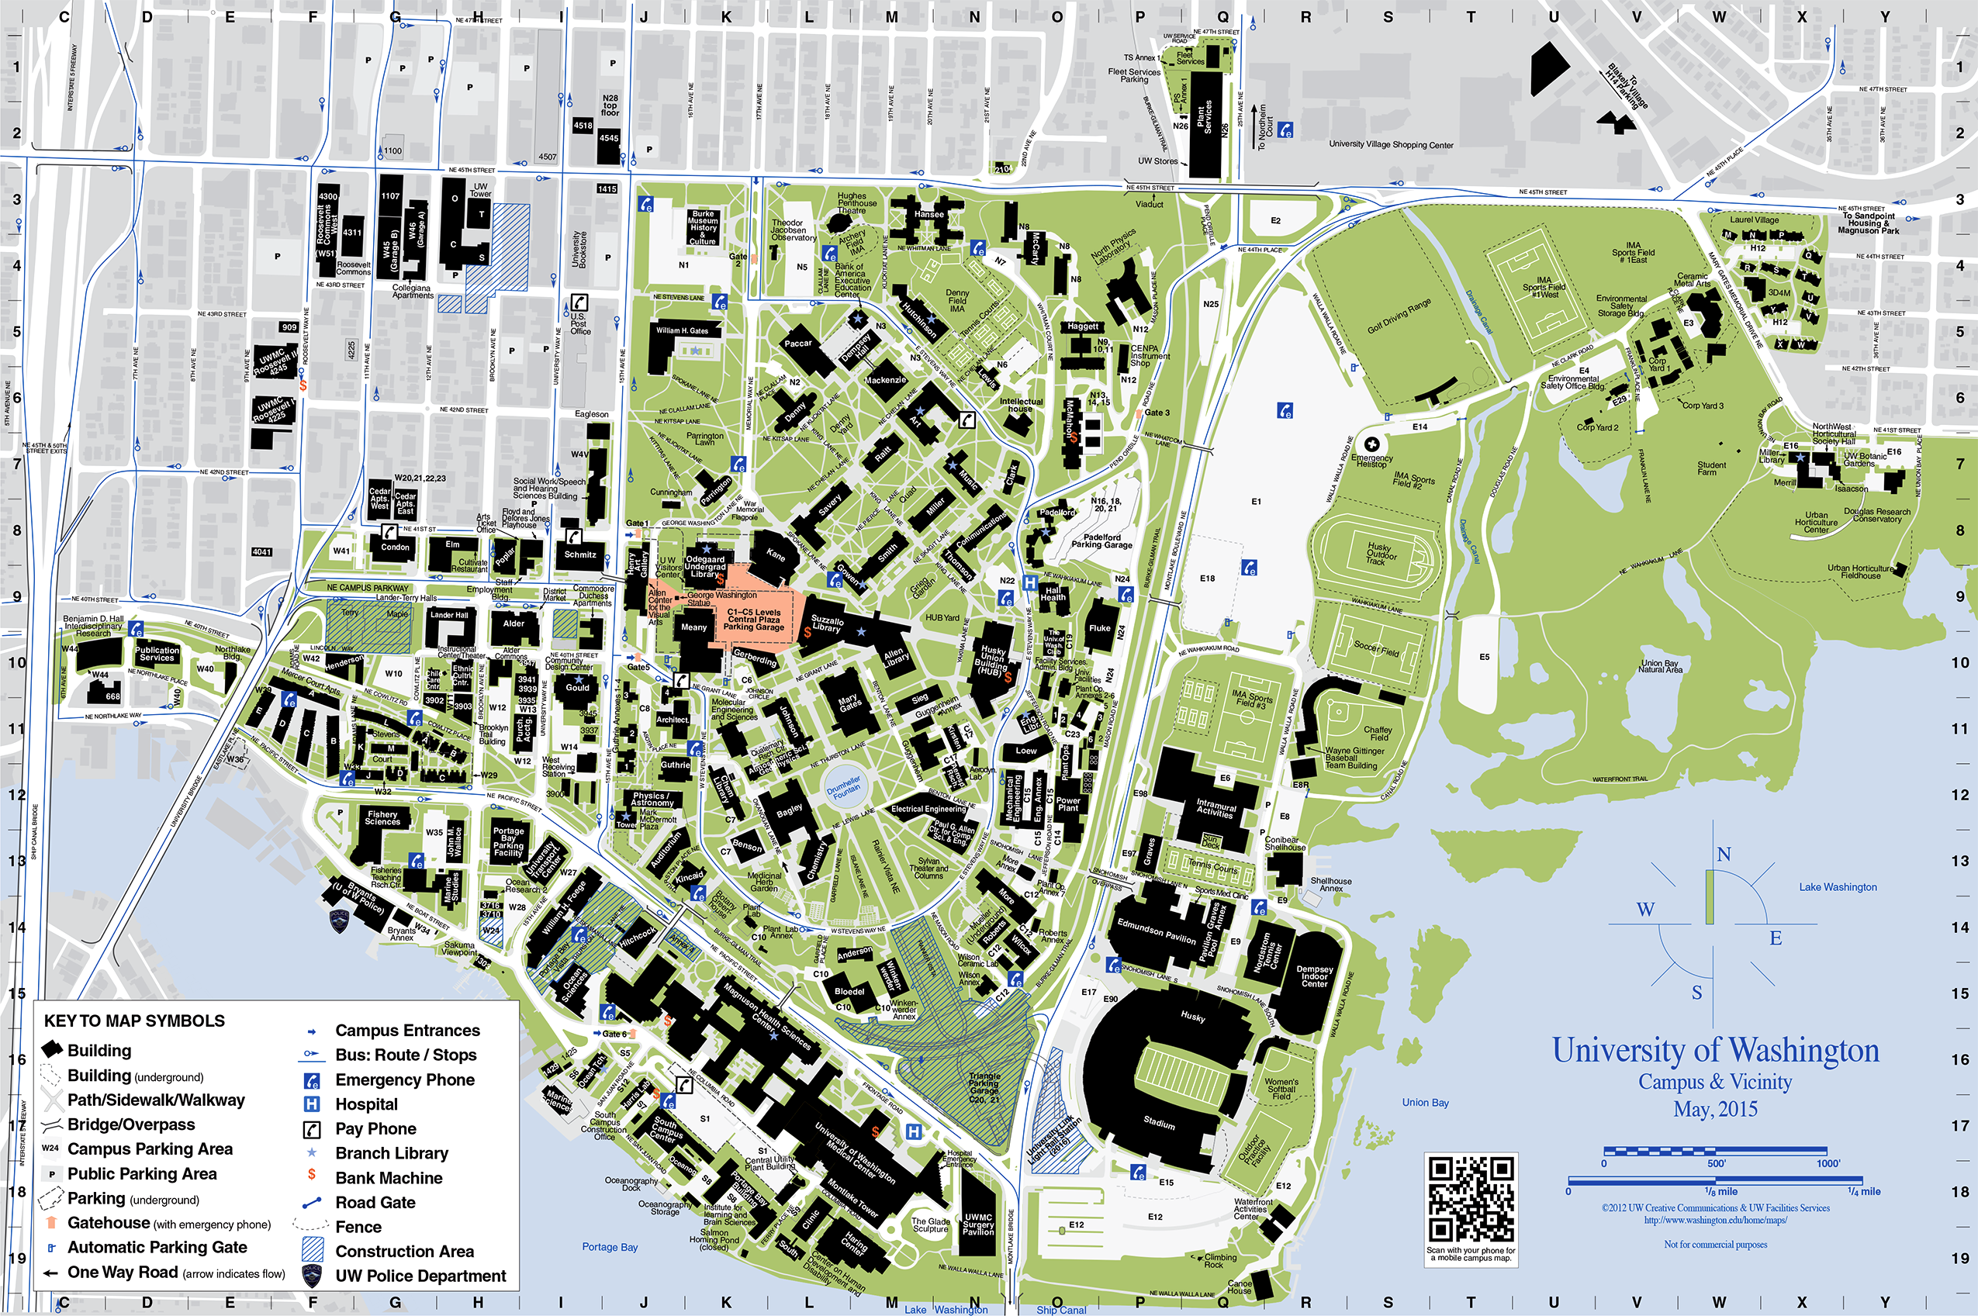
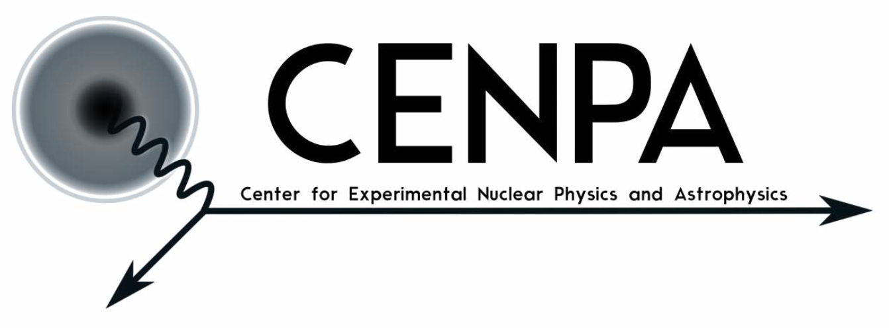
CENPA – Center for Experimental Nuclear Physics and Astrophysics

Slide 3
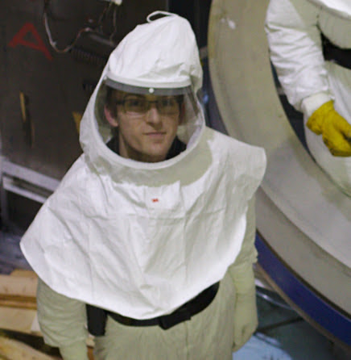
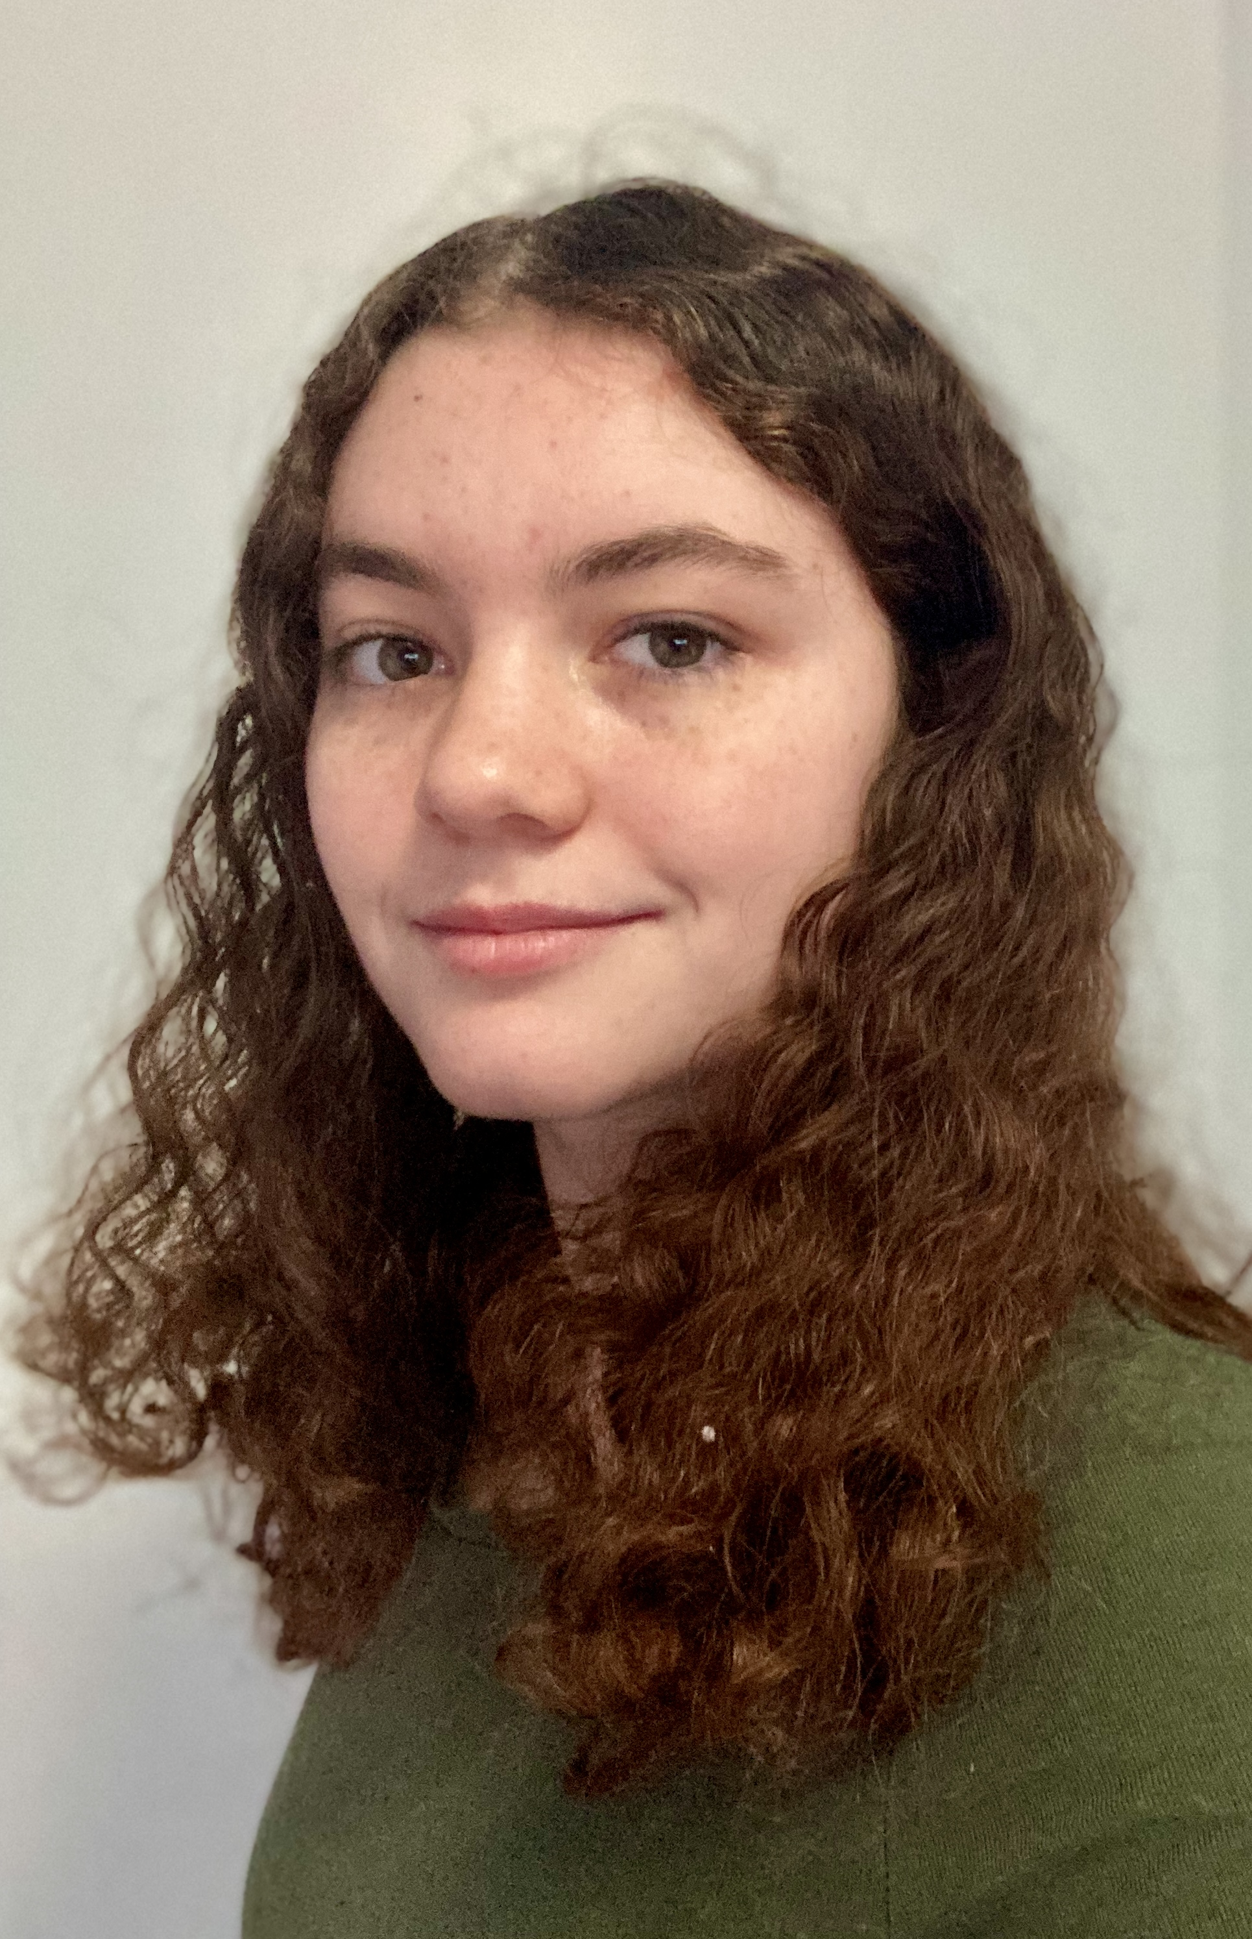
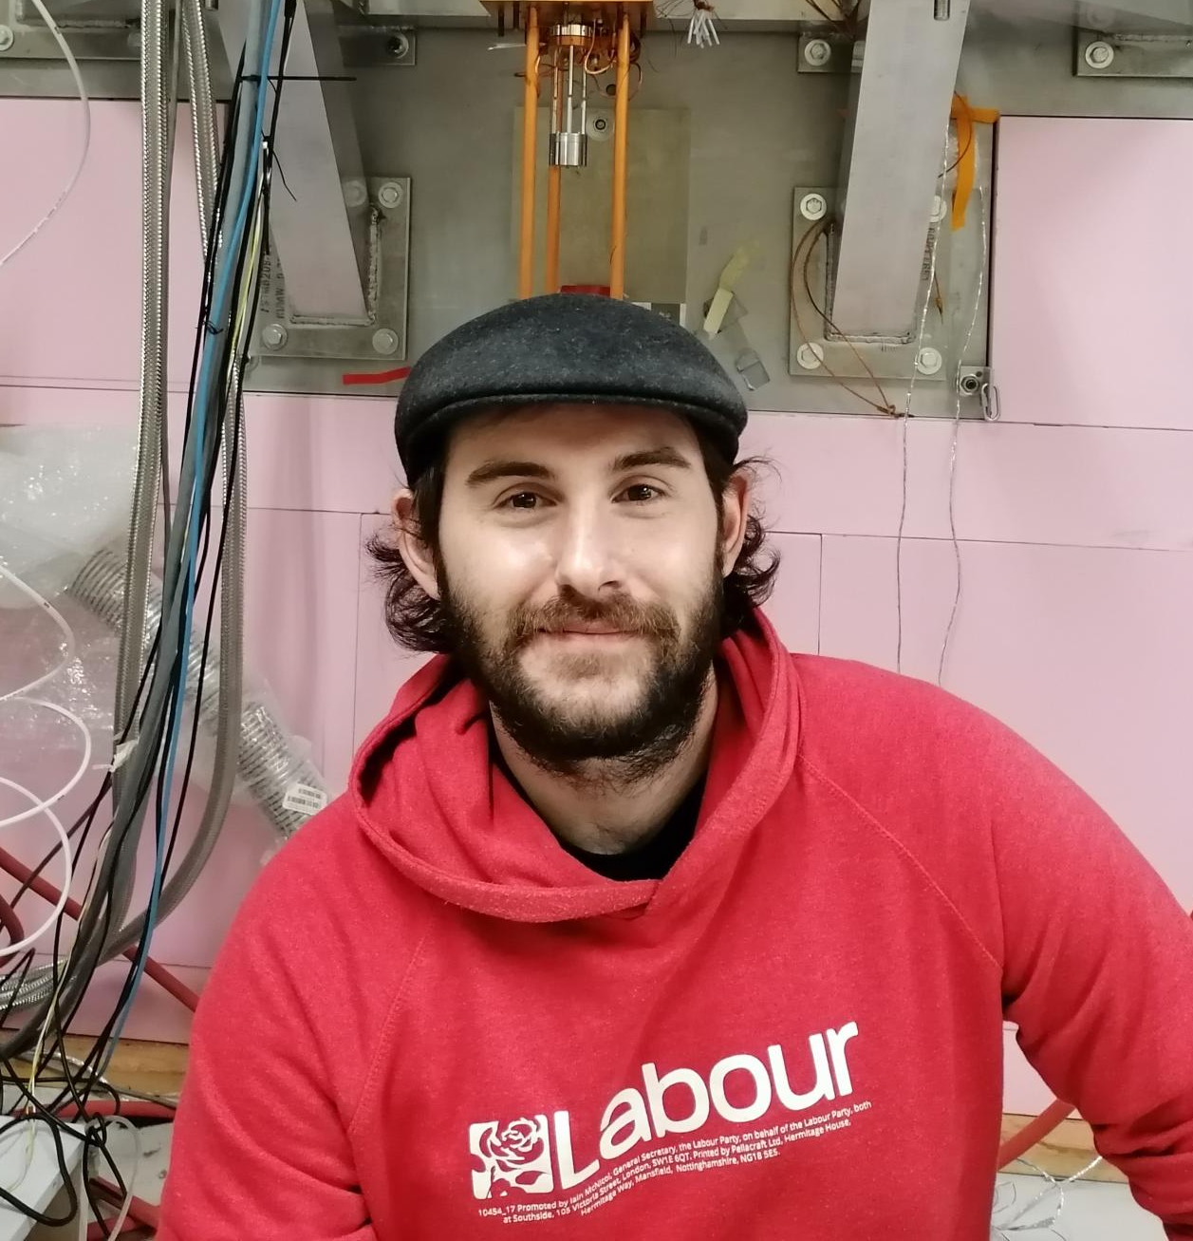
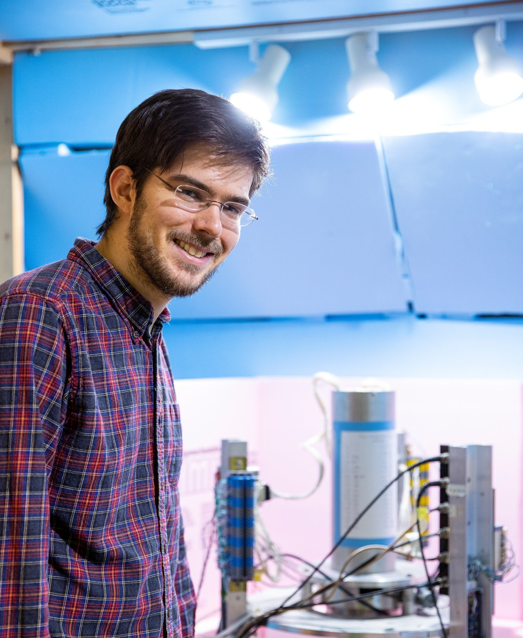
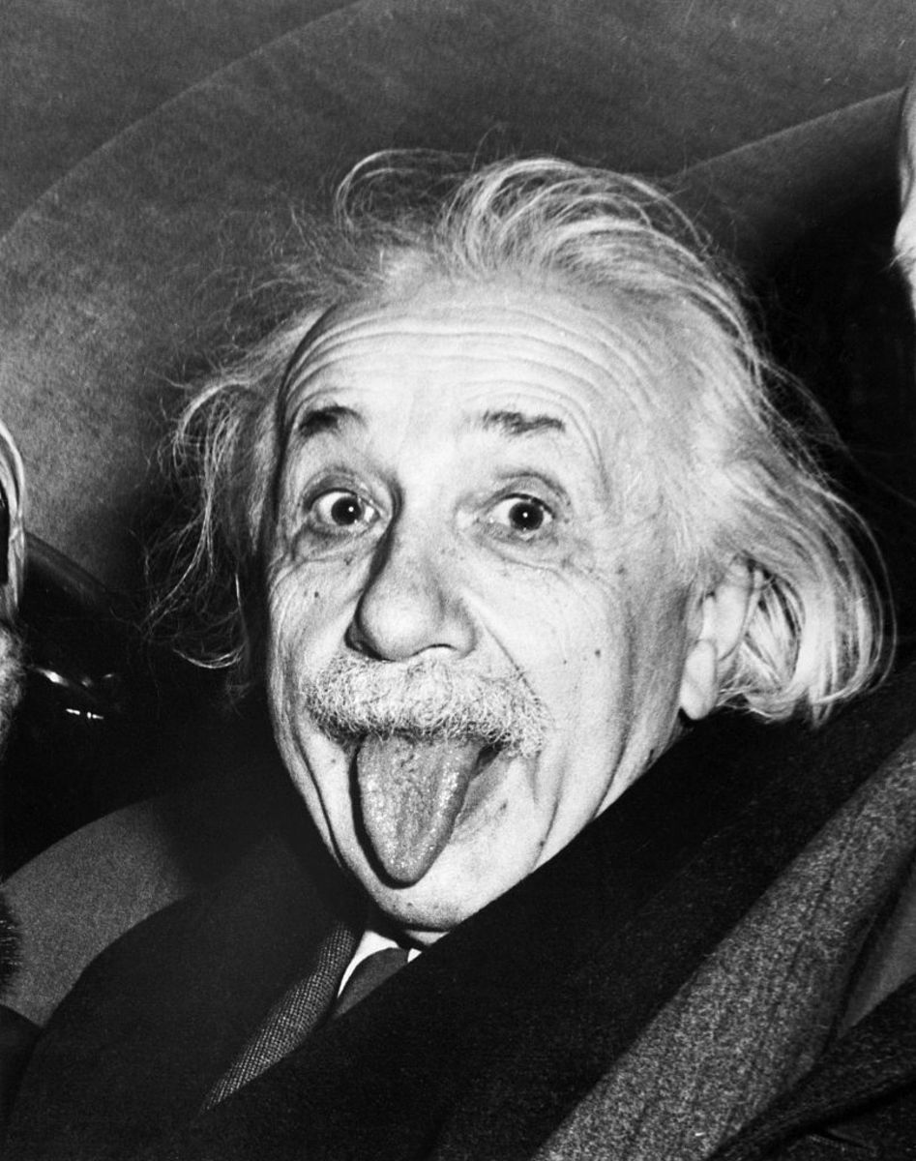
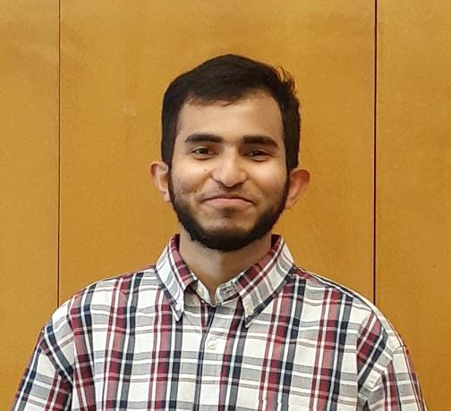
Eöt-Wash Group
Michael Ross
(Postdoc)
Shoshana Apple
(Grad student)
Conner Gettings
(Postdoc)
Erik Shaw (Postdoc)
Peter Wu
(Undergrad. RA)
Yasin Chowdhury
(Undergrad. RA)
Jens Gundlach (Professor)

Slide 4
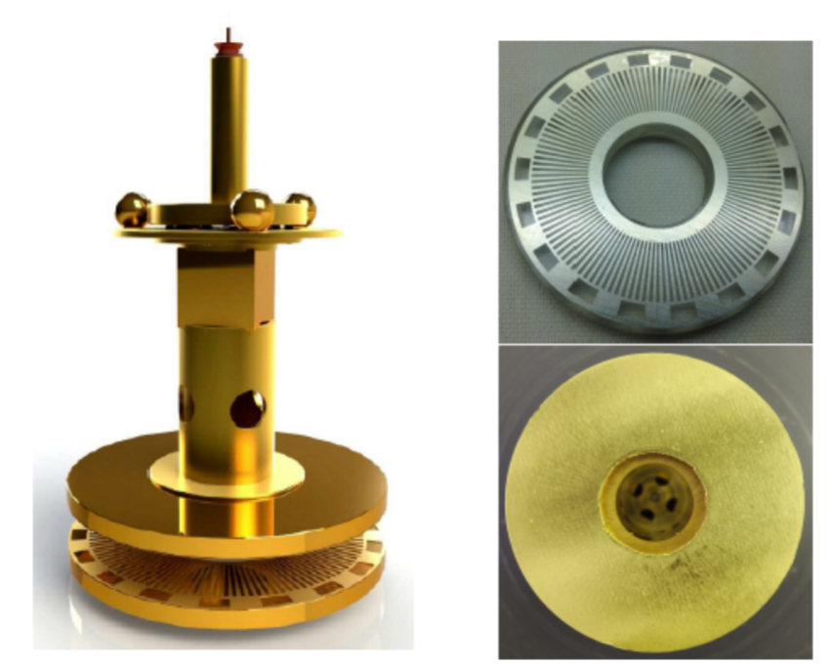
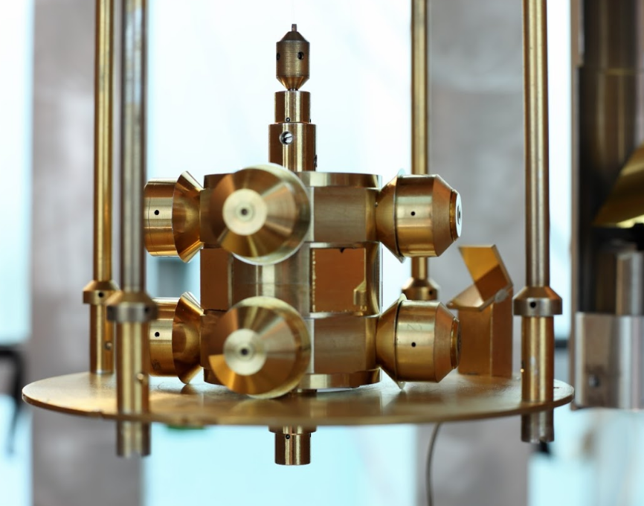
Torsion Balance Experiments
Testing gravity since the 1980s
We use torsion balances to:
Test gravity’s short-range behavior
Verify the equivalence principle (EP)
Search for ultra-light dark matter
Measure gravitational constant, G
Recent Results:
Test of short-range gravity at separations of 52 μm: arxiv.org/abs/2002.11761
Search for atto-eV (${10}^{−18})$ mass dark matter: https://arxiv.org/abs/2109.08822
On-going/Soon to be released:
Upgraded EP test
Test of EP for Cooper pairs ($η_{CP}<{10}^{−3})$
$$V\left(r\right)=−\frac{G m_{1}m_{2}}{r}\left(1+α e^{−r/λ}\right)$$

Slide 5
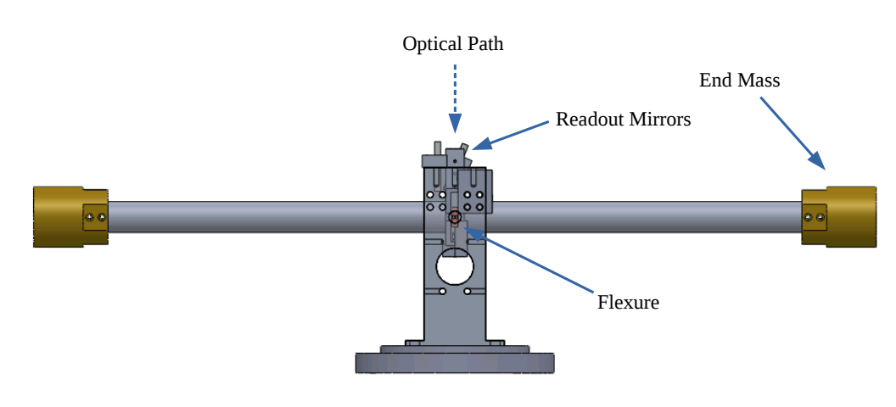
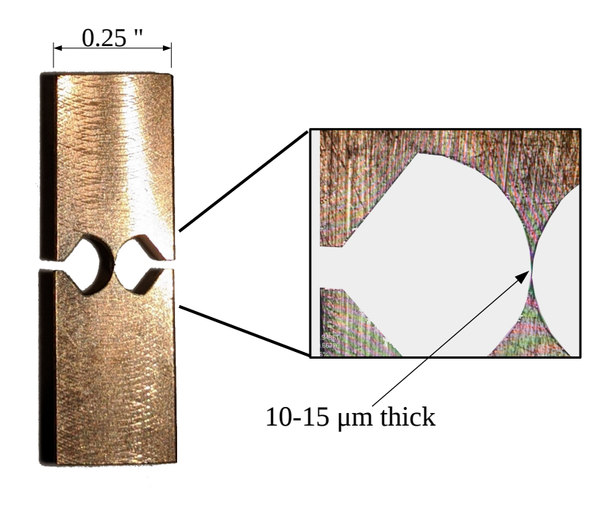
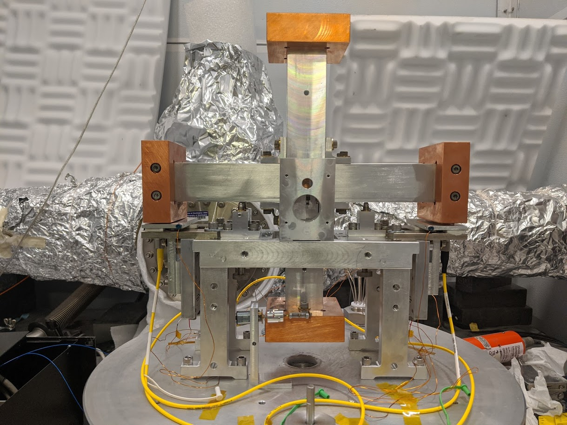
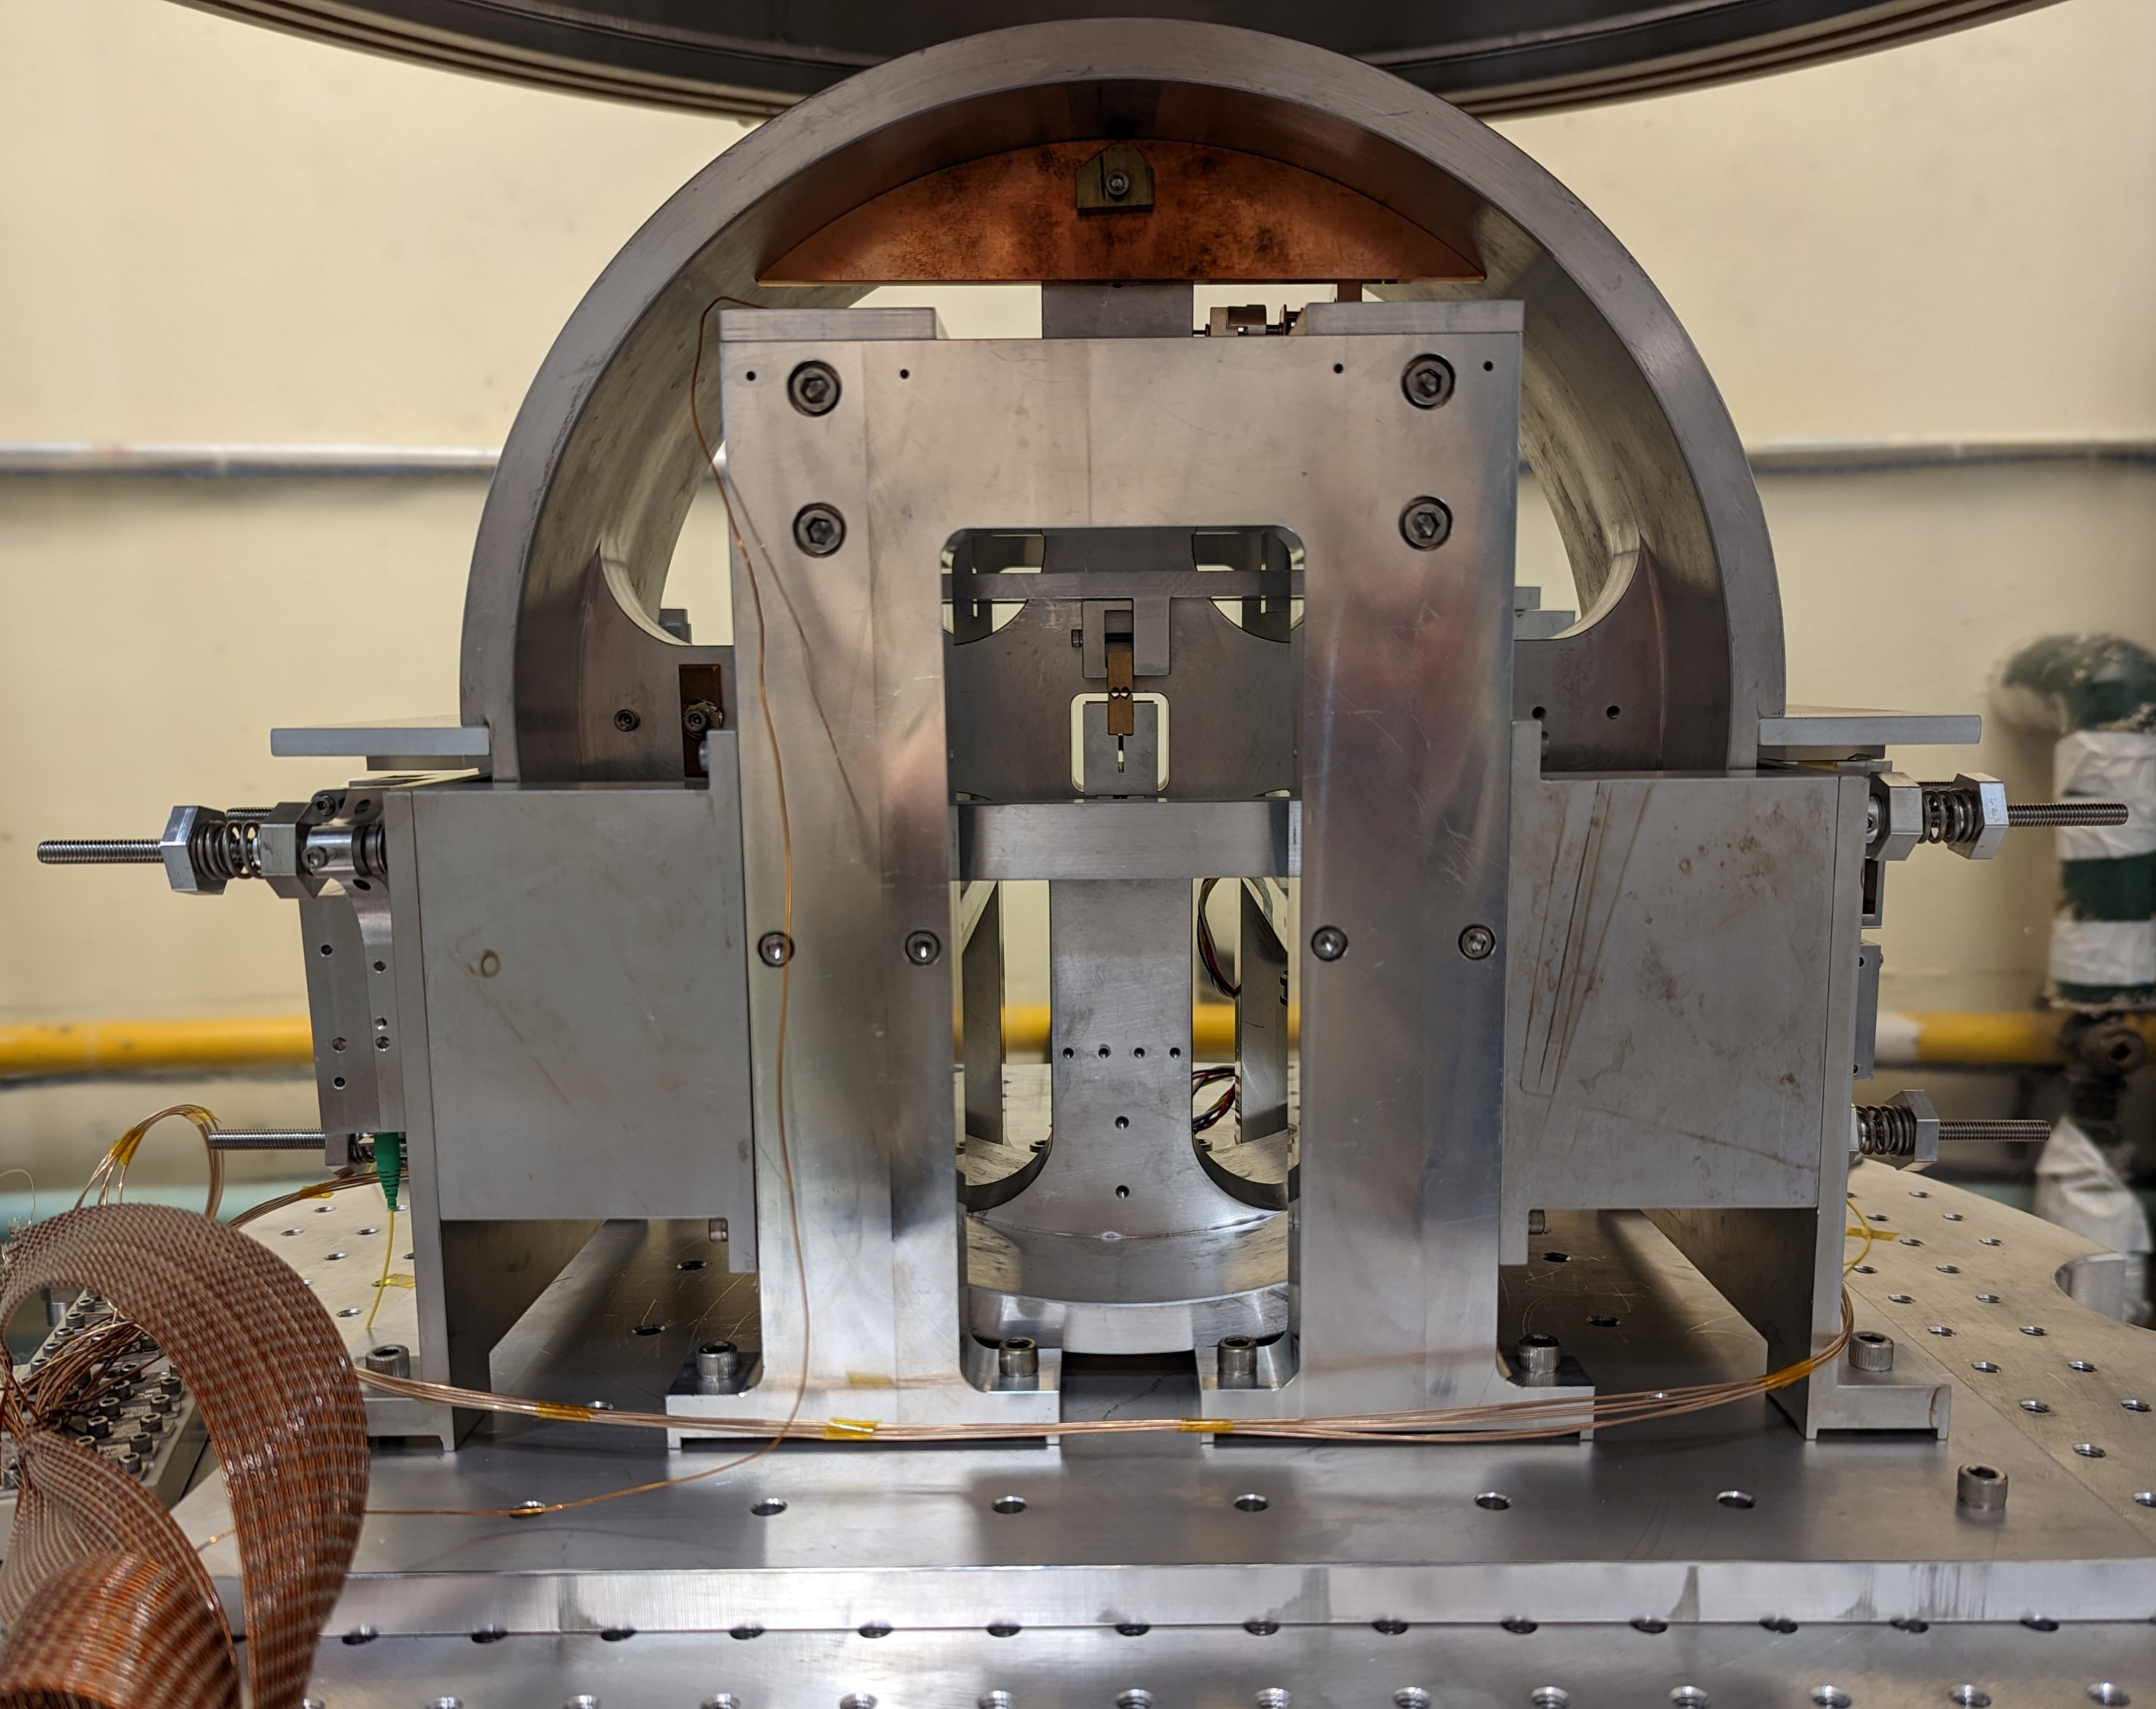
Rotation Sensors
Developed beam-balance based rotation sensors (rotational seismometers)
Proof-mass suspended from 10-15 μm thick Be-Cu flexures forms rotational spring-mass system
Three versions:
Beam Rotation Sensors (BRS): 1-m long beam, used to sense ground rotation for seismic isolation systems, 6 deployed at LIGO (LHO: 2, LLO: 4)
compact Beam Rotation Sensor (cBRS): 30-cm wide cross, installed on Stanford ETF ISI
Cylindrical Rotation Sensor (CRS): In development, 30-cm diam. cylinder, HoQI readouts, to be installed on ISI
BRS
cBRS
CRS

Slide 6
Newtonian Calibrator
“New” way to calibrate LIGO
Injects forces on the test mass with gravity instead of photon pressure
Aluminum rotor with tungsten slugs inserted into it injects at two times and three times the rotation rate
Successfully injected forces during LIGO’s third observing run
Initial Results yielded ~1% absolute calibration: https://arxiv.org/abs/2107.00141
New design expected to reach ~0.1% uncertainty: P2200021

Slide 7
Thanks

