Slide 1
Development of a Cylindrical Rotation Sensor for LIGO
Shoshana Apple
University of Washington
GWANW 2023

Slide 2
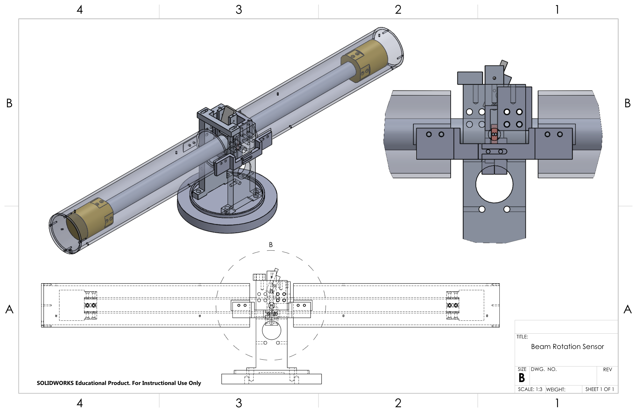
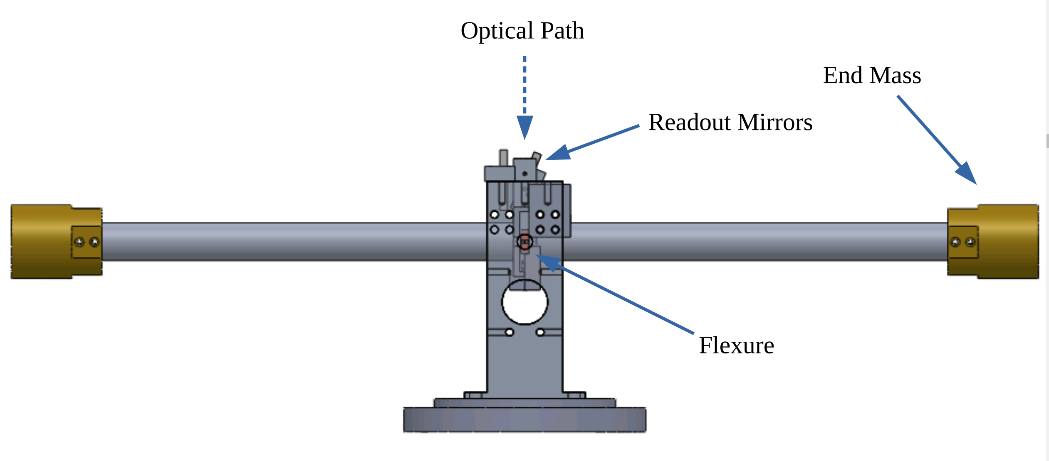
Tilt in Gravity Wave Detectors
Problem: During high winds, the seismometers pick up ground tilt and inject additional noise into the measurements
Solution: Have a separate device that can detect when the ground is tilting and subtract that out of the seismometer reading
Currently have sensors installed in LIGO

Slide 3
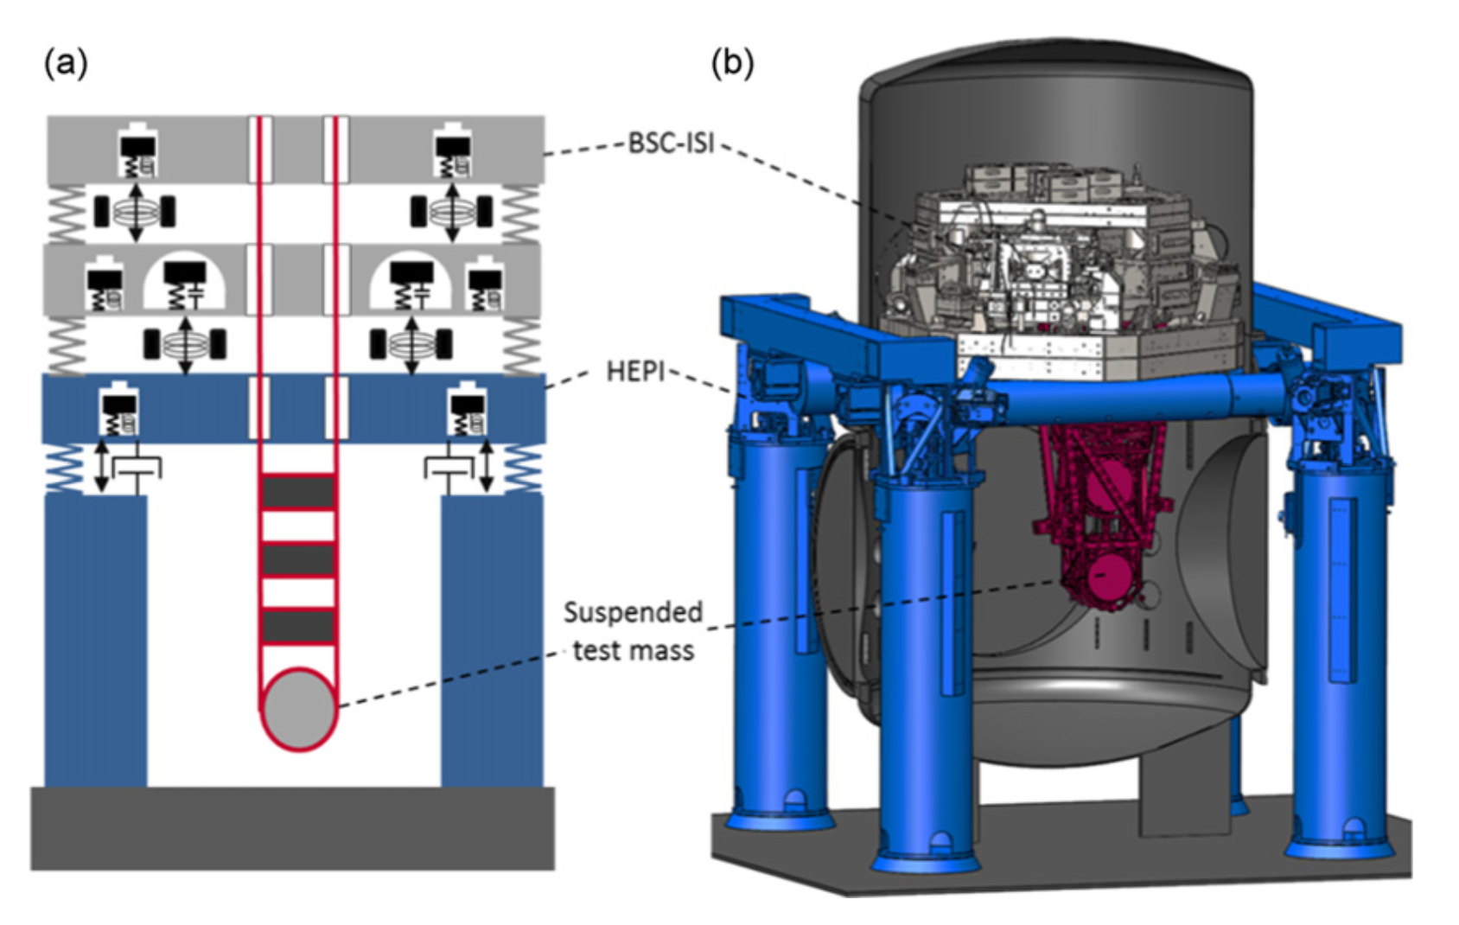
Requirements for CRS
Want to make compact version that can go on the Seismic isolation platform
Must be small enough to fit on the platform(30cm)
Must be vacuum compatible
Needs to be able to operated remotely
Image credit: F Matichard et al 2015 Class. Quantum Grav. 32 185003

Slide 4
CRS Design
Proof Mass
A proof mass supported by two flexures
rotationally isolated from supports
Interferometers detect how far each “wing” is from ground to calculate the tilt angle
Flexures
(BeCu 14 µm thick)
Support

Slide 5
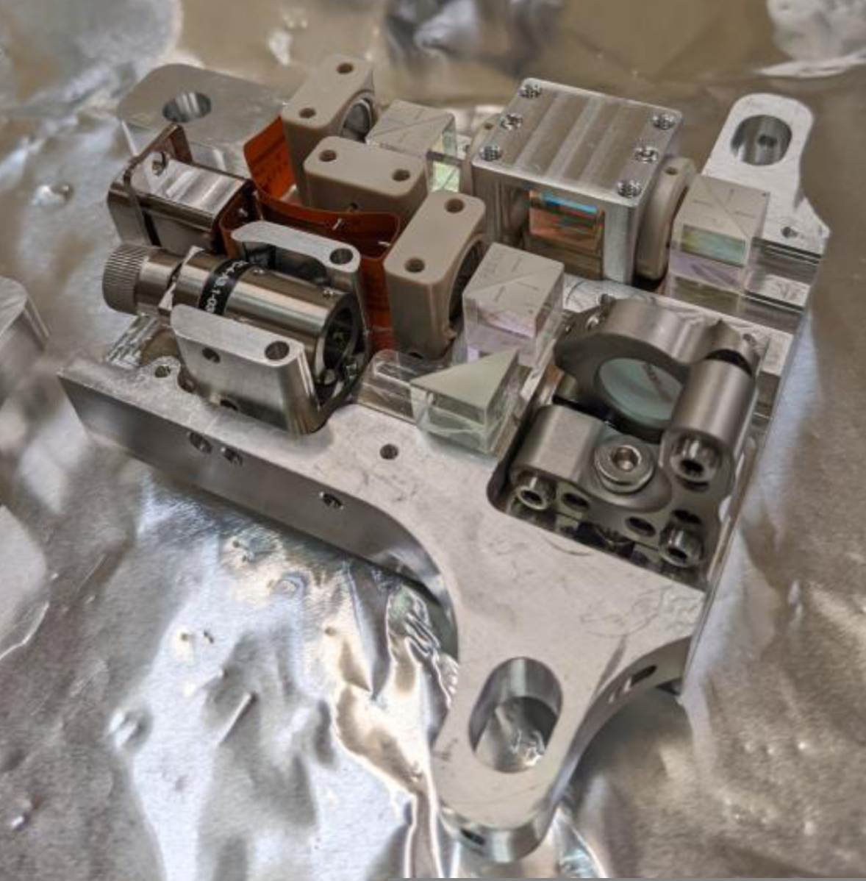
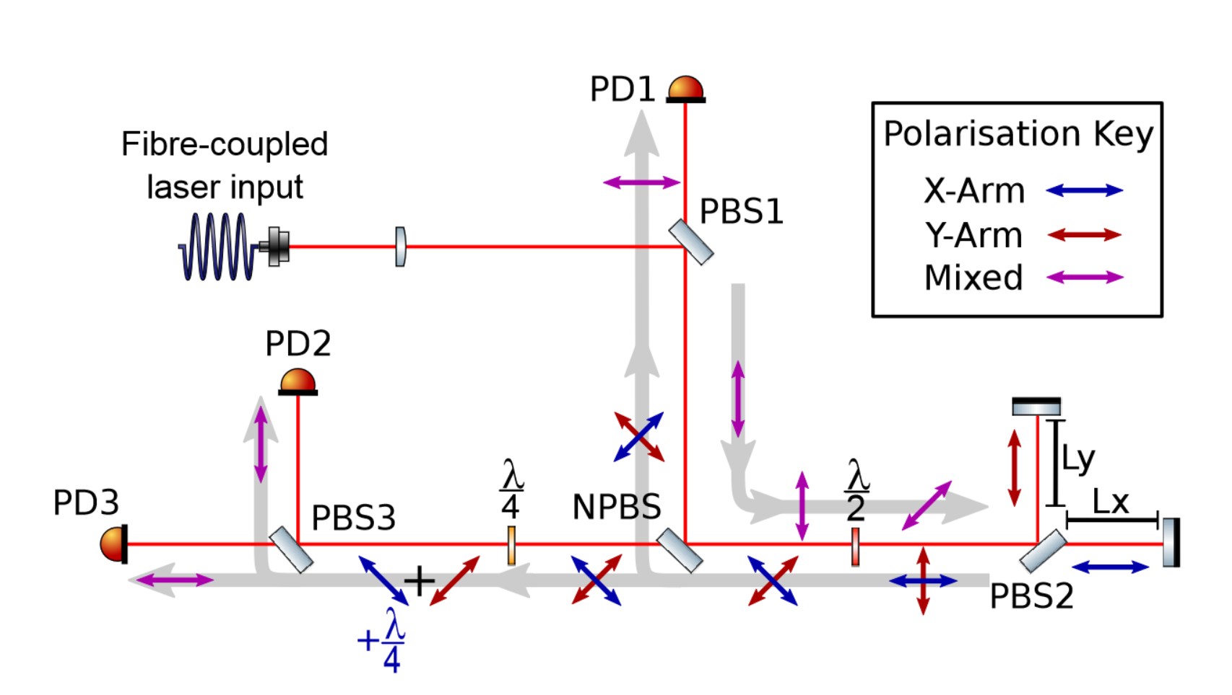
Optics
On proof mass
Image credit: S J Cooper et al 2018 Class. Quantum Grav. 35 095007
Homodyne Quadrature Interferometer
Developed by group at Vrije Universiteit Amsterdam & University of Birmingham
Mirrors on wings reflect beam to give a distance readout

Slide 6
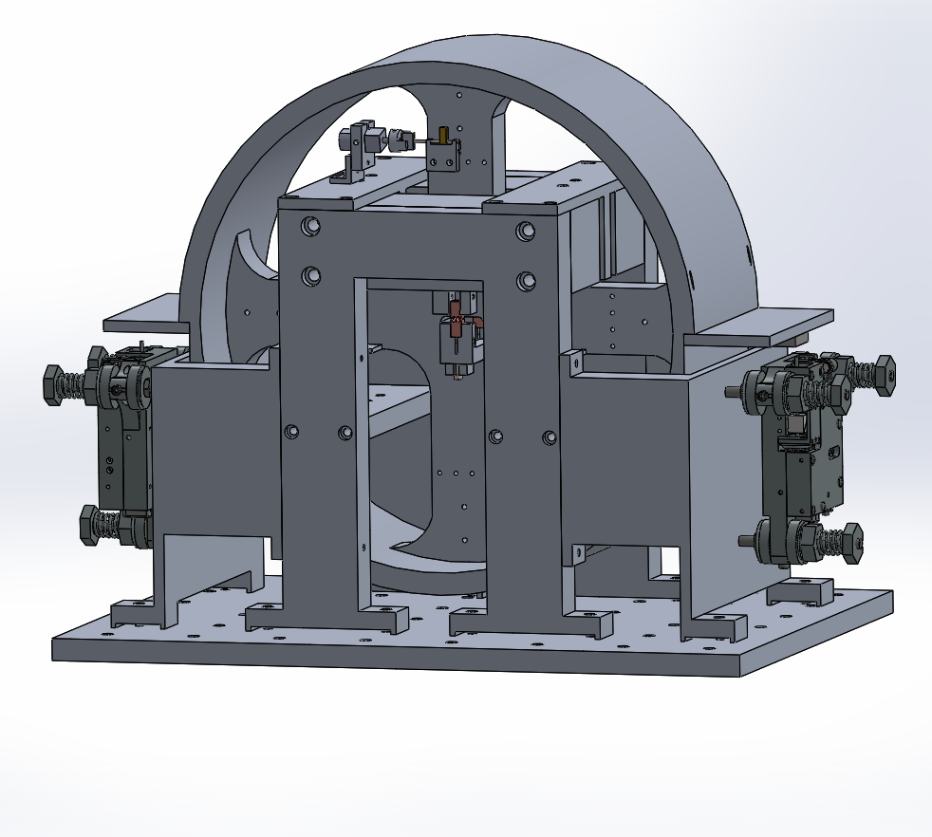
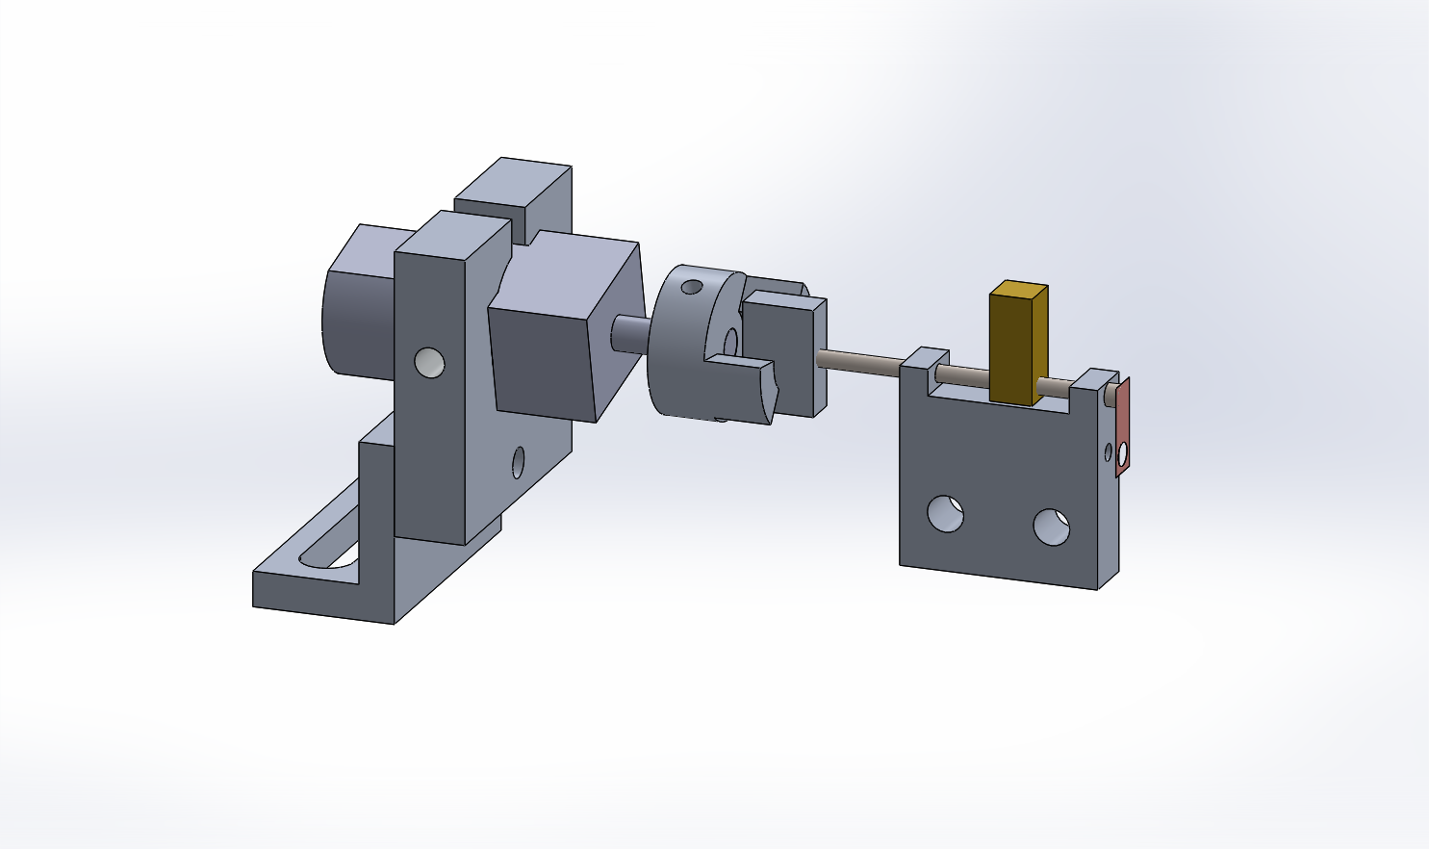
Mass Adjuster
Center of mass can shift (Temperature, etc.)
Adjustable mass on proof mass that can be moved via motor
Can be decoupled by rotating the opposite direction

Slide 7
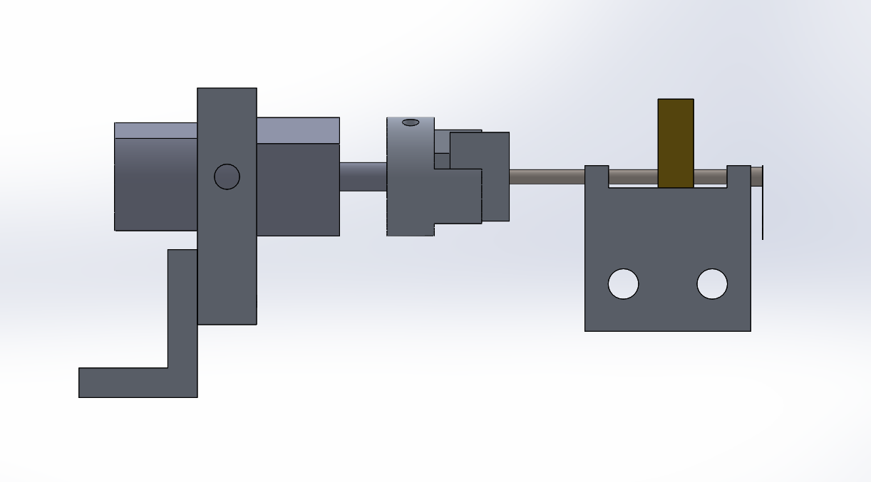
Remote Adjusting
Need to be able to remotely change CoM while in vacuum without impacting performance
Motor can couple/decouple itself
Warning “feelers” at end of track to keep adjuster from breaking itself
Output
Op Amp
Voltage
Grounded
Voltage
Coupled
Decoupled
Coupled

Slide 8
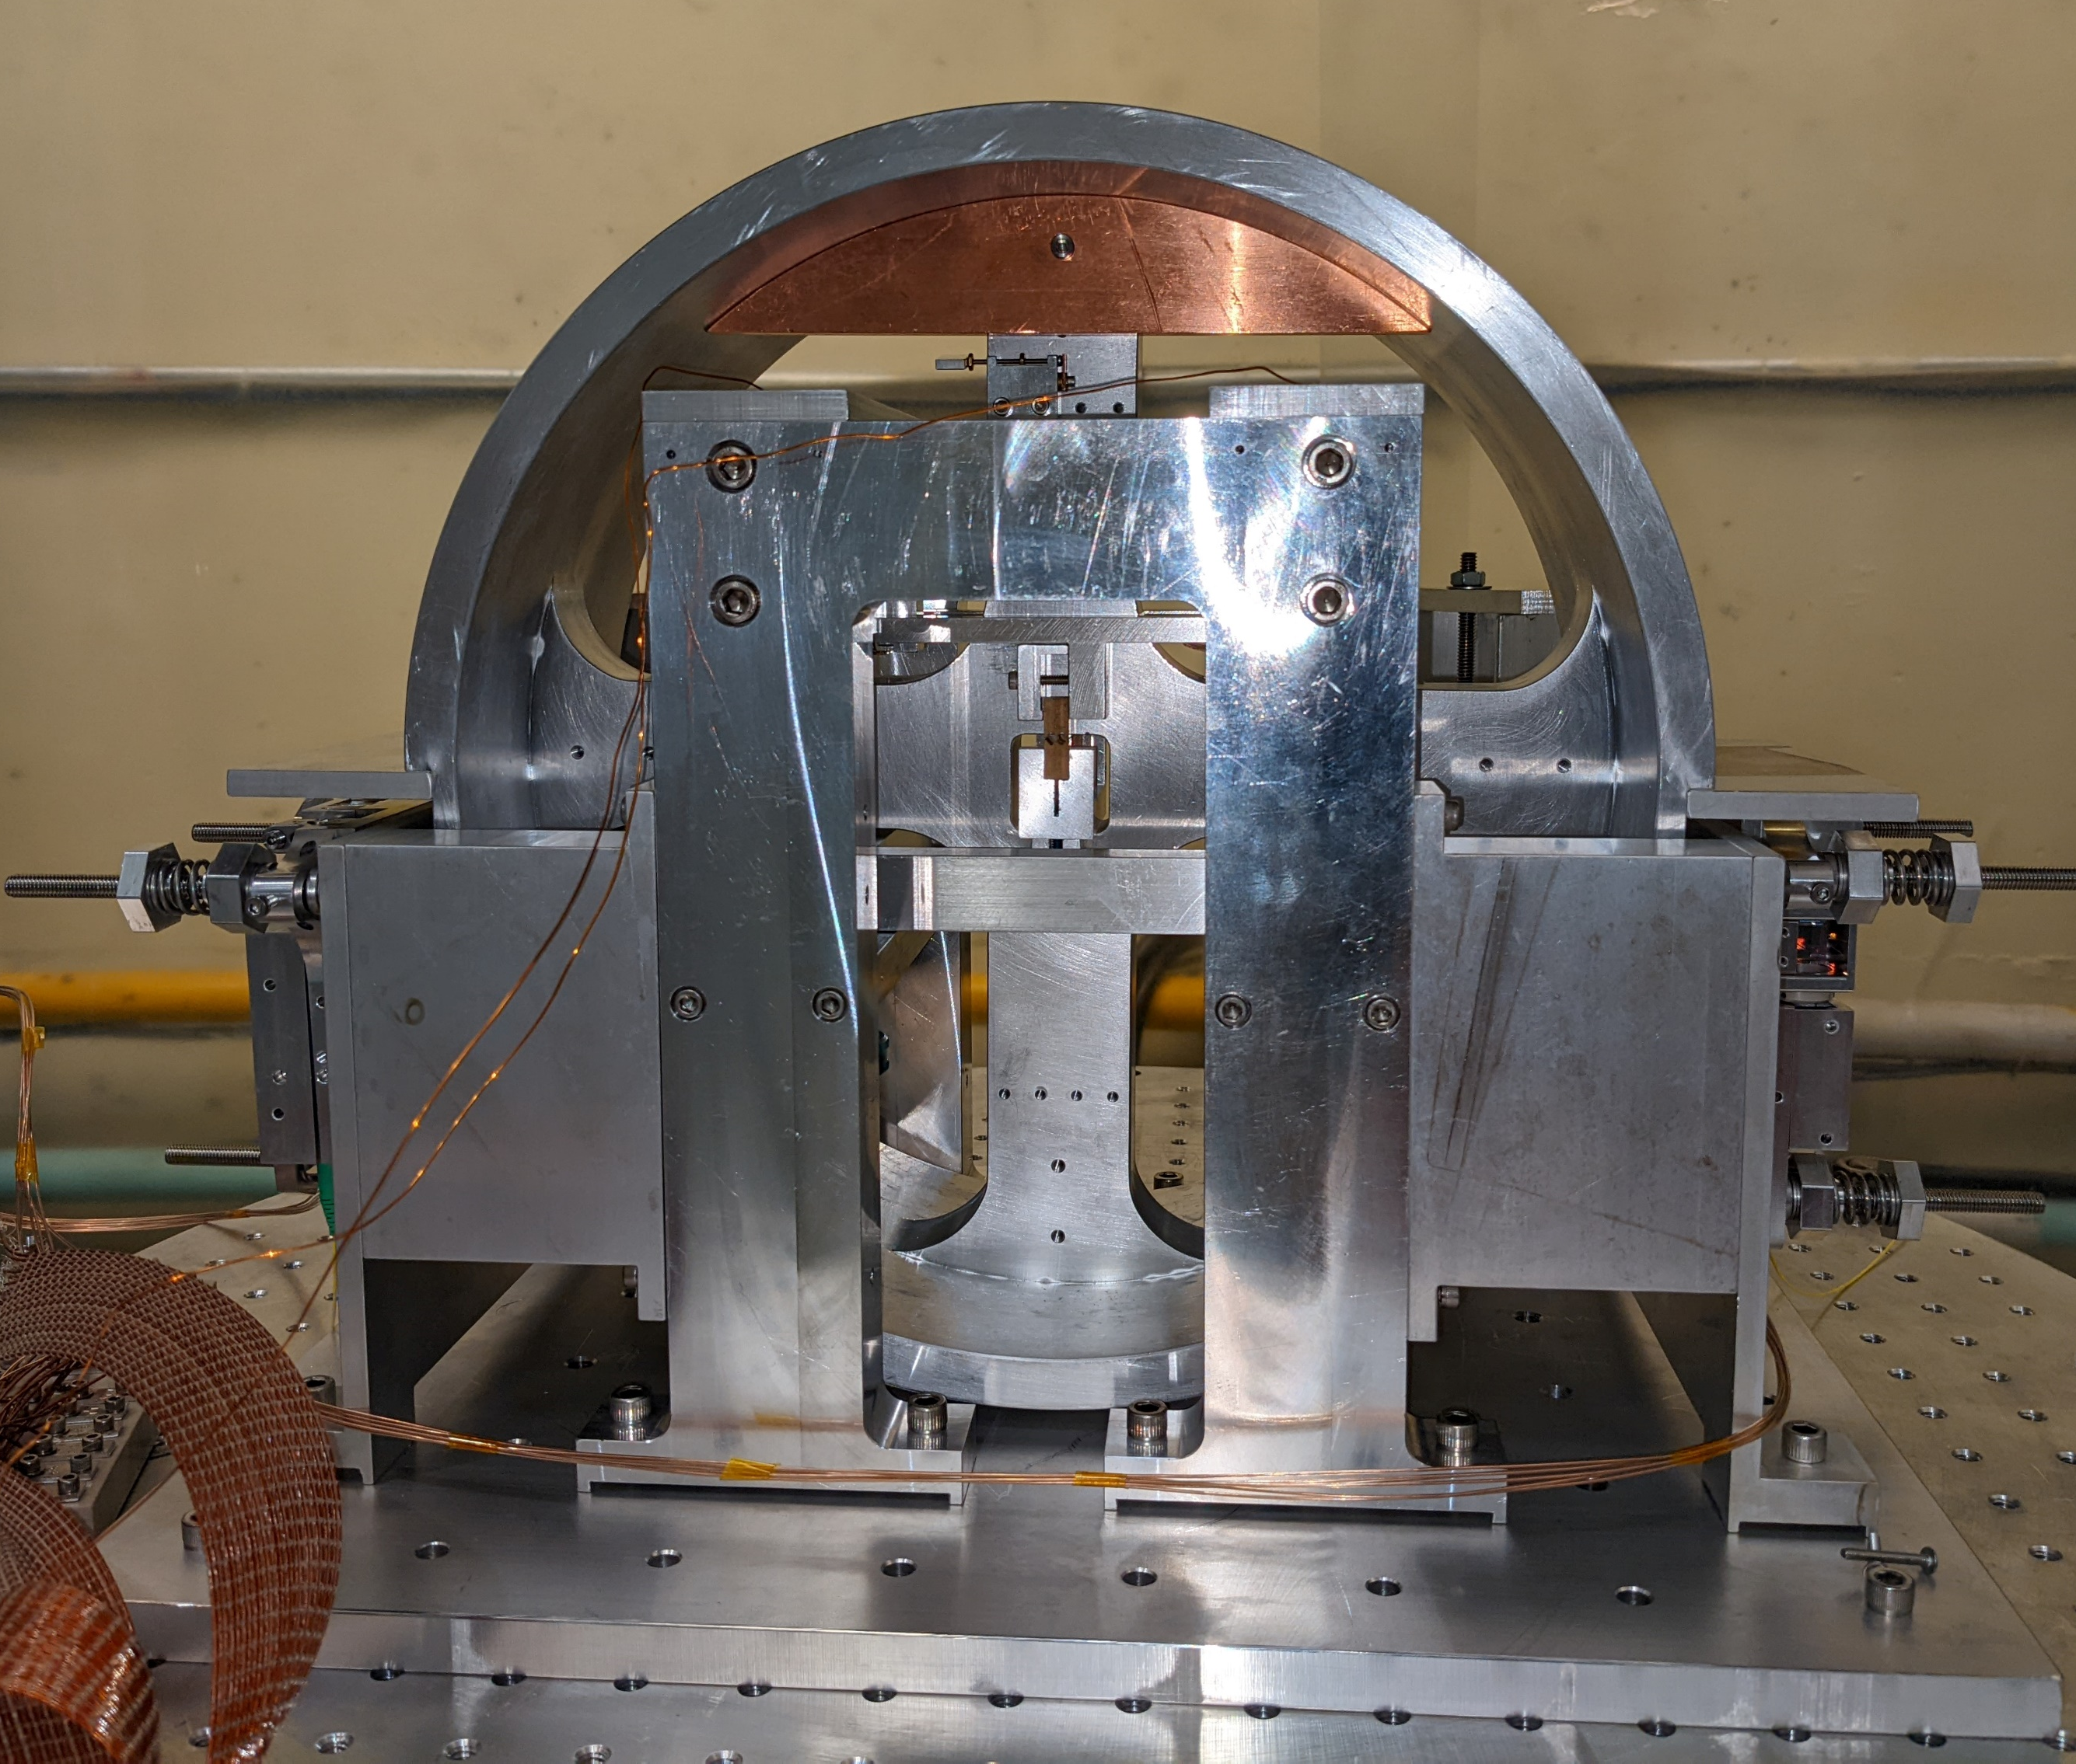
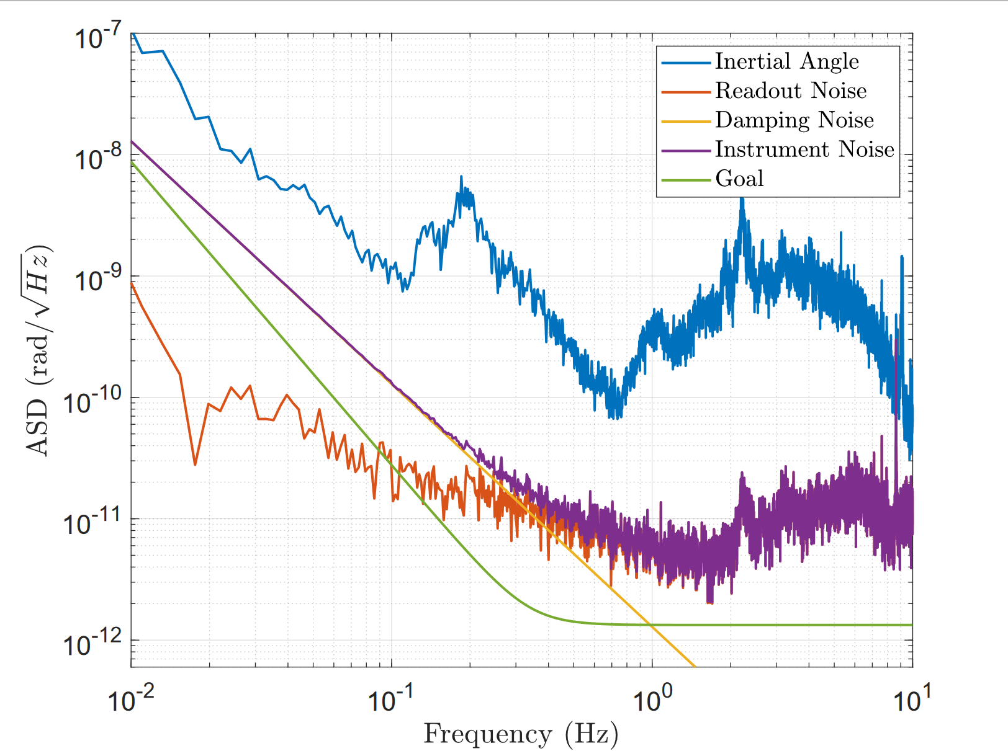
Current Noise Results
Reaches a sensitivity of ~5 prad/$\sqrt{Hz}$
Aim to install CRS for next observing run
Notes:
1.5 hz

Slide 9
Thank You

